Slide 1
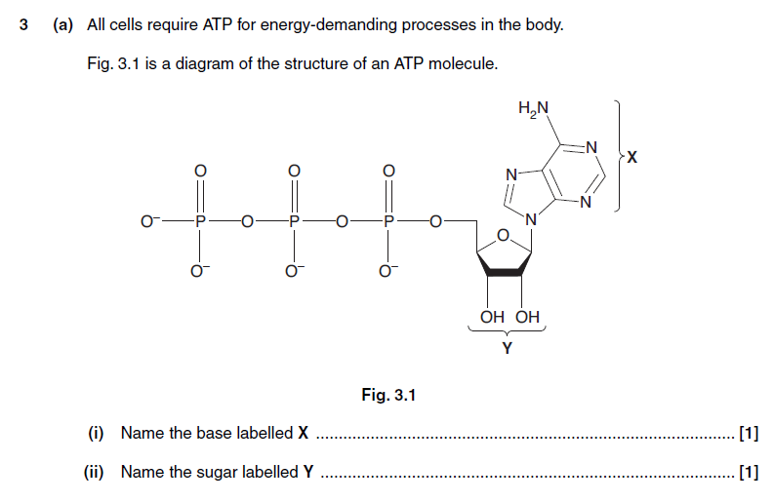

Slide 2
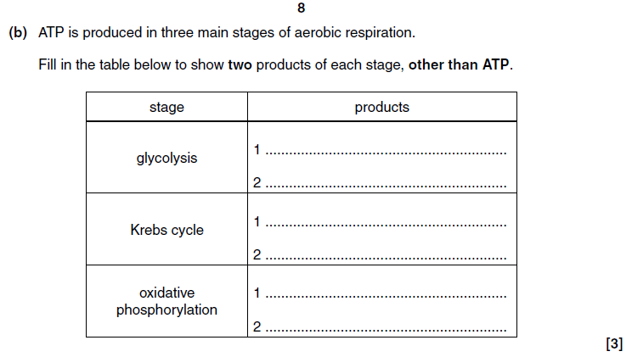

Slide 3
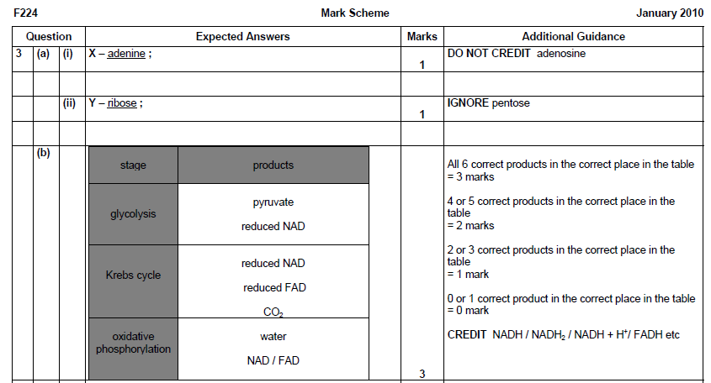

Slide 4
Anaerobic Respiration
Learning objectives
explain why anaerobic respiration produces a much lower yield of ATP than aerobic respiration;
define the term respiratory quotient (RQ);

Slide 5
Anaerobic production of ATP
Anaerobic conditions mean that there is no final hydrogen acceptor at the end of chemiosmosis.
Because there is no oxygen, NAD and FAD are not regenerated, which results in oxidation being blocked (NAD and FAD can’t get rid of H).
This subsequently means that no further link reaction, Krebs cycle or oxidative phosphorylation can occur.

Slide 6
Anaerobic production of ATP
Cells deprived of oxygen will undergo anaerobic respiration.
At the start of exercise, the circulatory system cannot work fast enough to supply oxygen to working muscles.
These cells still need to generate ATP, therefore can only get energy from glycolysis and substrate level phosphorylation.

Slide 7
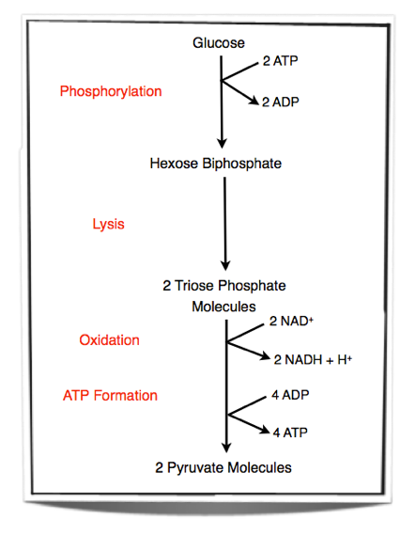
Substrate level phosphorylation
Remember, the net gain is only 2 ATP

Slide 8
Anaerobic production of ATP
Once this reaction has occurred once, it will not happen again unless the pyruvate is removed and the reduced NAD (NADH) is oxidised and able to pick up more hydrogen.
Why recycle NAD? We would not be able to produce more ATP in glycolysis without it.

Slide 9
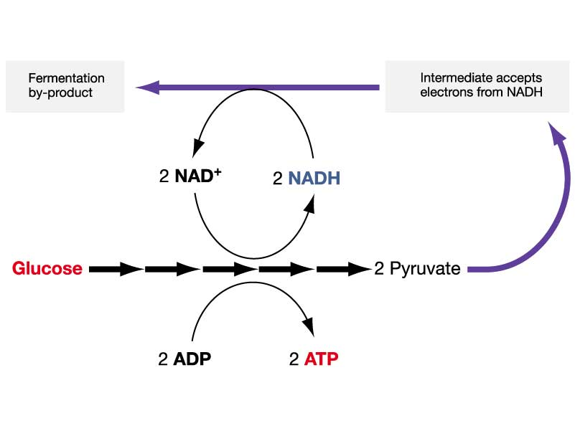

Slide 10
Anaerobic production of ATP
For NAD to be recycled, the following happens:
Pyruvate Lactate
NAD passes on its hydrogen to a new hydrogen acceptor – pyruvate.
Hydrogen reduces pyruvate, it is converted to lactate (lactic acid)
NAD is now free to accept another hydrogen so glycolysis can continue.
NADH
NAD

Slide 11
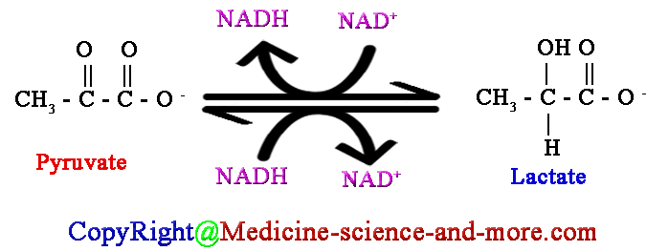
The fate of lactate
Lactate can build up in muscle cells, which will inhibit glycolysis and therefore stop ATP production.
To prevent this, lactate can be oxidised back to pyruvate by the enzyme lactate dehydrogenase (present in muscle and liver cells)

Slide 12
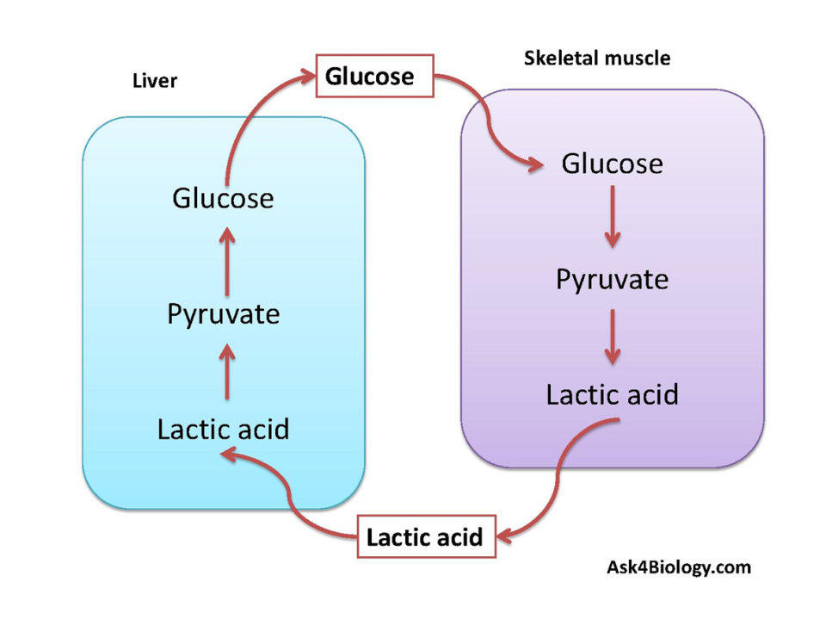
The fate of lactate
Majority of lactate produced in muscle cells will enter the bloodstream.
Build up of lactate in bloodstream can lead to “lactate acidosis” (lowering pH of blood)
Lactate contains a lot of potential energy so it is taken to the liver where it is converted to pyruvate.
From here, pyruvate is eventually converted back to glucose and returned to muscle cells or stored as glycogen.
The liver can do this because it has x50 the levels of enzymes needed to carry out the conversion.

Slide 13
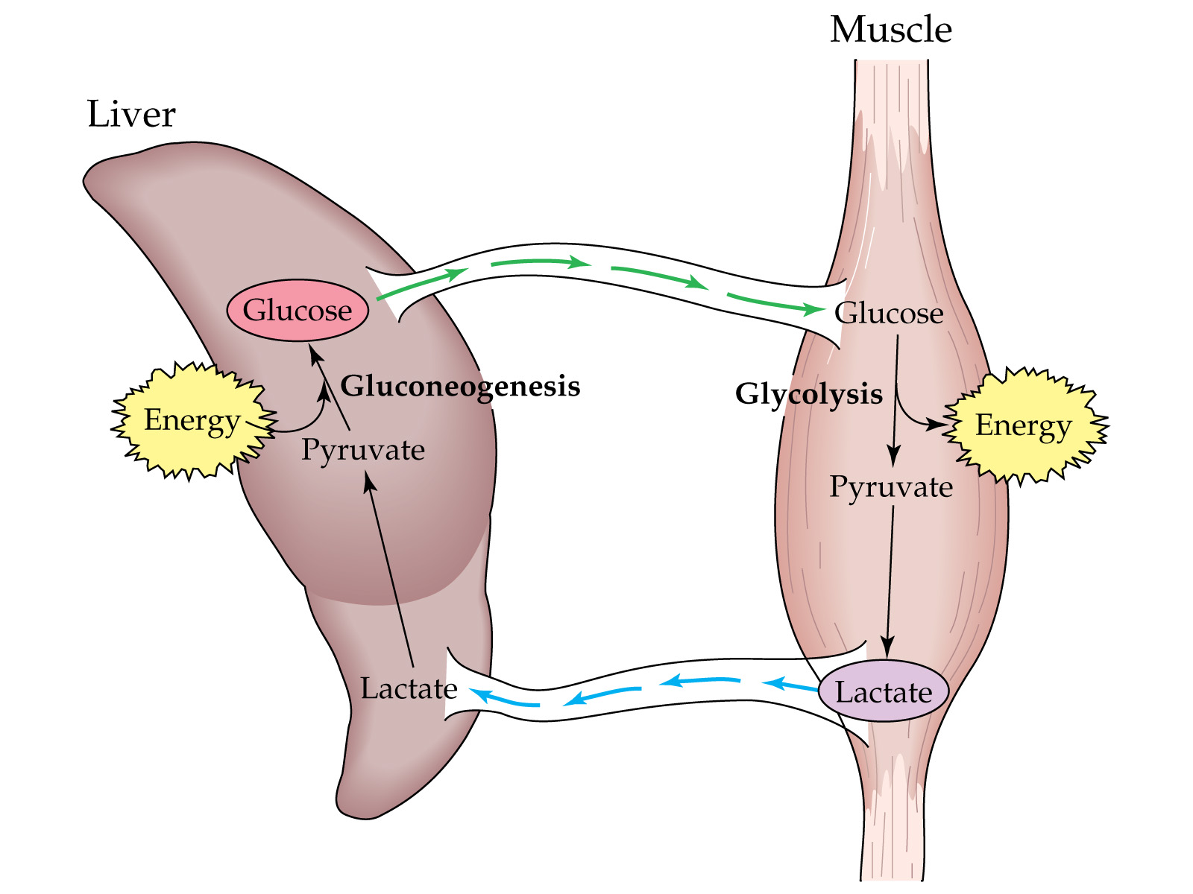

Slide 14
Summary
Reduced NAD from glycolysis, transfers hydrogen to pyruvate to form lactate and NAD.
NAD can then be reused in glycolysis.
This production of lactate regenerates NAD. This means glycolysis can continue even when there is not much oxygen around, so a small amount of ATP can be produced to keep some biological processes going.

Slide 15
Other Anaerobic Pathways
Yeast – eukaryotic cell that produces ethanal in aerobic respiration.
This is the hydrogen acceptor, not pyruvate.
Pyruvate is produced as a result of glycolysis but is decarboxylated to ethanal
Ethanal is reduced to ethanol. This occurs because of alcohol dehydrogenase enzymes.
To stop a build up of ethanol in human liver cells, alcohol dehydrogenase adds hydrogen to ethanol to convert it back to ethanal.

Slide 16

CO₂
NADH
NAD
pyruvate
ethanal
ethanol
Decarboxylase enzyme
NAD
NADH
In the liver
alcohol dehydrogenase

Slide 17
Summary
Carbon dioxide is removed from pyruvate to form ethanal
Reduced NAD (from glycolysis) transfers hydrogen to ethanal to form ethanol and NAD
NAD can then be reused in glycolysis
The production of ethanol also regenerates NAD so glycolysis can continue when there is not much oxygen.
The liver can oxidise ethanol to ethanal to stop the build up of alochol

Slide 18
Respiratory Quotients
All respiratory substrates use up oxygen and produce carbon dioxide when they are broken down to produce ATP.
The respiratory quotient can be worked out using the formula below:
RQ = volume of carbon dioxide given off
volume of oxygen taken in
The RQ value can tell you which substrate is being used and if it was respired under aerobic or anaerobic conditions

Slide 19
Respiratory Quotients
RQ = volume of carbon dioxide given off
volume of oxygen taken in
The basic equation for aerobic respiration using glucose is:
C₆H₁₂O₆ + 6O₂ 6CO₂ + 6H₂O + energy
RQ of glucose = molecules of CO₂ released / molecules of O₂ consumed
= 6/6
=1

Slide 20
Respiratory Quotients
Respiratory substrates | RQ
Lipids (triglycerides) | 0.7
Proteins or amino acids | 0.9
Carbohydrates | 1
Respiratory quotients have been worked out for other respiratory substrates.
Lipids and proteins have lower RQ values because more oxygen is needed to oxidise fats and lipids than to oxidise carbohydrates.

Slide 21
Respiratory Quotients
Under normal conditions, RQ values for humans are between 0.7 and 1.0
This range of values shows that some fats and some carbohydrates are being respired (remember protein is only used in extreme cases)
High RQs (>1) indicates an organism is short of oxygen and therefore is respiring anaerobically.
Plant RQ values can appear low because the carbon dioxide that is released is used in photosynthesis

Slide 22
Respirometers
The instrument called a respirometer collects data on RQ values.
Sodium hydroxide absorbs all CO₂ from the air in the apparatus from the beginning. Potassium hydroxide could be used instead of sodium hydroxide. They both absorb CO₂.
As the germinating seeds use oxygen and the pressure reduces in tube A so the manometer level nearest to the seeds rises.
Any CO₂ excreted is absorbed by the sodium hydroxide solution.
The syringe is used to return the manometer fluid levels to normal.
The volume of oxygen used is calculated by measuring the volume of gas needed from the syringe to return the levels to the original values.
If water replaces the sodium hydroxide then the carbon dioxide evolved can be measured.

Slide 23
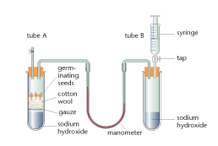

Slide 24
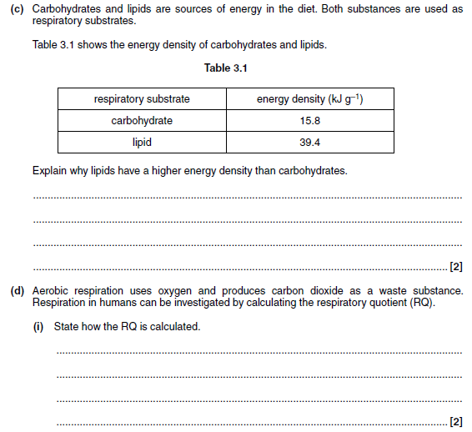

Slide 25
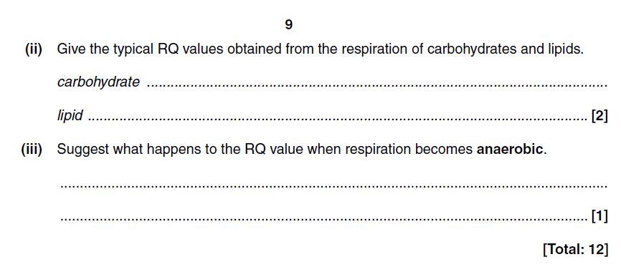

Slide 26
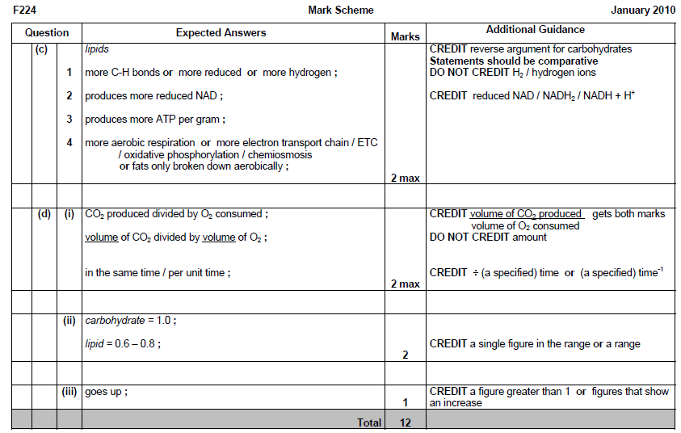

Slide 27
Questions
What molecule is made when carbon dioxide is removed from pyruvate during alcoholic fermentation?
Does anaerobic respiration release more or less energy per glucose molecule than aerobic respiration?
What is a respiratory substrate?
A culture of mammalian cells was incubated with glucose, pyruvate and antimycin C. Antimycin C inhibits an electron carrier in the electron transport chain of aerobic respiration. Explain why these cells produce lacate.
This equation shows the aerobic respiration of a fat called triolein: C₆H₁₀₄O₆ + 80O₂ 52H₂O + 57CO₂
Calculate the RQ for this reaction. Show your working.

Slide 28
Answers
Ethanal, NOT ethanol!
Anaerobic respiration releases much less energy (only 2ATP) because only glycolysis can take place.
A respiratory substrate is a biological molecule that can be broken down to release energy.
Lactate fermentation does not involve electron carriers/the electron transport chain/ oxidative phosphorylation
RQ = CO2 / o2 (1 mark)
So the RQ value of triolein = 57/80 = 0.71(1 mark)

