Slide 1
23 February 2014
Today’s Title: CW: Vectors and Velocity
Learning Question:
Why are speed, velocity and acceleration different things?
Starter - Match the unit to the item:
What do all these units have in common?
Km/h
mm/day
mph
m/s
Usain bolt
Plant shoot
Superbike
rocket

Slide 2

Key words…
Speed
Velocity
Displacement
Vector
Magnitude
Direction
Acceleration
Gradient

Slide 3


Add the punctuation
a velocity time graph shows how an object’s velocity changes with time a horizontal line on a velocity time graph shows the object has a constant velocity the higher the line is on the graph the greater the velocity a sloping line shows that the object is changing its velocity the gradient of the line lets us calculate the objects acceleration the steeper the line the greater the acceleration line sloping upwards with time means that the velocity of the object is getting faster a line sloping downwards with time means that the velocity of the object is getting slower

Slide 4
Add the punctuation
A velocity–time graph shows how an object’s velocity changes with time. A horizontal line on a velocity–time graph shows the object has a constant velocity. The higher the line is on the graph, the greater the velocity.
A sloping line shows that the object is changing its velocity. The gradient of the line lets us calculate the object’s acceleration. The steeper the line, the greater the acceleration.
A line sloping upwards with time means that the velocity of the object is getting faster.
A line sloping downwards with time means that the velocity of the object is getting slower.

Slide 5
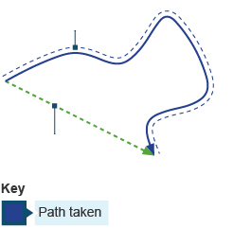
Distance and displacement – what’s the difference??
The distance is the total path that is actually travelled
Displacement is the distance between the start and finish points
distance
displacement

Slide 6
Speed and velocity
Measured in mph or km/h or m/s
speed
Can tell you the magnitude of something i.e. how fast something is travelling
Speed (m/s) = distance ÷ time
velocity
Tells you how fast something is travelling AND the direction it’s travelling in

Slide 7
Speed
The equation
When an object moves in a straight line at a steady speed, you can calculate its speed if you know:
  how far it travels and
  how long it takes.
This equation shows the relationship between speed, distance travelled and time taken:
For example, a car travels 300 metres in 20 seconds.
Its speed is 300 ÷ 20 = 15m/s.
The speed of an object can then be used to calculate the velocity.

Slide 8
Get yourself a white board!!

Slide 9

Q1.
What does displacement mean?
the speed of something
The speed and size of something
The total path travelled
The distance between the start and finish

Slide 10
D

Slide 11
Q2.
What is the equation to work out speed?
Speed (m/s) = distance ÷ time
Speed (m/s) = time – distance
Speed (m/s) = distance x time
Speed (m/s) = distance + time

Slide 12
A

Slide 13
Q3.
What information does velocity give you?
How fast something is going
The magnitude of something
The speed and direction
The path of something

Slide 14
C

Slide 15

23 February 2014
Today’s Title: CW: Vectors and Velocity Cont.
Learning Question:
Why are speed, velocity and acceleration different things?
Starter – The cab is travelling at 30mph from Grand Central Station to the Upper East Side. What word have you learned describes this speed with a direction?
Learning objectives 3.1 – 3.4

Slide 16
Key words…
Speed
Velocity
Displacement
Vector
Magnitude
Direction
Acceleration
Gradient

Slide 17

Vectors
Anything that has a size (magnitude) and direction is called a vector
Which of these are vectors?
Displacement
Speed
Velocity
Can you think of any other examples of vectors?
Forces are vectors – you can have big or small forces (the magnitude) and they move in a particular direction

Slide 18
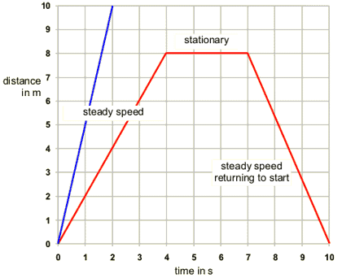
Distance – time graphs
Since distance and time are used to calculate speed, these graphs can tell us various things about speed
  Horizontal lines mean the object is stationary
  Straight, sloping lines mean the object is travelling at a constant speed
  The steeper the line, the faster the object is travelling
  The speed can be calculated from the gradient of the line

Slide 19
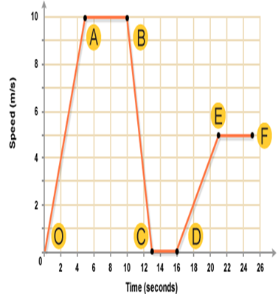
  Look at each of the lettered sections OA, AB, BC, CD, DE and EF on the speed-time graph.
  1. Choose the correct word from the list below to describe the motion taking place in each section.
          acceleration
          steady speed
          stationary
  (i) OA (ii) AB (iii) BC (iv) CD (v) DE (vi) EF
  2. At what time during the journey did the bus reach its greatest speed?
  3. How long was the bus stopped for during its journey?
  4. During which section of the journey did the bus have the greatest acceleration?
  5. Which section could be described as a deceleration?

Slide 20
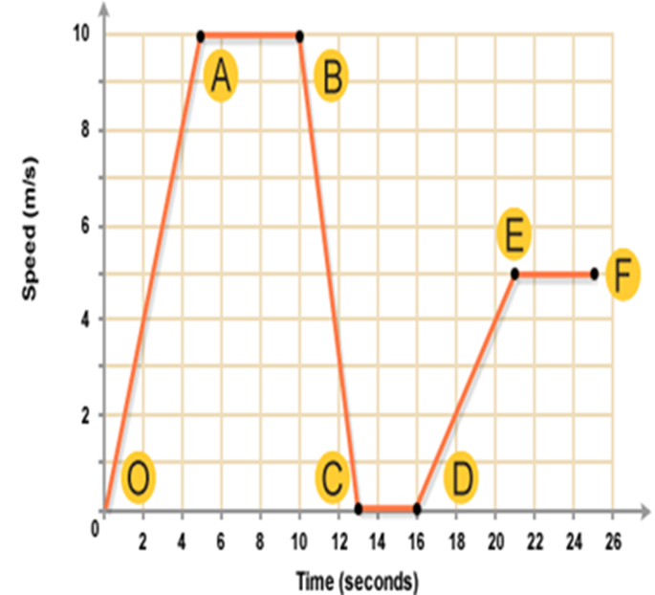
1. OA = acceleration
AB = steady speed of 10 m/s.
BC = acceleration
CD = stationary.
DE = acceleration.
FG = steady speed of 5 m/s.
  2. At what time during the journey did the bus reach its greatest speed?
After 5 s
  3. How long was the bus stopped for during its journey?
3 s
  4. During which section of the journey did the bus have the greatest acceleration?
BC. This part of the graph has the steepest slope.
  5. Which section could be described as a deceleration?
BC. The bus is slowing down. This type of acceleration is referred to as deceleration

Slide 21
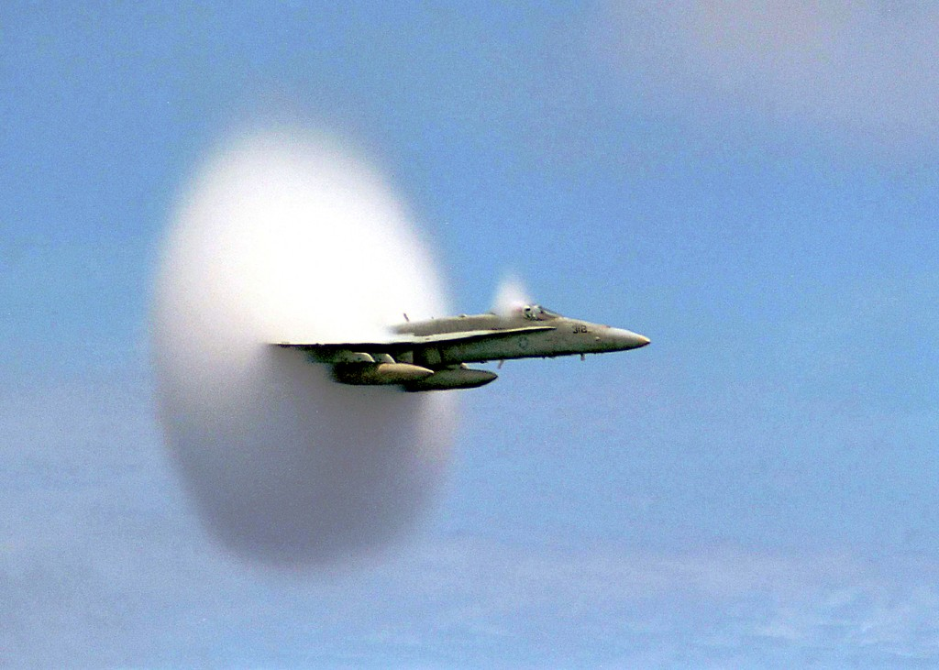
Speed
How could we measure the speed of an object?
What do we need to know?
How fast do you think I am going?

Slide 22
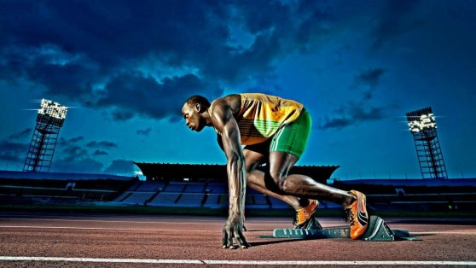
How fast?!

Slide 23
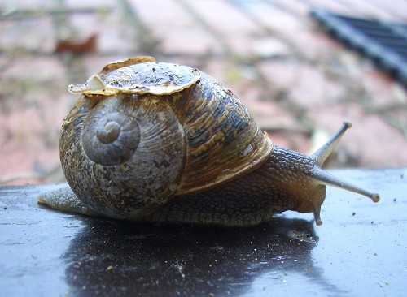
Speed
Speed = distance travelled
time taken

Slide 24
Speed
metres
Speed = distance travelled
time taken
Metres per second (m/s)
seconds

Slide 25
Speed
kilometres
Speed = distance travelled
time taken
Kilometres per hour (km/h)
hours

Slide 26
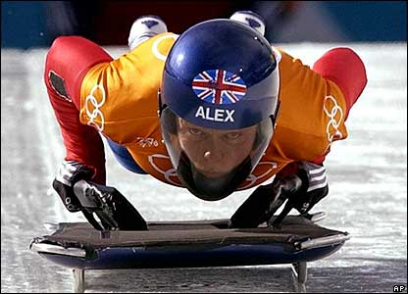
Distance travelled?
What if we know the speed of an object and the time it moved for and need to calculate the distance travelled?

Slide 27
Distance travelled?
What if we know the speed of an object and the time it moved for and need to calculate the distance travelled?
Speed = distance
time
distance = speed x time

Slide 28
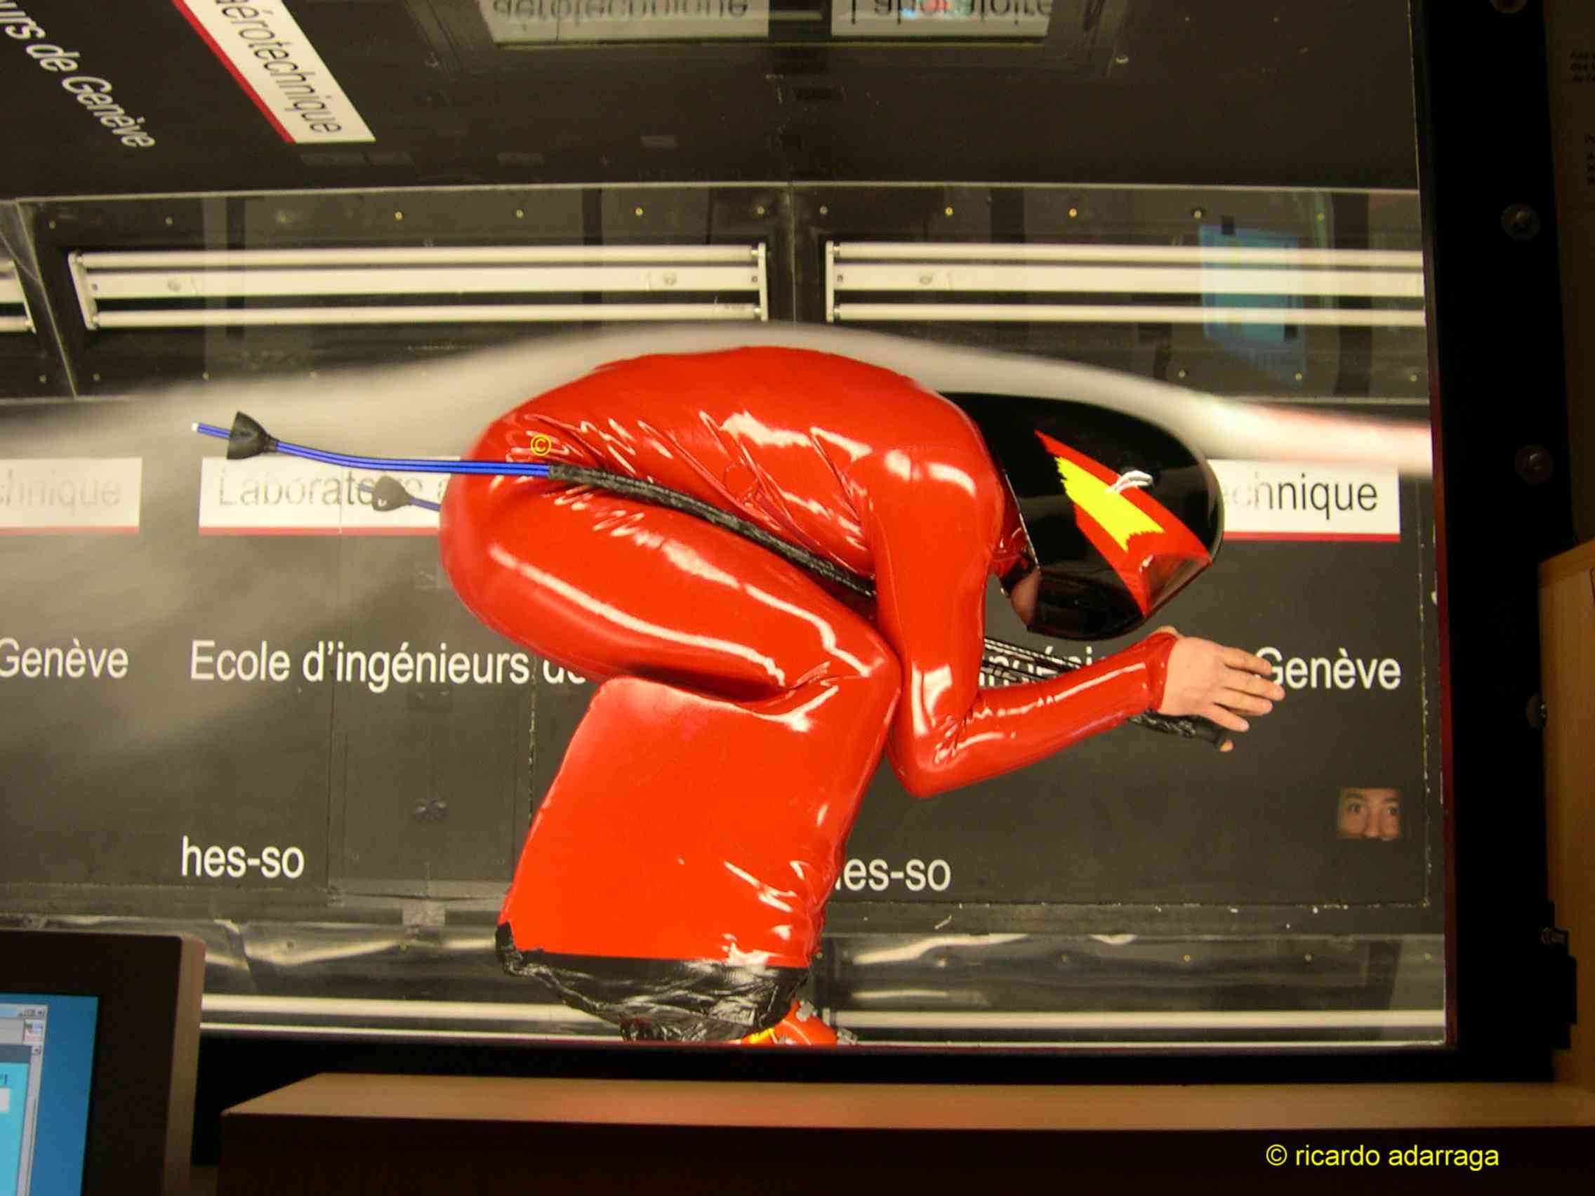
Time?
What if we know the speed and the distance travelled, how do we calculate how long (time) the journey took?

Slide 29
Time?
What if we know the speed and the distance travelled, how do we calculate how long (time) the journey took?
Speed = distance
time
time = distance
speed

Slide 30
triangle
d
s
t
x

Slide 31
Don’t forget!
If the distance is measured in metres and the time in seconds, the speed will be in metres per second (m/s or m.s⁻¹). If the distance is in kilometres and the time in hours, the speed will be in kilometres per hour (km/h or km.h⁻¹) etc.

Slide 32
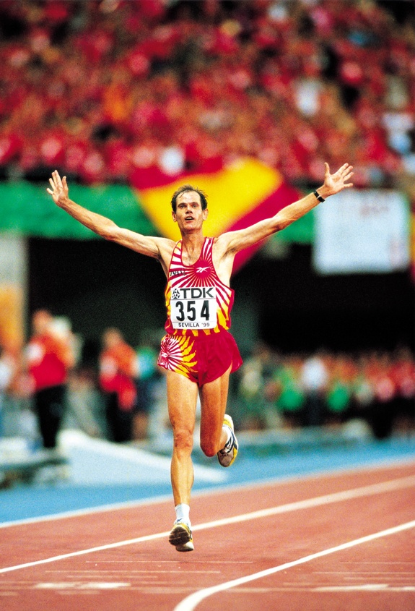
Examples
A man runs 45 m in 5 seconds. What is his speed?

Slide 33
Examples
A man runs 45 m in 5 seconds. What is his speed?
Speed = distance/time
= 45/5 = 9 m/s

Slide 34
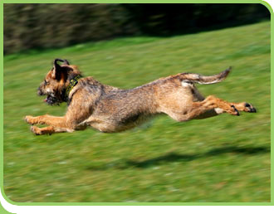
Another example
A dog runs at a speed of 5 m/s for one minute. How far does he run?

Slide 35
Another example
A dog runs at a speed of 5 m/s for one minute. How far does he run?
Distance = speed x time = 5 x 60 = 300 m

Slide 36
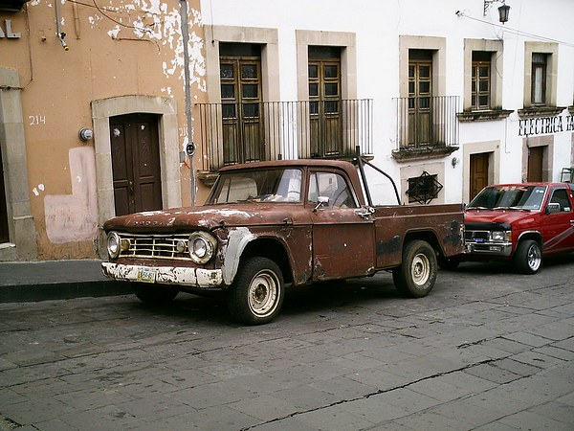
Another example!
A car travels at 30 km/h and covers a distance of 900 km. How long did it take?

Slide 37
Another example!
A car travels at 30 km/h and covers a distance of 900 km. How long did it take?
Time = distance/speed = 900/30 = 30 hours

Slide 38
Over to you
Work though the problems on speed, distance and time.
Make sure you are able to complete all questions.
Remember to show all working and units!

Slide 39
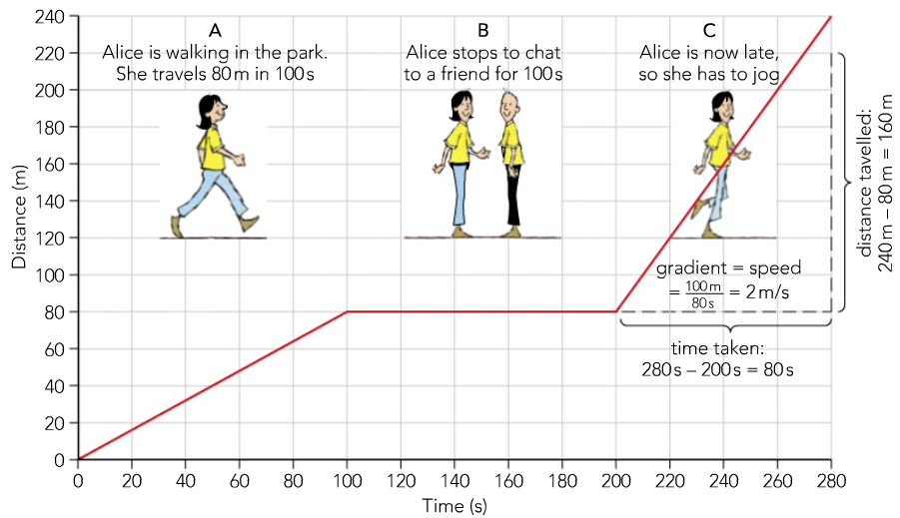

Slide 40
Distance against time graphs
distance
time

Slide 41
Your task
Complete questions 2,3,4,5,7 and 9
Extension (higher work) complete questions 6 and 8

