Slide 1
23 February 2014
Today’s Title: CW: Vectors-Velocity Time Graphs
Learning Question:
How can we use graphs to calculate velocity?
Starter – describe what is happening in this graph:
distance
time

Slide 2
Acceleration
Acceleration is how quickly speed in a certain direction is changing.
What word have you learned that could replace the phrase “speed in a certain direction”?
Velocity

Slide 3
Question 1
How are velocity and acceleration connected?
Acceleration is the change in velocity per second. It is calculated from the equation acceleration = change in velocity/time taken.

Slide 4
Acceleration
Acceleration can be a change in:
  Speed;
  Direction;
  Or speed and direction
Acceleration can be described as a vector quantity because it has a magnitude (size) and direction
Remember, acceleration does not always mean getting faster, it is a change, so it can mean getting slower too.

Slide 5
Question 2
Explain why acceleration is a vector quantity.
A: Because velocity is a vector quantity; because acceleration has a direction as well as a size.

Slide 6
Acceleration equation
Acceleration (m/s²) = change in velocity (m/s)
time take (s)
a = (v – u)
t
v= velocity at the end
u= velocity at the start
v-u = means working out the change in velocity
The unit of acceleration is m/s² NOT to be confused with velocity, which is m/s

Slide 7
Acceleration
a = (v – u)
t
Example question:
A car accelerates in 5s from 25 m/s to 35 m/s.
What is its change in velocity?
35 – 25 = 10 m/s
What is its acceleration?
10m/s = 2 m/s²
5s

Slide 8
Question 3
SpaceShip Two accelerates from 0 m/s to 2100 m/s vertically upwards in 90 seconds. What is its acceleration?
A: 2100 – 0 = 2100
2100 / 90 =
23.3 m/s²

Slide 9
Question 4
A car travels along a straight road at 40 m/s. The driver brakes and brings the car to a halt in 8 seconds. What is the car’s acceleration?
A:0 – 40 = -40 (because the car is slowing down)
-40 / 8 =
–5 m/s²

Slide 10
Question 5
A train is travelling at 35 m/s. Coming into a station, it slows down with an acceleration of 0.5 m/s². How much time does it take to stop?
A:a = 0.5 m/s²
(v – u) = (0 -35)
= -35m/s
0.5 m/s² = -35m/s ÷ t
35m/s ÷ 0.5 m/s²
⁼70 s
a = (v – u)
t

Slide 11
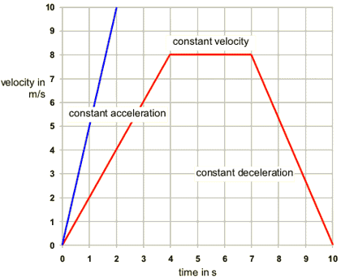
Velocity-time graphs
When an object is moving with a constant velocity, the line on the graph is horizontal.
When an object is moving with a constant acceleration, the line on the graph is straight, but sloped.
The steeper the line, the greater the acceleration of the object.

Slide 12

Get yourself a white board!!

Slide 13
Can you plot our results?
distance
time

Slide 14
No movement?
distance
time
Notes:
Ask a student to sketch on whiteboard.

Slide 15
No movement
distance
time

Slide 16
Constant speed?
distance
time
Notes:
Ask a student to sketch on whiteboard.

Slide 17
Constant speed
distance
time

Slide 18
Constant speed
distance
The gradient of this graph gives the speed
time

Slide 19

Constant speed
How would the graph look different for a faster constant speed?
distance
time
Notes:
Ask a student to sketch on whiteboard.

Slide 20
Constant speed
fast
distance
time

Slide 21
Constant speed
fast
How would the graph look different for a slower constant speed?
distance
time
Notes:
Ask a student to sketch on whiteboard.

Slide 22
Constant speed
fast
distance
slow
time

Slide 23
Constant speed
fast
The gradient of the graph gives the speed
distance
slow
time

Slide 24
Getting faster? (accelerating)
distance
time
Notes:
Ask a student to sketch on whiteboard.

Slide 25
Getting faster (accelerating)
distance
time

Slide 26
Examples
distance
time

Slide 27
A car accelerating from stop and then hitting a wall
distance
time
Notes:
Ask a student to sketch on whiteboard.

Slide 28
A car accelerating from stop and then hitting a wall
distance
time

Slide 29
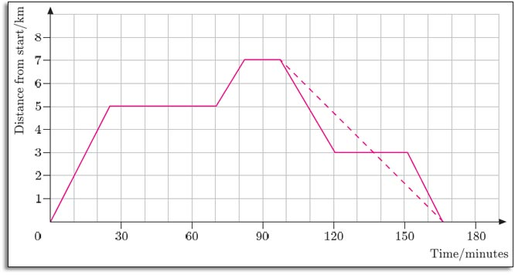
Calculations using a velocity-time graph
What was the acceleration to this point?
5-0 / 25 = 0.5km/min²

Slide 30
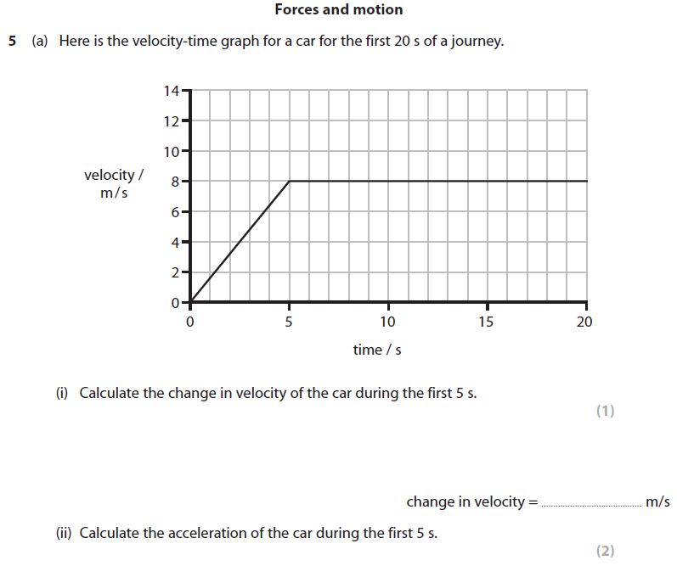

Slide 31
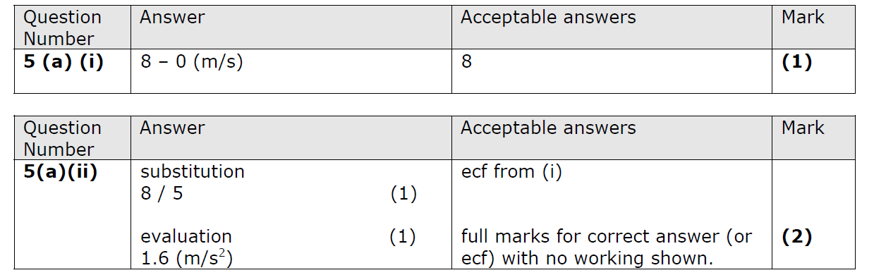

Slide 32
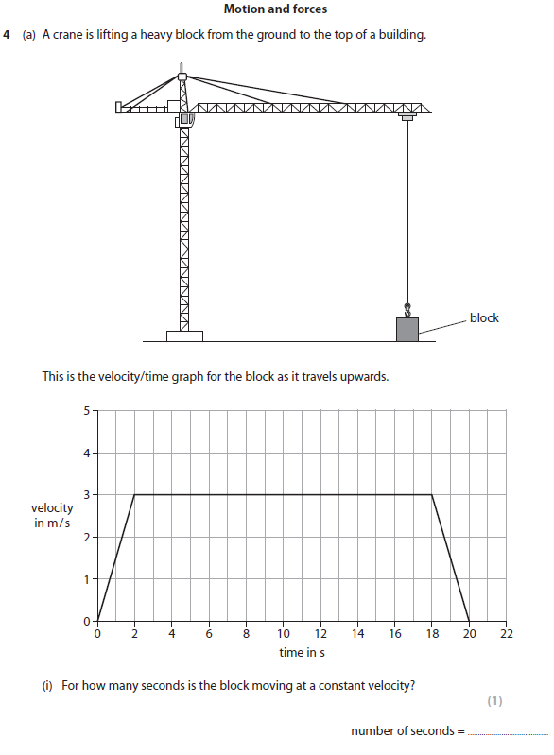

Slide 33
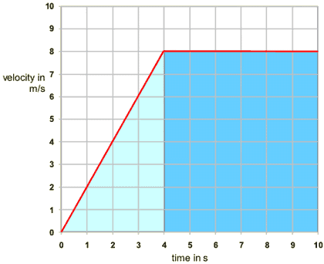
Calculating distance – higher tier
The distance travelled can be calculated from the graph, too. The area under the graph is equal to the distance travelled. Study this velocity-time graph.

Slide 34
Higher Tier
The area
The area under the line in a velocity-time graph represents the distance travelled. To find the distance travelled in the graph above, you need to find the area of the light-blue triangle and the dark-blue rectangle.
Area of light-blue triangle
  The width of the triangle is 4 seconds and the height is 8 metres per second. To find the area, you use the equation:
  area of triangle = ¹⁄₂ × base × height
  so the area of the light-blue triangle is ¹⁄₂ × 8 × 4 = 16 m
Area of dark-blue rectangle
  The width of the rectangle is 6 seconds and the height is 8 metres per second. So the area is 8 × 6 = 48 m.
Area under the whole graph
  The area of the light-blue triangle plus the area of the dark-blue rectangle is:
  16 + 48 = 64 m.
  This is the total area under the distance-time graph. This area represents the distance covered.

