Slide 1
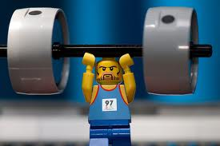
23 February 2014
Today’s Title: CW: Forces
Learning Question: What is an action-reaction pair?
Starter – What forces can you see acting on this weight lifter?
gravity
pushing

Slide 2

Key words…
Force
Free-body diagram
Resultant force
Action force
Reaction force

Slide 3
Introduction
A stationary object remains stationary if the sum of the forces acting upon it - resultant force - is zero.
A moving object with a zero resultant force keeps moving at the same speed and in the same direction.
Acceleration depends on the force applied to an object and the object's mass.
Gravity is a force that attracts objects with mass towards each other. The weight of an object is the force acting on it due to gravity.

Slide 4
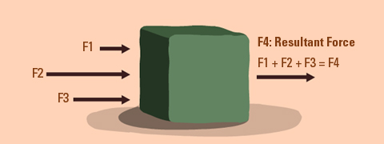
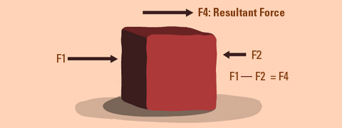
Resultant force
An object may have several different forces acting on it, which can have different strengths and directions.
They can be added together to give the resultant force.
This is a single force that has the same effect on the object as all the individual forces acting together.

Slide 5
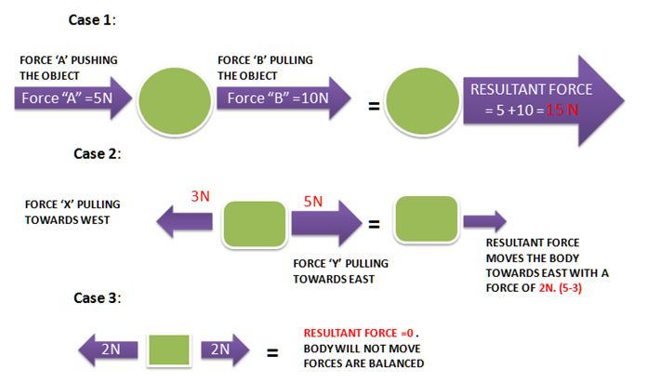
MWB

Slide 6
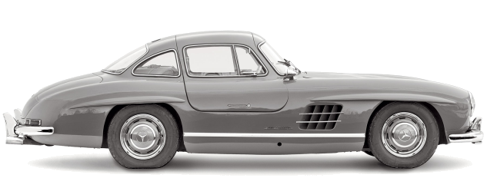
Situation 1: Resultant forces
To know how forces affect different objects.
Reaction (push back from ground)
Is the car…
✓
Stationary
Moving with
constant speed
No Drag
Force
No Drive
Force
Accelerating
Weight
Decelerating
Resultant force = zero (how do you know?) and the car is stationary.
If it was moving there would be a drag force.

Slide 7
To know how forces affect different objects.
Situation 2:
Is the car…
Stationary
Moving with
constant speed
✓
Accelerating
Decelerating
Resultant force = zero
The car remains at the same speed, in the same direction

Slide 8
To know how forces affect different objects.
Situation 3:
Is the car…
Stationary
Moving with
constant speed
✓
Accelerating
Decelerating
Resultant force is NOT zero, so…
The car accelerates in the direction of the resultant force (forwards)

Slide 9


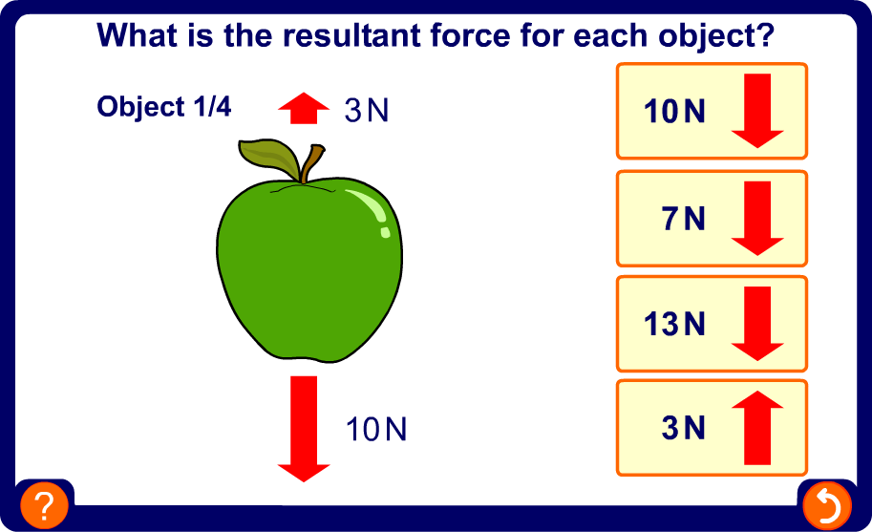
To know how forces affect different objects.

Slide 10
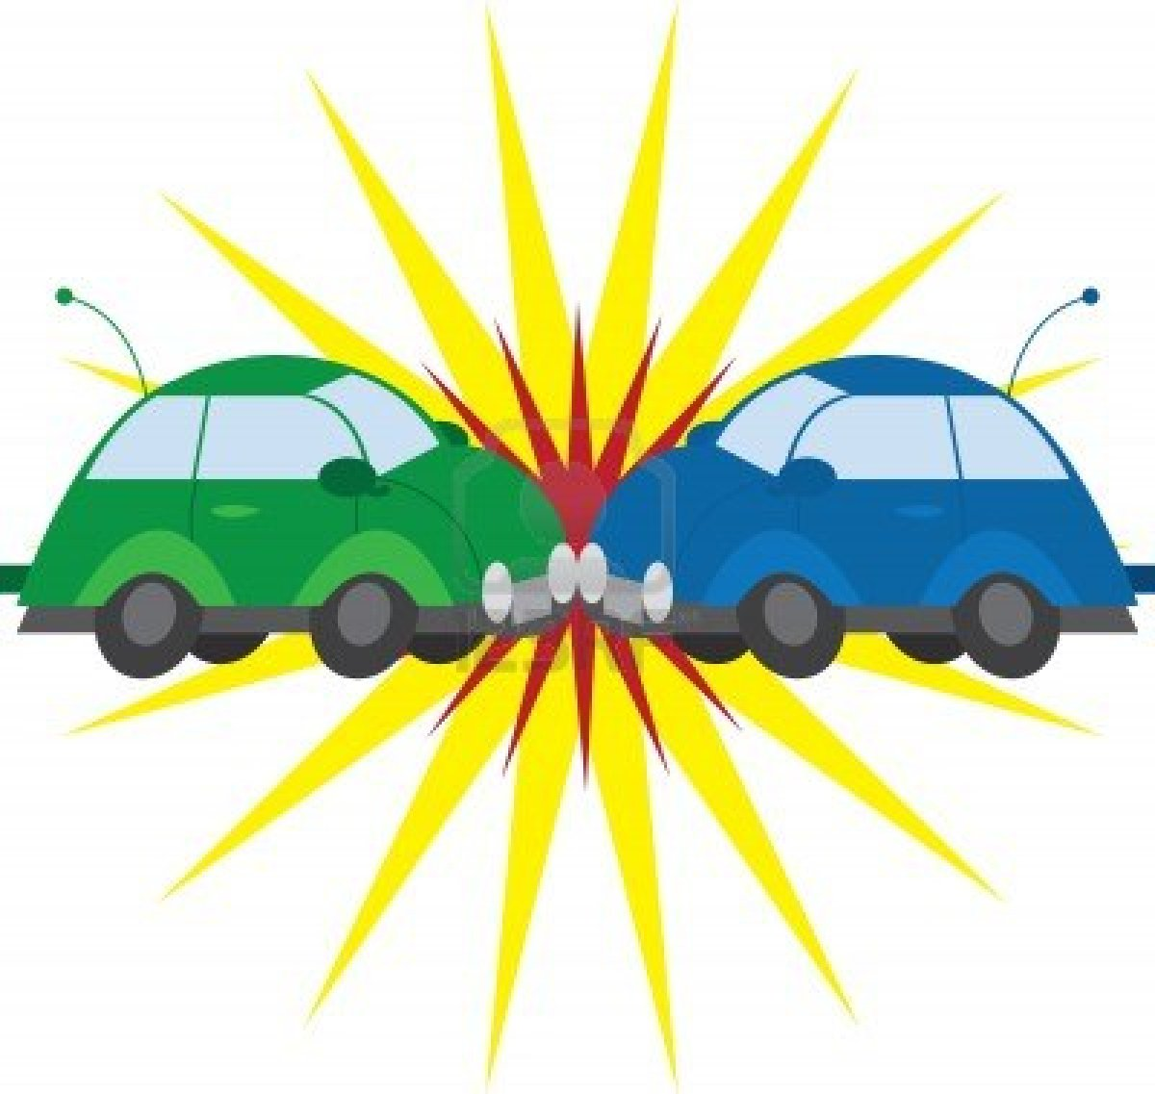
Action and Reaction Forces
Whenever two objects touch, they interact with each other.
This interaction involves two forces, acting on different objects.

Slide 11
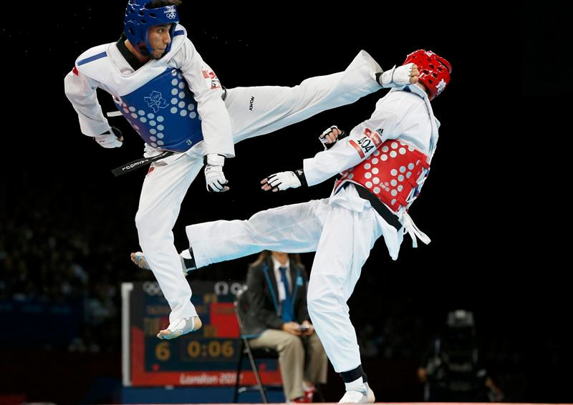
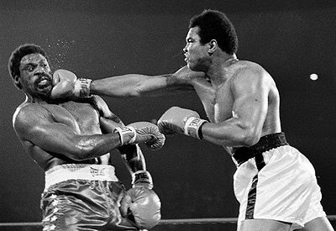
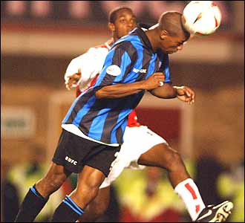
Describe the action and reaction forces in each of these pictures.

Slide 12
Action force of
foot
Reaction force of head

Slide 13
Action force of glove
Reaction force of head

Slide 14
Reaction force of ball
Action force of head

Slide 15
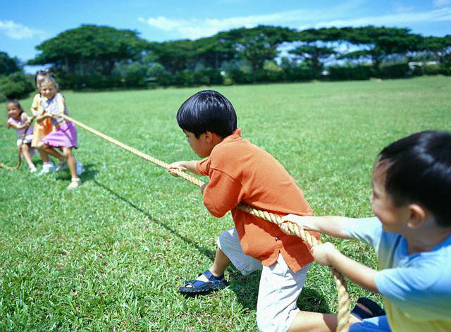
Resultant Forces

Slide 16
What is the Resultant Force?
5N
4N
The resultant force is 1N to the right

Slide 17
What is the Resultant Force?
3N
6N
The resultant force is 3N to the left

Slide 18
What is the Resultant Force?
5N
5N
There is no resultant force

Slide 19
What is the Resultant Force?
7N
4N
The resultant force is 11N to the right

Slide 20
What is the Resultant Force?
8N
3N
The resultant force is 5N to the left

Slide 21

What are the Resultant Forces?
1N
2N
9N
1N
The resultant force is 7N to the right

Slide 22
What are the Resultant Forces?
6N
8N
7N
5N
The resultant force is 1N to the left and 1N up

