Slide 1
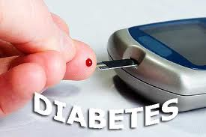
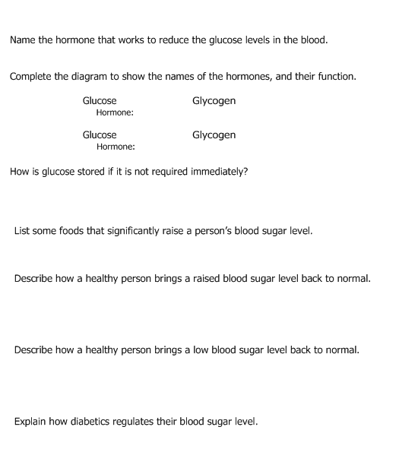

Slide 2
Resources
http://www.bbc.co.uk/wales/eclips/pages/eng_14to16_bio_organisms_hormones.shtml BBC Video: Diabetes - A Cure
http://www.bbc.co.uk/wales/eclips/pages/eng_14to16_bio_organisms_insulin.shtml BBC Video: Diabetes and Insulin Control
http://www.diabetes.org.uk/ General diabetes info
http://nobelprize.org/educational/medicine/insulin/ Diabetic Dog game
http://www.bbc.co.uk/schools/gcsebitesize/science/edexcel/responses_to_environment/homeostasisrev6.shtml

Slide 3
Complete these questions in full sentences
1 What is diabetes?
Why must people with Type 1 diabetes inject themselves with insulin?
What may happen to someone who has Type 1 diabetes who forgets to inject insulin?
Why does an increase in the amount of food that a diabetic eats also increase the amount of insulin they need?
Explain why taking exercise is helpful for controlling diabetes.(Hint: Think about respiration.)
Suggest one way in which a person’s diet will need to change if they have just been diagnosed with Type 2 diabetes.
Explain why the treatment of Type 2 diabetes may not require insulin but the treatment of Type 1 diabetes will

