Slide 1
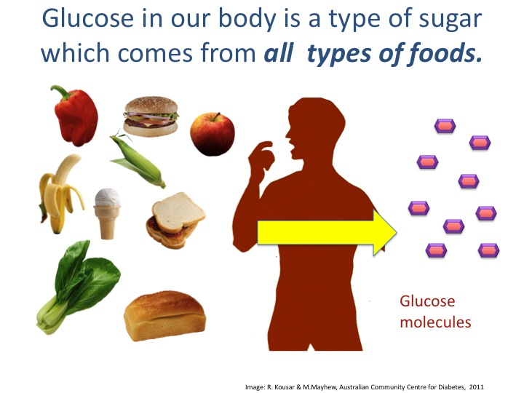

Title: Diabetes 10th March 2014
Learning question: How do we control our blood sugar levels?
L.O
Homework: study for homeostasis test next Monday 17th March– use BBC bitesize to help you revise.
Starter: What foods have sugar in them?
Key words…
Diabetes
Type 1
Type 2
Insulin
Glucagon
Pancreas
liver

Slide 2
Blood glucose regulation
Glucose is needed by cells for respiration.
It is important that the concentration of glucose in the blood is maintained at a constant level.
Insulin is a hormone produced by the pancreas that regulates glucose levels in the blood.

Slide 3
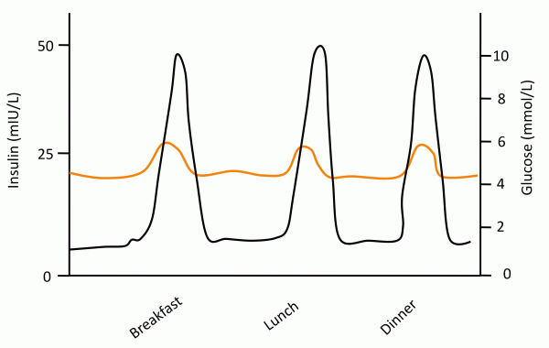
The orange line is the glucose level in your blood.
The black line is the levels of the hormone insulin.
What trend can you see happening each time you eat?

Slide 4
Blood glucose regulation
When you eat something, your glucose levels rise.
To stop glucose levels from going too high, the hormone insulin is released from the pancreas and moves into the blood stream.
Body cells absorb excess glucose and this brings the blood glucose levels back down to normal levels.
The liver helps to convert excess glucose to glycogen, where it can be stored until needed.

Slide 5
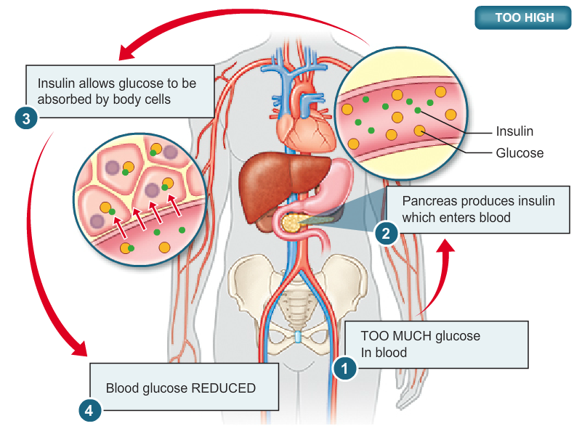

Slide 6
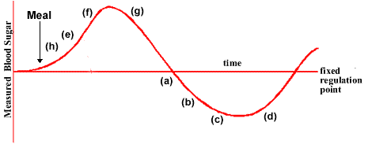
Why do we need insulin?
From points (h) to (f), blood glucose level is rising above the normal line. This is because something has been eaten or drunk.
Insulin is released from the pancreas to store glucose in cells and lower the levels of glucose in the blood stream
This line represents a normal balance in blood sugar levels

Slide 7
Glucagon – Higher tier
The pancreas releases another hormone, glucagon, when the blood sugar levels fall. (This happens when you are hungry and not had glucose in a while)
This causes the cells in the liver to turn glycogen back into glucose which can then be released into the blood.
The blood sugar levels will then rise.

Slide 8
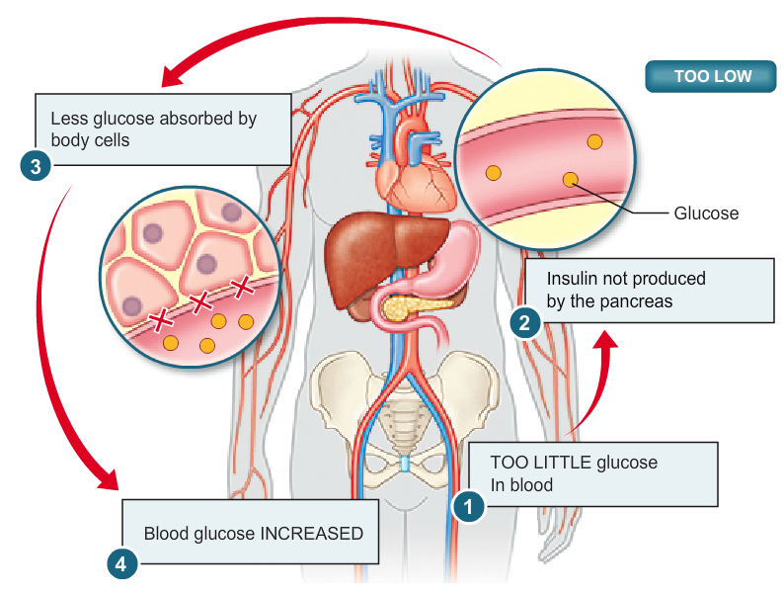

Slide 9
Why do we need glucagon?
This line represents a normal balance in blood sugar levels
Glucagon is released from the pancreas to release stored glucose in cells and put it back into the blood stream.
From point (a) – (c), the blood glucose level of the blood is falling below our normal line.

Slide 10
Insulin produced by the pancreas causes glucose to change to glycogen
Stored in the liver and muscles
Glucose rises (eat food)
Normal blood
glucose level
(80-120 mg/100cm³ blood)
Normal blood
glucose level
(80-120 mg/100cm³ blood)
Glucagon released and glycogen converted back to glucose
Glucose falls (exercise)

Slide 11
produced by the pancreas causes _____ to change to _______
Stored in the and ________
Glucose rises (eat food)
Normal blood
glucose level
(________/100cm³ blood)
Normal blood
glucose level
(________ mg/100cm³ blood
________ released and _________ converted back to glucose
Glucose falls (exercise)

Slide 12
Diabetes
Diabetes is a disorder in which the blood glucose levels remain too high.
It can be treated by injecting insulin.
The extra insulin allows the glucose to be taken up by the liver and other tissues, so cells get the glucose they need and blood-sugar levels stay normal.
There are two types of diabetes.
  Type 1
  Type 2

Slide 13
Type 1 Diabetes
Type 1 diabetes is caused by a lack of insulin. It can be controlled by:
  monitoring the diet
  injecting insulin
People with type 1 diabetes have to monitor their blood sugar levels throughout the day as the level of physical activity and diet affect the amount of insulin required.

Slide 14
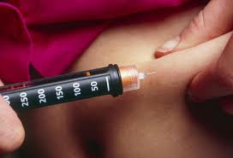
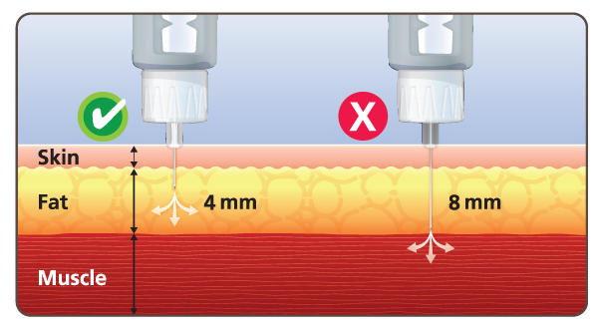
Sufferers of diabetes have to inject insulin into the subcutaneous fat directly underneath the skin.
This is because fat easily absorbs insulin.
The insulin spreads into blood vessels and is carried around the body in the blood.

Slide 15
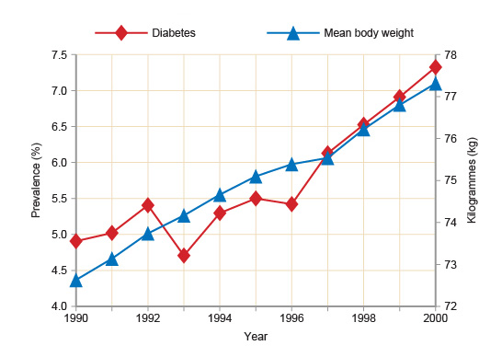
Data analysis
Look at the graph opposite.
What trend does it show?
Write a sentence to summarise what is the graph tells you about diabetes and mean body weight over time.

Slide 16
Type 2 diabetes
Type 2 diabetes is caused by a person becoming resistant to insulin. (insulin no longer works they way it should)
It can be controlled by diet and exercise.
There is a link between rising levels of obesity (chronic overweight) and increasing levels of type 2 diabetes.

Slide 17
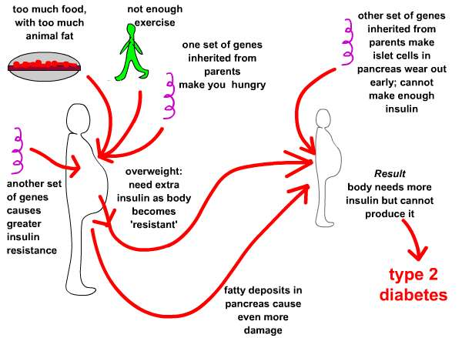

Slide 18
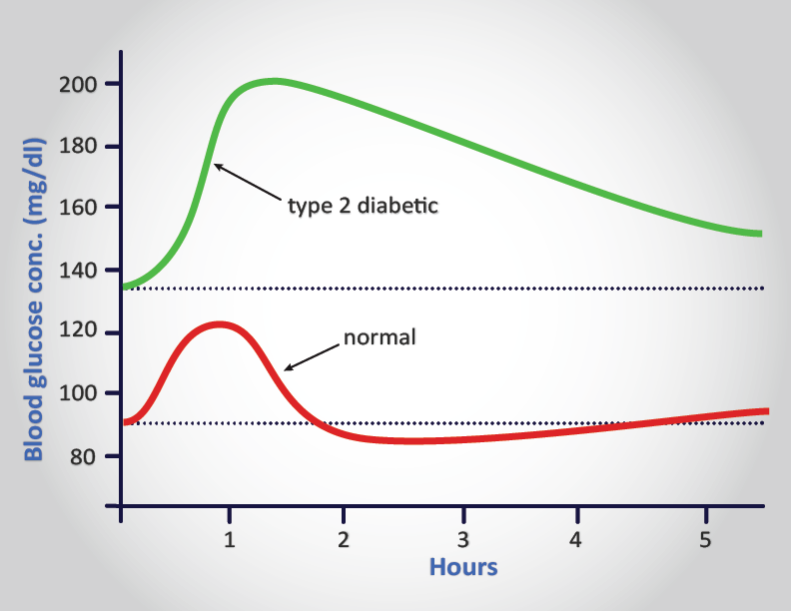

Slide 19
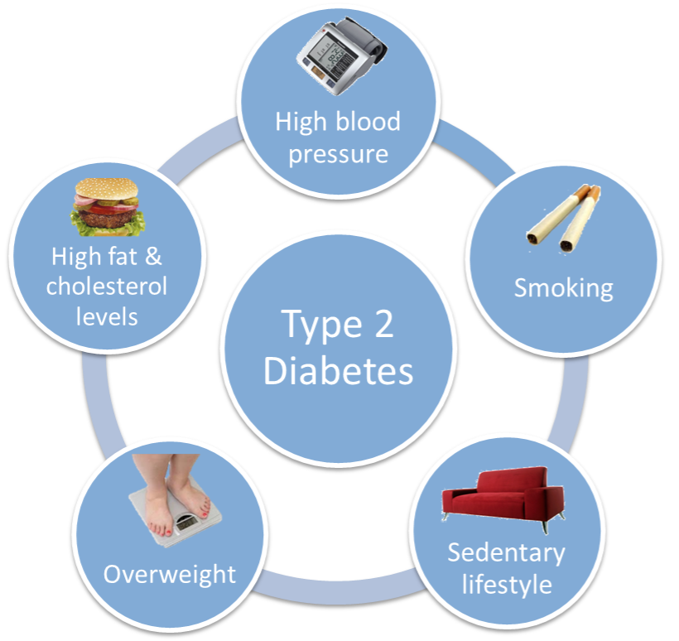
Country | Prevalence | Number of people
England* | 5.8 per cent | 2,566,436
Northern Ireland | 4.0 per cent | 75,837
Scotland | 4.4 per cent | 234,871
Wales | 5.3 per cent | 167,537

Slide 20
Complete these questions in full sentences
1 What is diabetes?
Why must people with Type 1 diabetes inject themselves with insulin?
What may happen to someone who has Type 1 diabetes who forgets to inject insulin?
Why does an increase in the amount of food that a diabetic eats also increase the amount of insulin they need?
Explain why taking exercise is helpful for controlling diabetes.(Hint: Think about respiration.)
Suggest one way in which a person’s diet will need to change if they have just been diagnosed with Type 2 diabetes.
Explain why the treatment of Type 2 diabetes may not require insulin but the treatment of Type 1 diabetes will

Slide 21
Hormone | Where is it made? | Effects on the body?
Insulin
Testosterone
Progesterone and Oestrogen
Antidiuretic Hormone
Adrenaline
Growth Hormone
Thyroxine
TASK: Complete this table

Slide 22
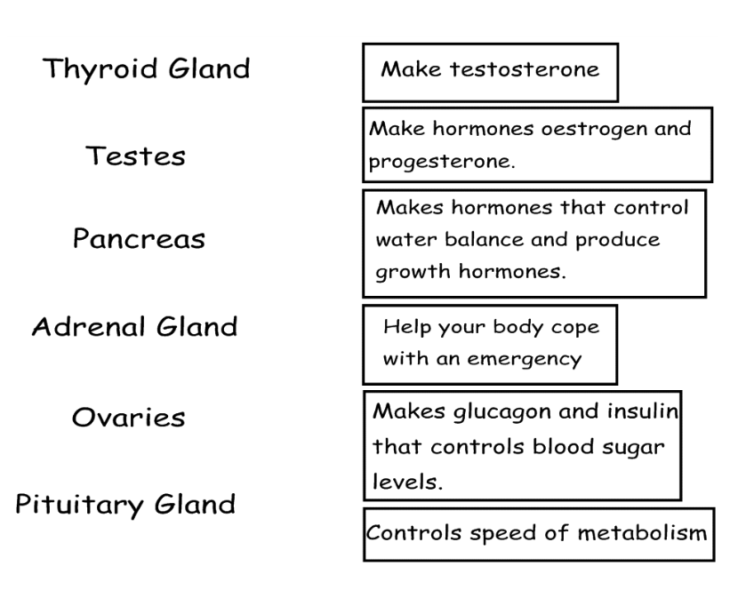
TASK: Match up the correct hormone with the function

