Slide 1

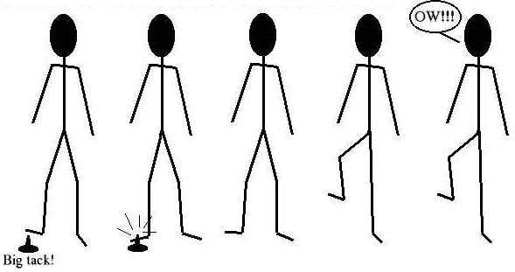
Title: Sensitivity and responding to stimuli 13th February 2014
Learning question: How do animals detect stimuli?
L.O 2.19 – 2.23
Homework:
Past paper questions due in today!
What’s happening in this series of pictures? Use the key words to help you describe what’s going on.
Key words…
Pain
Reflex
Receptor cells
Stimulus
Neurons
Spinal cord
Central Nervous System

Slide 2
Starter
What is negative feedback?
What does it mean and how does it link to homeostasis?

Slide 3
Answer
Negative feedback ensures that, in any control system, changes are reversed and returned back to the set level.
Conditions in the body are controlled, to provide a constant internal environment. This is called homeostasis.

Slide 4
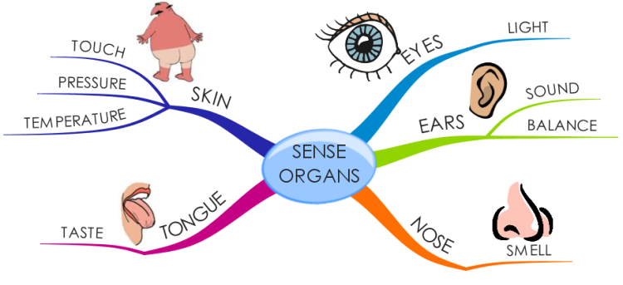
How many sense organs do you have?

Slide 5
Receptor cells
Receptors are groups of specialised cells.
They can detect changes in the environment, which are called stimuli, and turn them into electrical impulses.
Receptors are often located in the sense organs, such as the ear, eye and skin.
Each organ has receptors sensitive to particular kinds of stimulus.

Slide 6
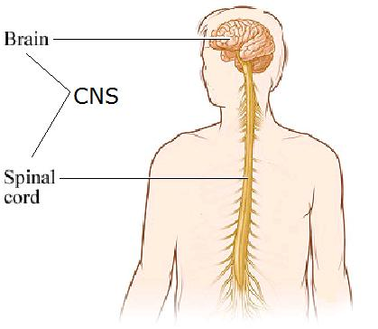
The Central Nervous System (CNS)
The brain and the spinal cord make up the central nervous system (CNS)
The CNS controls all areas of the body by sending information to and from the CNS through special cells called neurones

Slide 7
Neurones
There are three different types of neurone:
  Sensory neurones
  Relay neurones
  Motor neurones
Sensory neurones pick up information from our senses e.g. information about sound, light, touch, taste or smell
The brain decides what it wants to do with this information and nerve impulses are sent to muscles or glands to bring about the appropriate response
Muscles and glands are known as effectors (they carry out the effect that you want)

Slide 8
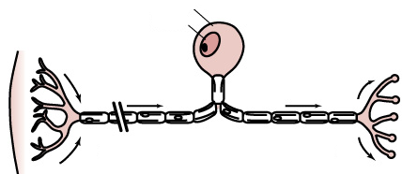
Sensory neurone
A neurone is the term used to describe a nerve cell
A sensory neurone is a type of nerve cell that passes messages back to the CNS from sense organs
Cell Body
Nucleus
Skin
CNS
Direction of impulse

Slide 9
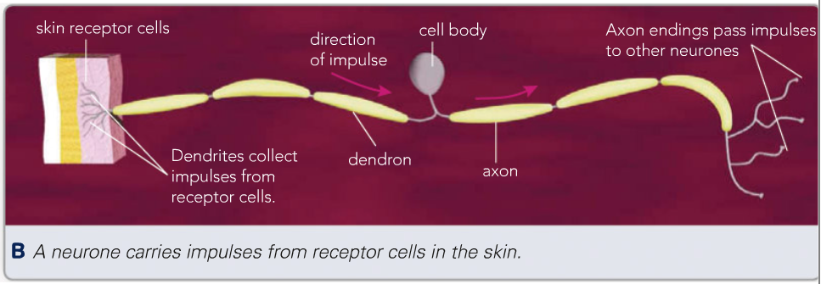
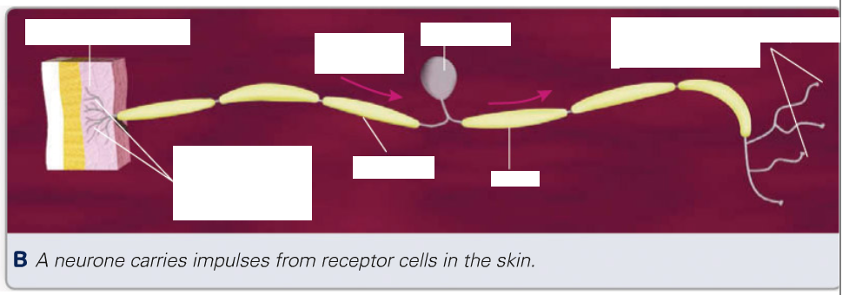
Label the diagram of the sensory neurone
Draw out a simple flow diagram to show how a nerve impulse travels from the skin receptors to the axon endings.
Skin receptor cells -> dendrites -> dendrons -> cell body -> axon -> axon endings

Slide 10
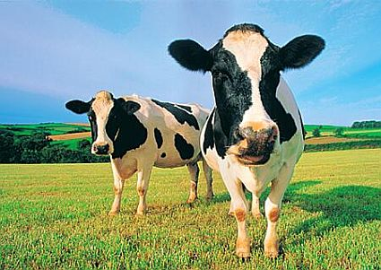
Sensitivity – some questions to think about
How do you know that someone has tapped you on the shoulder if you haven’t seen them?
Which areas of your body are most sensitive?
What makes this area sensitive?

Slide 11
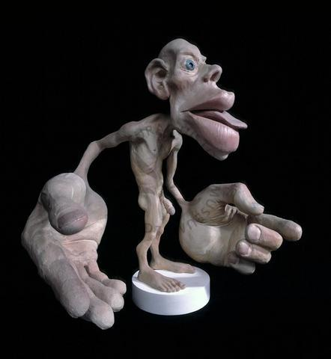

Slide 12
Mini plenary
1 What is a stimulus?
A: A change in your surroundings that you can detect.
2 In which organ are light receptor cells found?
A: Eye

Slide 13
Mini plenary
3 Which sense organ do you think contains the greatest number of receptors of different types? Explain your answer.
A:Skin because it detects many more different environmental changes than other sense organs.

Slide 14
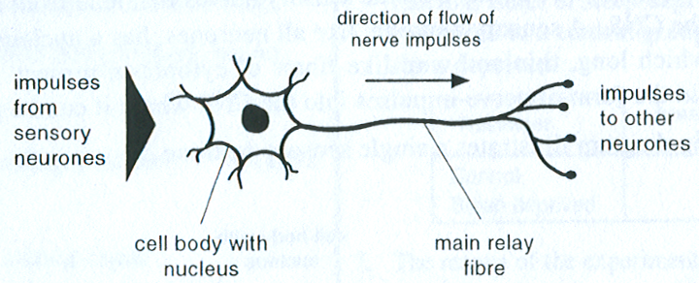
Relay neurone
Relay neurones are found in the CNS. They connect (relay) information from sensory neurones to other neurones in the body.

Slide 15
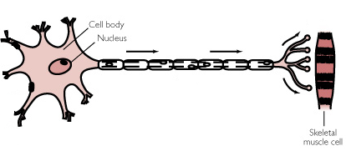
Motor neurone
Motor neurones transmit information to effectors such as muscles
Motor neurones carry nerve impulses from relay neurones in the CNS to effector muscles and glands

Slide 16
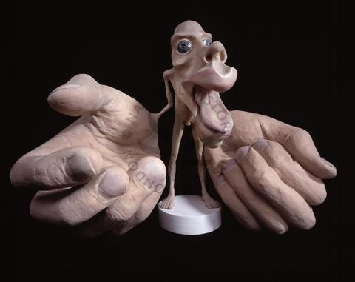

Slide 17
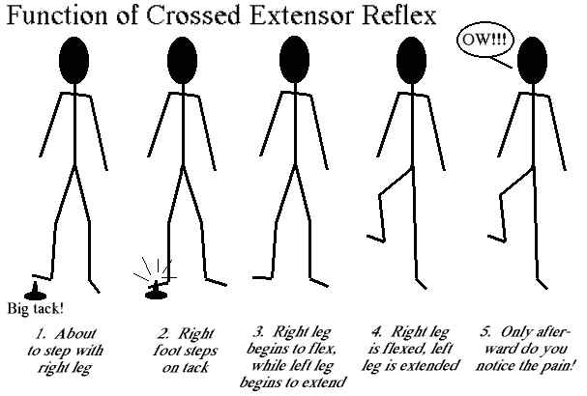

Slide 18
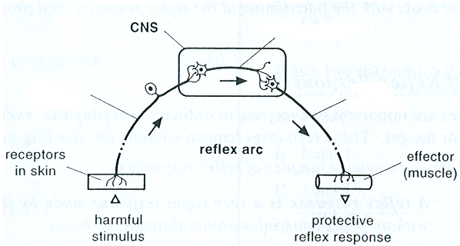
Relay neurone
Sensory neurone
Motor neurone

Slide 19
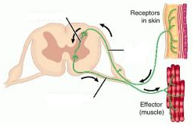
Relay neurone
Section of the spinal cord
Sensory neurone
Motor neurone

Slide 20
Reflex arc
A reflex arc is an arrangement, usually of three neurones, that allows a reflex response to take place
The response in a reflex arc is extremely fast because only three neurones are involved in the response
Only the spinal cord is involved in this process which means that you do not use your brain to think of what to do in these situations
E.g. sneezing, coughing, blinking, moving your hand from a very hot object
Reflex reactions are very important – they could save you from danger to your life or damage to your body

Slide 21
Activity
Using the diagram on the next slide, describe what is happening using the following words:
  Motor neurone
  Sensory neurone
  Reflex arc
  Rapid
  Relay neurone
  Effector (muscle)
  Stimulus
http://www.bbc.co.uk/schools/gcsebitesize/science/add_ocr_21c/brain_mind/nervoussystemrev3.shtml

Slide 22
Answer
  A harmful stimulus is detected by sensory neurones. This is passed on to the relay neurone in the spinal cord.
  The message is then passsed on to the motor neurone which ends in an effector (muscle) to move the hand away from the harmful stimulus. This is an example of a reflex arc because it is a rapid response.

Slide 23
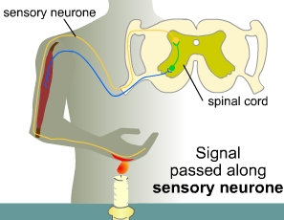

Slide 24
Quick Questions
What do the letters CNS stand for?
Name the two main types of neurone
Which of these two links the CNS with the effectors?
Describe three features of reflex actions
Give two examples of reflex actions

Slide 25
Answers
Central Nervous System
Sensory and Motor
Motor
They are quick, automatic and difficult to suppress
Coughing and Sneezing

Slide 26
4 State one way in which the brain alters the way the body works to stop it getting too cold.
A: One of: makes you shiver, directs blood flow away from the skin, makes you feel cold so you put on more clothes/ move to a warmer area.
5 Why is it necessary for neurones to link to each other?
A: To carry impulses from one part of the body to other parts.

Slide 27
6 Draw a flowchart to show how impulses caused by a stimulus reach the brain.
A: A possible solution is:

Slide 28
7 a Which organs are in the CNS?
A: Spinal cord, brain.
b Describe the route impulses take from a touch receptor cell in the foot to the brain.
A: The impulses from the touch receptor cell travel via neurones in the leg, then into the spinal cord and then to the brain.

Slide 29

8 You pick up an ice cube. Explain all the different ways in which your brain knows that it is an ice cube.
A: Receptor cells - in the skin detect cold – and those in the eye detect light - impulses are sent - via neurones - to the brain - where the information is processed and you ‘feel’ the cold/see the cube.

