Slide 1
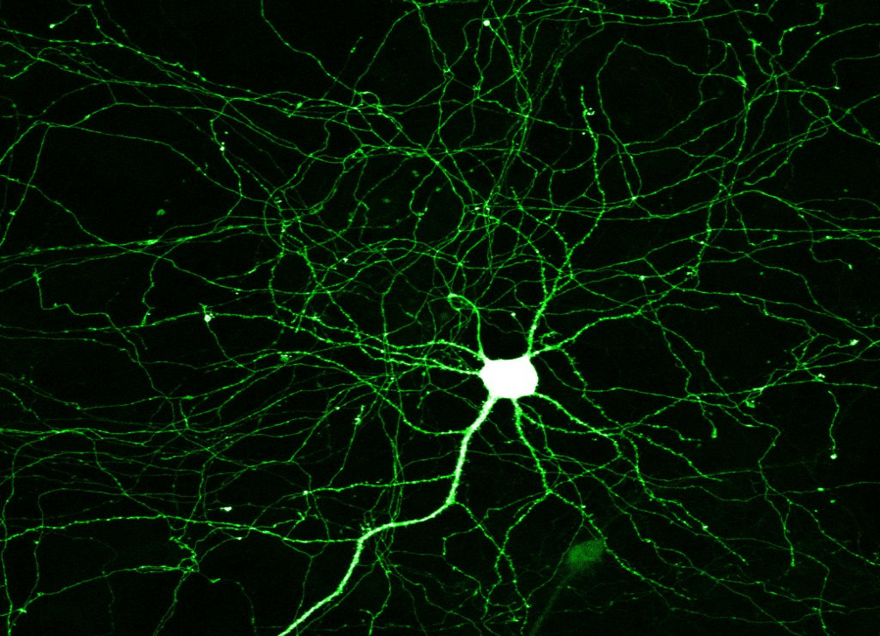
Title: Sensory receptors
07 September 2014
Learning question: What is the basic structure of a neuron?
Starter: draw and label a neurone from GCSE knoweldge

Slide 2

Key words
Sensory receptor
Transducer
Sensory neurone
Motor neurone
Dendron (dendrites)
Axon
Myelin
Schwaan cells
Node of Ranvier

Slide 3
Learning Outcomes
Outline the roles of sensory receptors in mammals in converting different forms of energy into nerve impulses.
Describe, with the aid of diagrams, the structure and functions of sensory and motor neurones.

Slide 4
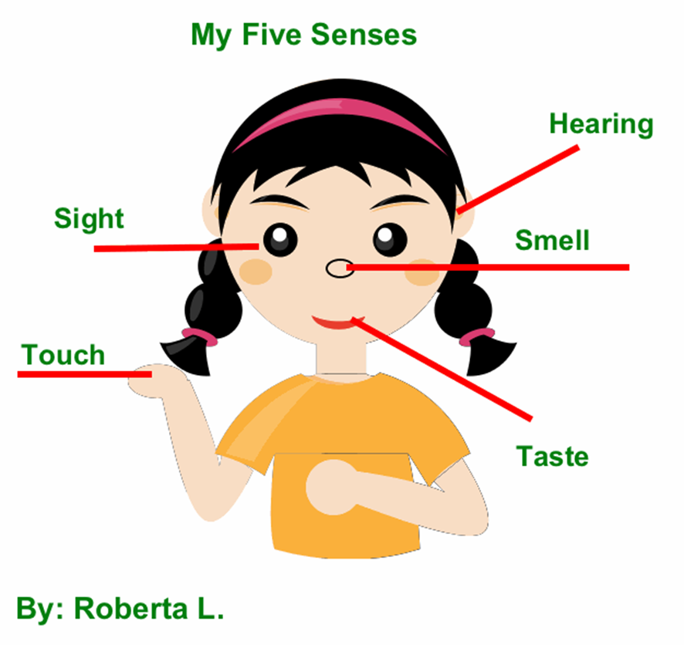
Sensory Receptors
Changes in our surroundings are detected by specialised cells called sensory receptors.
Sensory receptors convert one form of energy into another.
E.g. a change in pressure in the skin.
Change in energy levels in the environment is called a stimulus.

Slide 5

Sound receptors in the inner ear (cochlea)
Light-sensitive cells (rods and cones) in the retina of the eye
Vibrations in the air
Olfactory cells lining the inner surface in the nasal cavity
Light intensity and range of wavelengths (colour)
Pressure receptors (Pacinian corpuscles) in the skin
Presence of volatile chemicals
Taste buds in the tongue, hard palate, epiglottis and the first part of the oesophagus
Pressure on skin
Presence of soluble chemicals

Slide 6
Summary
Sensory receptors detect changes from surroundings;
Sensory receptors transduce signals – they convert one type of energy into a form of electrical energy;
Changes in energy levels in the environment are called stimuli;
Stimuli are converted by sensory receptors into electrical energy called a nerve impulse.

Slide 7
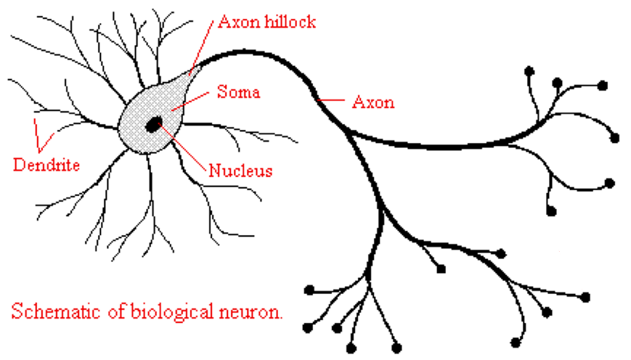
Basic neurone structure

Slide 8
Task
Read page 13 of your textbook and label the diagrams of sensory and motor neurones.
Complete questions 1-3 in sentences – you will need these at the basis of your notes!
Self assessment: check answers at back of textbook.

Slide 9
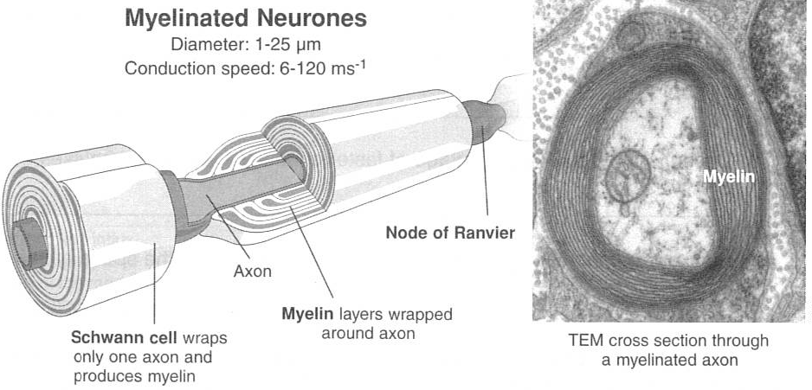

Slide 10
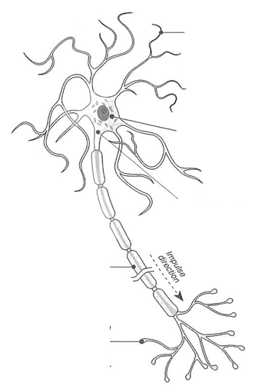

Slide 11
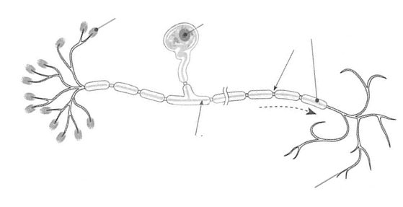

Slide 12
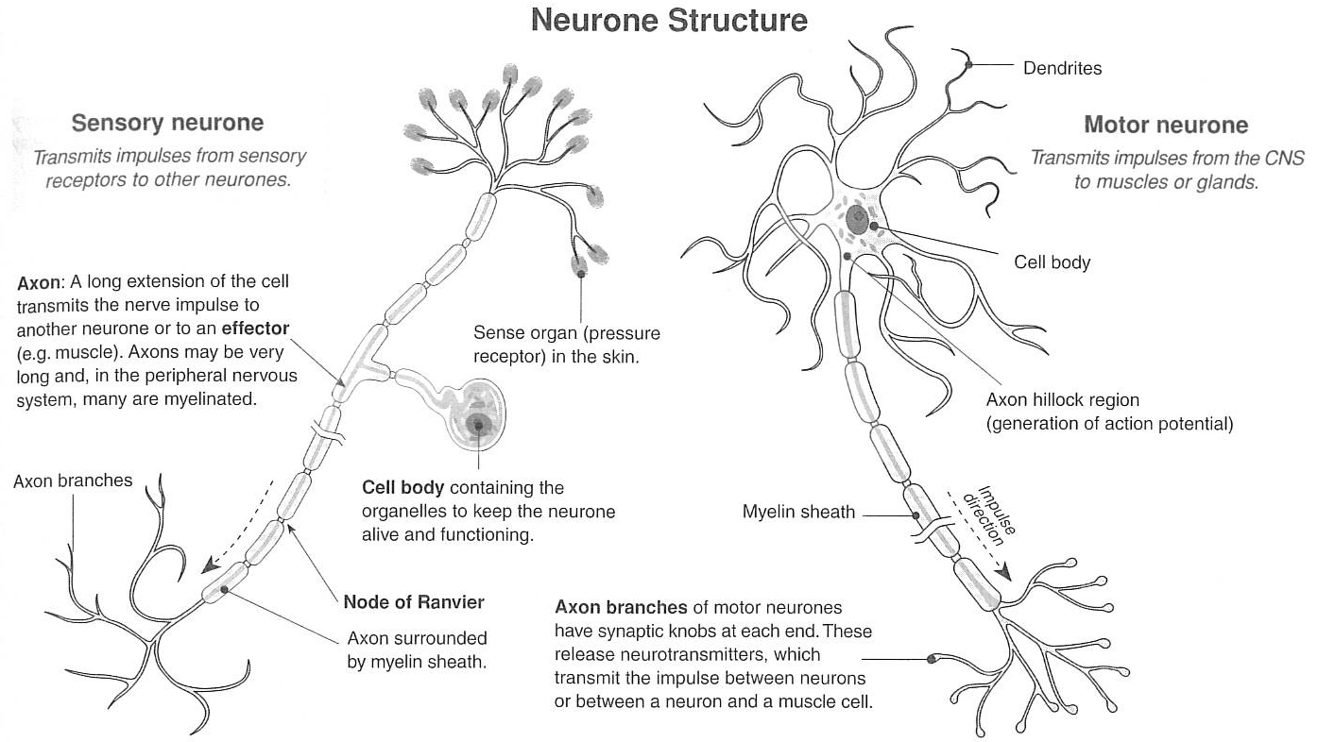

Slide 13
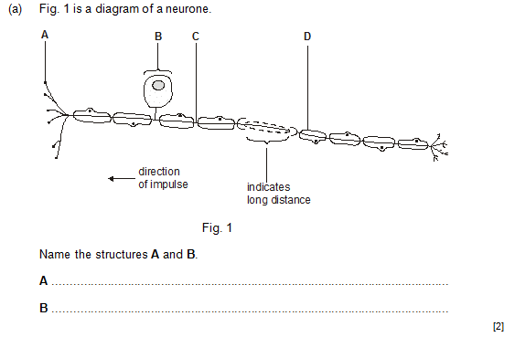

Slide 14
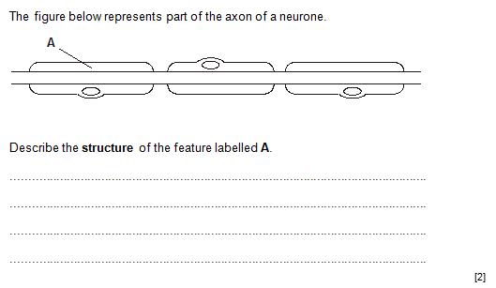
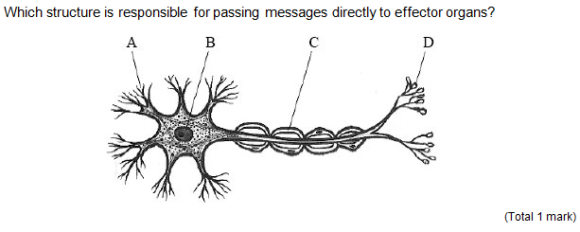

Slide 15
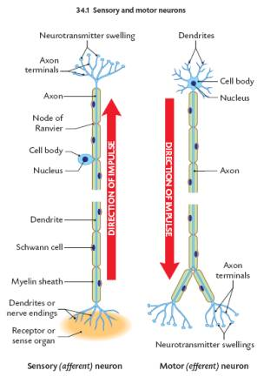

Slide 16
The Plasma Membrane - review
Made of phospholipids and about 6 different proteins
How do molecules get across the cell membrane?
What are the mechanisms of transport across the membrane?

Slide 17
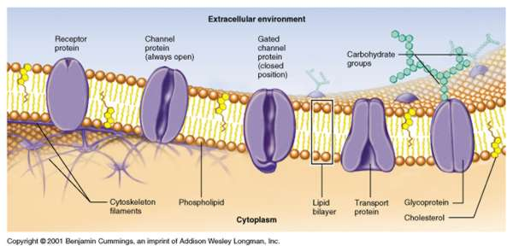

Slide 18
Task
Read pages 14-15 carefully.
Write out key words and definitions.

