Slide 1
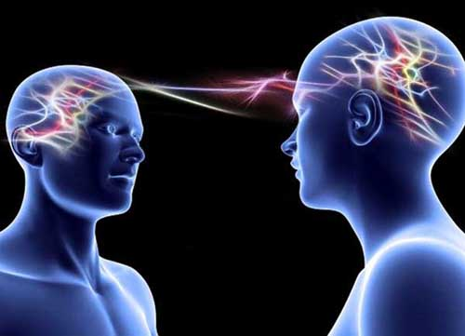
Title: Resting potentials
14 September 2014
Learning question: how are nerve impulses generated?
Starter: What type of protein in the plasma membrane allows diffusion of sodium into an axon?
Na⁺
http://www.bbc.co.uk/news/science-environment-29093700

Slide 2

Key words
Resting potential
Threshold potential
Action potential
Polarised
Depolarised
Hyperpolarised
Repolarisation
Refractory period

Slide 3
Learning Outcomes
(c)describe and explain how the resting potential is established and maintained;
(d) describe and explain how an action potential is generated;
(e) describe and explain how an action potential is transmitted in a myelinated neurone, with reference to the roles of voltage-gated sodium ion and potassium ion channels;
(f) interpret graphs of the voltage changes taking place during the generation and transmission of an action potential;
(g) outline the significance of the frequency of impulse transmission;
(h) compare and contrast the structure and function of myelinated and non-myelinated neurones;

Slide 4
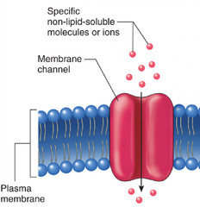
Voltage gated ion channels
Some of the proteins found on the surface of the cell membrane are channels that allow ions to move across.
Open channels allow ions to diffuse from an area of high concentration to lower concentration until they are evenly spread out.
Channel proteins found in neurons are more specific than this.

Slide 5
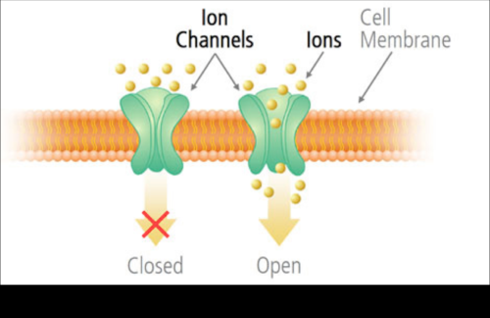
Voltage gated ion channels
Protein channels in neurones are specific to either sodium or potassium ions;
These protein channels have gates that open or close the channel. They are usually kept closed;
When open, the permeability of the ions is increased and they flow through the channel. When closed, the permeability is reduced.

Slide 6
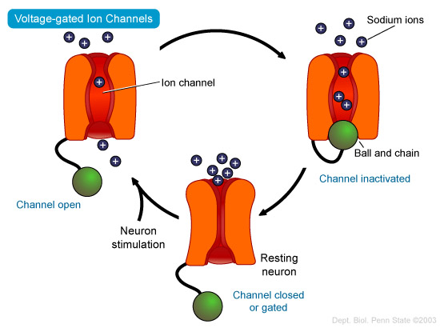
NOTE! These types of proteins simply let sodium or potassium ions to pass in or out of the cell

Slide 7
Summary
There are a type of protein found on the cell surface called voltage-gated ion channels.
When the channel/gate is open, proteins allow sodium or potassium ions to pass in to or out of the cell down a concentration gradient.
Channels are normally kept closed.

Slide 8
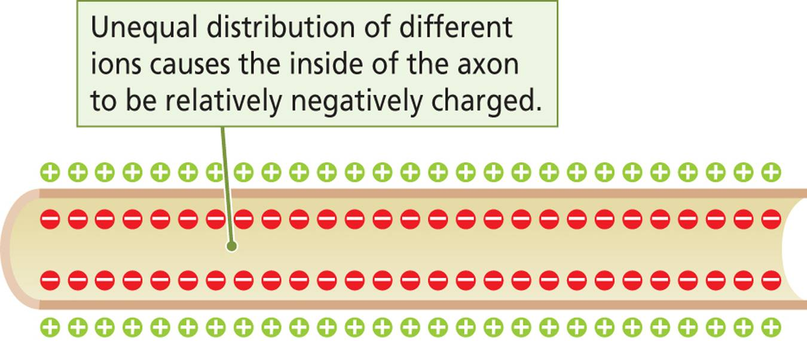
Ion pump proteins
Another type of protein in the cell membrane is one that actively pumps ions in or out of the cell.
These pumps transport sodium (Na⁺) and potassium (K⁺) ions extra- and intracellularly respectively.
This means lots of Na⁺ is pumped out of the cell, while K⁺ is pumped into the cell.
This creates an overall negative charge inside the cell with respect to the outside.

Slide 9
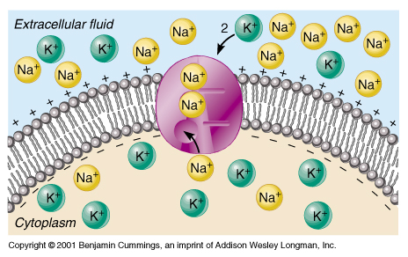
Polarisation
As the inside of the cell is “more negative” than outside, we say the cell membrane has become polarised.
Positive charge
Negative charge

Slide 10
Depolarisation
Altering the permeability of sodium ions creates a nerve impulse.
Sodium channels open, sodium ions flow down the concentration gradient from high to low, flowing back into the cell (These were the first proteins we talked about).
The movement of positive Na ions going back into the cell makes the inside of the cell “less negative” than before.
This creates a change in the potential difference, or charge, across the cell.
This change of charges across the membrane of neurones is called depolarisation.

Slide 11
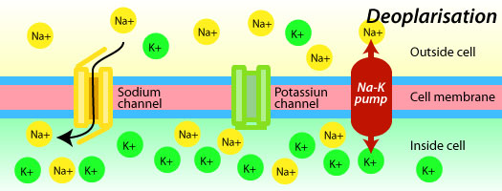
Sodium channel is open, allowing sodium ions to flow back into the cell.
Sodium ions flowing back into the cell makes it “less negative” than before

Slide 12
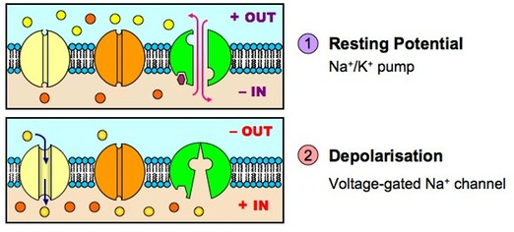
Neurone at rest: only Na⁺/K⁺ pump is working
V-gated Na⁺ channel is closed
Neurone depolarisation: Na⁺/K⁺ pump is working but
V-gated Na⁺ channel is open, causing lots of Na^{+ to} rush into the cell

Slide 13
Task
Sketch a graph to show the resting potential and depolarisation as mV (millivolts) against time (seconds)
Which way does the line go? Can you explain why it does this?

Slide 14
Generator Potentials
Receptor cells respond to changes in the environment.
If a small number of Na⁺ cross the channel, this is called a generator potential.
The larger the stimulus (the change in energy levels in the environment) the more gated channels will open.
If there are enough Na⁺ entering the cell, the potential difference changes significantly and will initiate an impulse, known as an action potential.
http://www.youtube.com/watch?v=7EyhsOewnH4

Slide 15
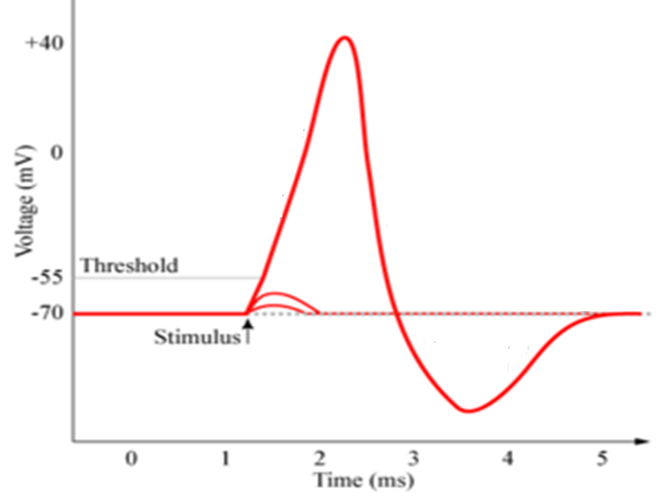
Large stimulus creates large change in potential difference
Small stimuli create small changes in potential difference

Slide 16
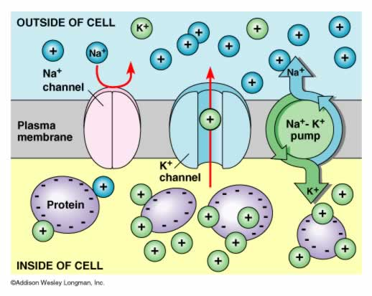
Repolarisation
Depolarisation
  Massive influx of sodium ions into the cell
  Causes internal environment to become more positive
Repolarisation
  Making internal environment negative again
  Export of potassium ions via K⁺ channels
  At this point, Na⁺ channels are closed

Slide 17

Repolarisation
At +40mv, Na⁺ ion channels close and K⁺ ion channels open
K⁺ ions flow out of the cell by diffusion, making the internal environment more negative with respect to outside
K⁺ ion channels are a bit leaky, causing an overshoot of repolarisation. Results in hyperpolarisation.

Slide 18
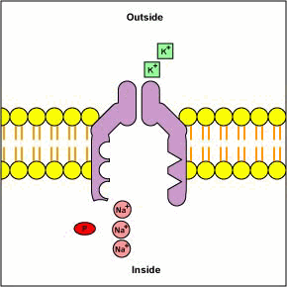
Refractory period
Phase were no further APs can be fired to allow cell to recover and to ensure APs only travel in one direction
Sodium/potassium ion pumps actively transport 3Na⁺ out of the cell and 2K⁺ into the cell to restore charge across the membrane

Slide 19
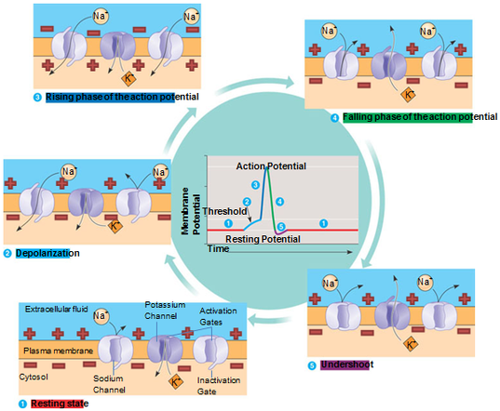

Slide 20
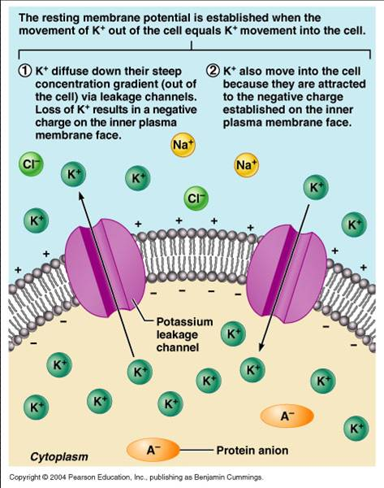

Slide 21
Transfer of information
Stimuli detected have energy. This energy is converted in order to depolarise the membrane of a neurone (make the receiving neuron membrane “less negative”). Once this happens, an impulse is transmitted to other parts of the body.
The impulse is transmitted through neurones as action potentials from one part of the body to the other.

Slide 22
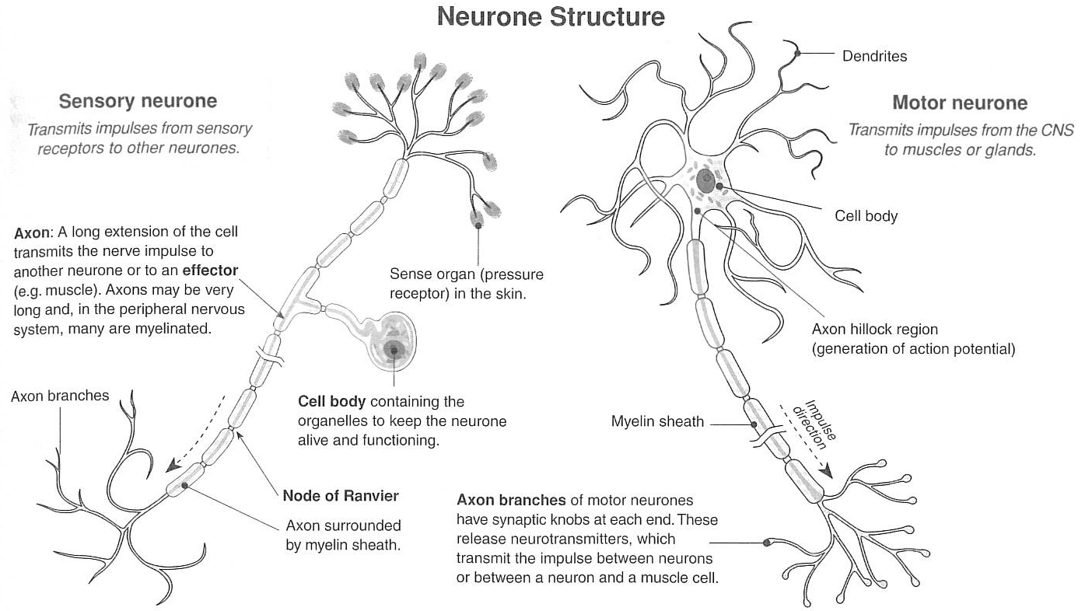

Slide 23
Neurone Specialisations
Very long axons – transmit over long distances
Many gated ion channels on cell membrane surface to allow Na, K and Ca ions through
Na/K pumps to facilitate active transport of ions into/out of cell
  Maintain a potential difference across cell membrane (+ve outside, -ve inside)
Myelin sheath (Schwann cells) insulate neurone from electrical activity of nearby cells
Cells have a nucleus, many mitochondria and ribosomes – why?

Slide 24
Questions
Explain how the presence of a myelin sheath speeds up the movement of a nerve impulse.
Why is the term “polarised” used when describing a neurone’s charge across the membrane at rest?

