Slide 1

Action Potentials
Miss Tagore
A2 Biology

Slide 2
Learning Outcomes
describe and explain how the resting potential is established and maintained;
describe and explain how an action potential is generated;
describe and explain how an action potential is transmitted in a myelinated neurone, with reference to the roles of voltage-gated sodium ion and potassium ion channels;
interpret graphs of the voltage changes taking place during the generation and transmission of an action potential;
outline the significance of the frequency of impulse transmission;
compare and contrast the structure and function of myelinated and non-myelinated neurones;

Slide 3

Feeling like this?
Watch this video, it might help ☺

Slide 4
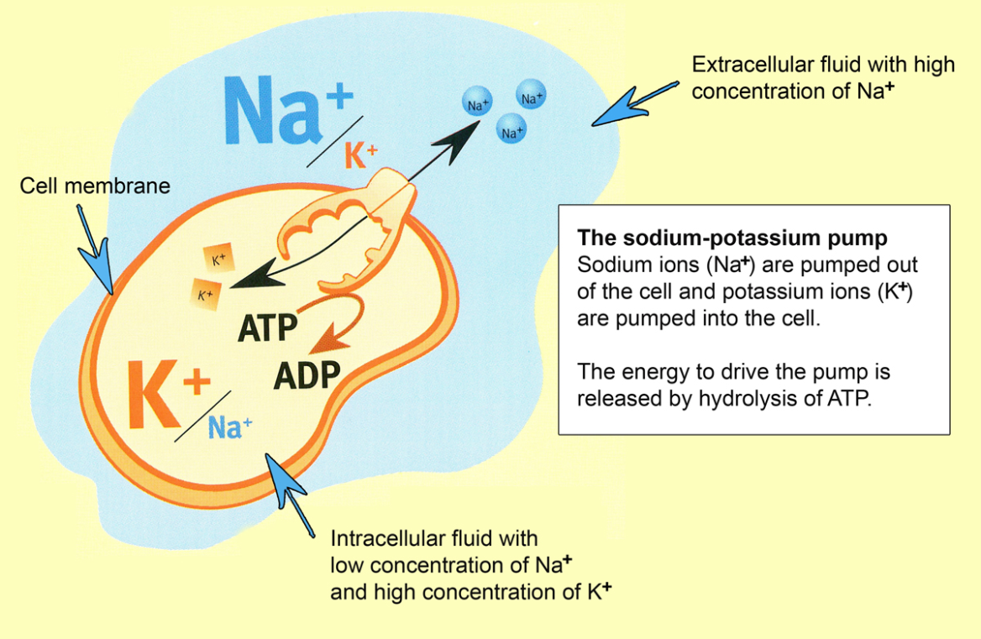
A resting neurone?
Neurones not transmitting action potentials are said to be at rest…
In fact, they are NOT resting, but actively transporting ions back and fourth across the cell membrane.
3 Na⁺ ions are pumped out of the cell for every 2 K⁺ ions that are pumped in.
This process uses ATP as it is moving against the concentration gradient.

Slide 5
A resting neurone?
Even though K⁺ are actively being pumped into the cell, the plasma membrane is actually more permeable to K⁺ ions than Na⁺.
This means some K⁺ diffuse back out of the cell through “leaky” channels.
The cell interior is actually negatively charged due to the presence of negatively charged anions.
This helps to create the negative potential inside and make the cell membrane polarised.
The potential difference across the membrane is -70mV. This is the resting potential.

Slide 6
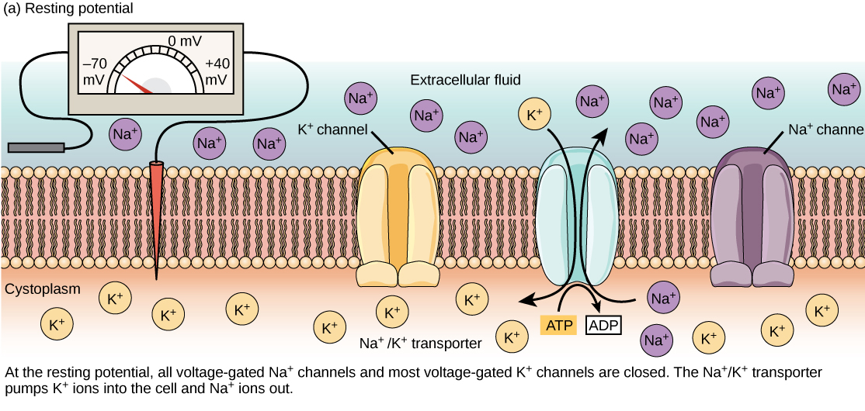

Slide 7
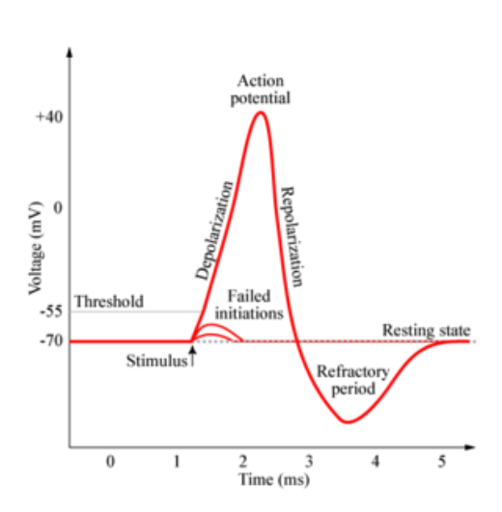
Action Potential
5 main stages
1. Reaching threshold
2. Depolarisation
3. Repolarisation
4. Hyperpolarisation
(Refractory period)
5. Return to Resting potential

Slide 8
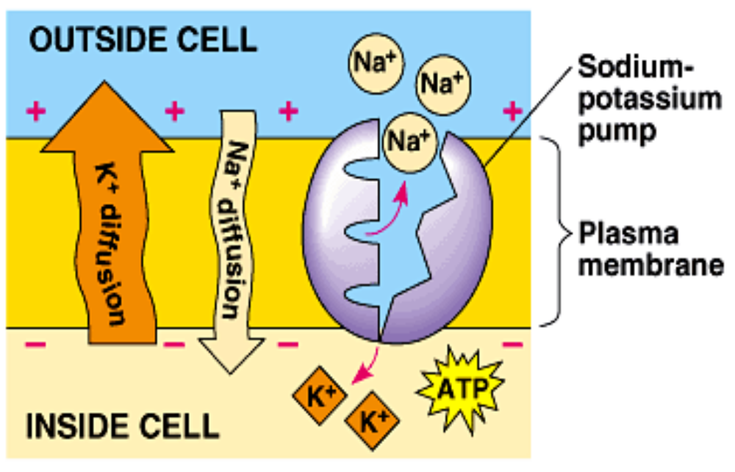
Action Potential
At rest, Na⁺ channels are kept closed.
The Na⁺/K⁺ pump uses ATP to actively pump out 3 Na⁺ for every 2 K⁺ that are transported into the cell.
Some K⁺ channels remain open, which means that some K⁺ diffuses back out of the cell.

Slide 9
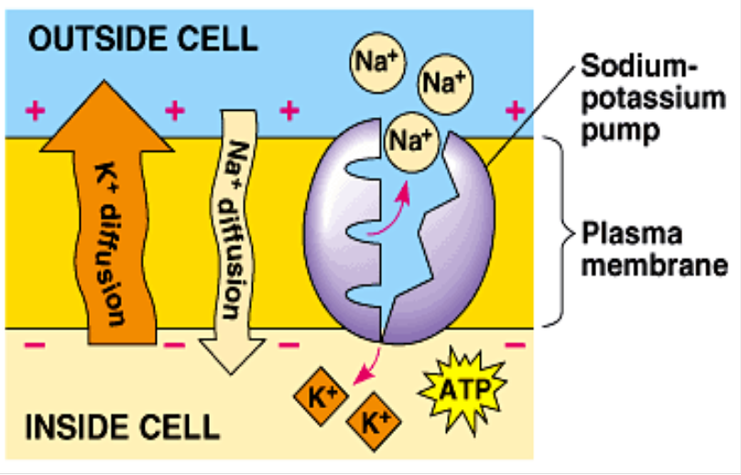
Action Potential
The diffusion of Na⁺ ions back into the cell can cause the membrane to depolarise.
Energy changes in the environment will stimulate the opening of more Na⁺ channels.
  The more channels that open, the more sodium enters (chain reaction, as Diana Ross would say).
  This means that the cell is further depolarised.
More channels open because they respond to changes in the potential difference (voltage across the membrane).
Voltage gated ion channels are called so because they respond to depolarisations of the membrane.

Slide 10

Energy changes in the environment (A STIMULUS) will stimulate the opening of more Na+ channels.
Rest: Na+ channels are kept closed.
Membrane is polarised

Slide 11
Summary
Initiation of an action potential occurs from a stimulus at receptor or nerve ending.
Energy provided by stimulus causes rapid reversal of polarity (charge) of membrane.
Causes a Na⁺ voltage-gated channel to open.
Na⁺ will start to diffuse into cell (along concentration gradient).
This causes inside of membrane to become more positive and therefore depolarised.
Starts at the axon hillock and moves along the axon

Slide 12
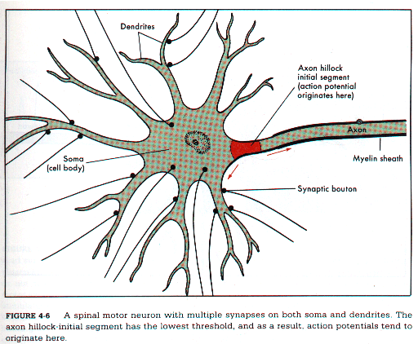

Slide 13
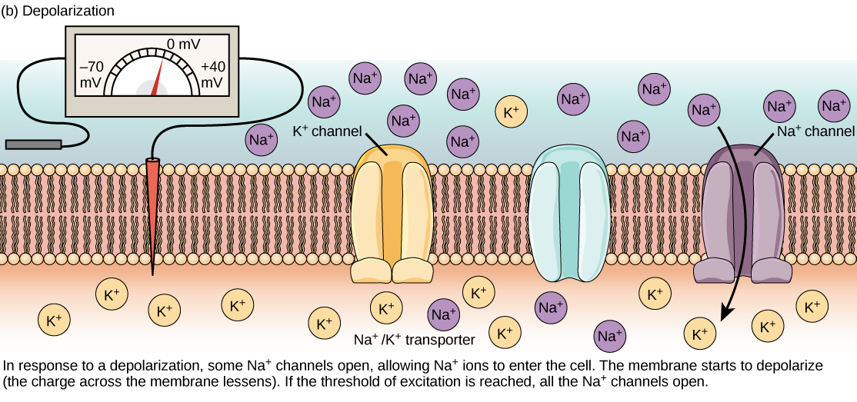

Slide 14
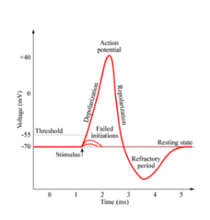
Reaching Threshold
If stimulus is GREAT enough, threshold will be reached and an action potential generated.
This happens because some voltage-gated ion channels nearby are open.
This causes lots of Na⁺ ions to flood into the cell, causing the depolarisation to reach +40mV.
'All or nothing' law - action potential will only be generated if enough sodium enters to change membrane to a certain threshold.

Slide 15
Depolarisation
As some Na⁺ starts to enter cells, more and more Na⁺ voltage-gated channels open (positive feedback)
This in turn rapidly increases Na⁺ levels inside the cell
This continues until ALL Na⁺ voltage-gated channels are open
The influx of Na⁺ causes inside of membrane to become much more positive (+40mV) than the outside
The K⁺ voltage-gated channels are shut still
Depolarisation: a REDUCTION in membrane potential (becomes LESS NEGATIVE)

Slide 16
Voltage-gated sodium ion channels open and many sodium ions flood in. As more sodium ions enter, the cell becomes positively charged inside compared with outside.
The potential difference across the plasma membrane reaches +40mV. The inside of the cell is positive compared with the outside.

Slide 17
Repolarisation
Increased Na⁺ levels resist further entry of Na⁺ into cell at about +40mV
K⁺ voltage-gated channels start to open and K⁺ rushes OUT of cell
This means interior of cell membrane becomes negative again
Repolarisation: a RETURN to resting membrane potential

Slide 18
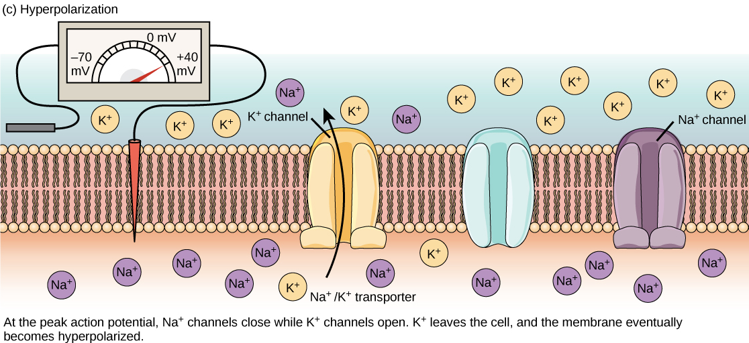

Slide 19
Repolarisation
Sodium-potassium pump acts to correct ionic imbalance caused by depolarisation i.e. they want to get the membrane back to -70mV
The influx/efflux of ions seems to be tremendous, but actually only small amounts (about 0.012% of cellular contents) cross the membrane
This is quickly corrected by sodium-potassium pump
The entire cycle - depolarisation, repolarisation and hyperpolarisation - is extremely rapid lasting about 0.002 seconds

Slide 20
The sodium ion channels close and potassium ion channels open.
Potassium ions diffuse out of the cell bringing the potential difference back to negative inside compared with outside – this is called repolarisation

Slide 21
Hyperpolarisation
After the action potential, it is impossible to stimulate the cell membrane to reach another action potential.
Potassium channels are slow to close so too many K⁺ ions diffuse out of the neurone.
This makes the cell more negative than -70mV, which is the resting potential.
This is called the refractory period. It allows the cell to recover from an action potential and also ensures that action potentials only travel in one direction

Slide 22
Resting potential
Ion channels are reset
The sodium-potassium pump returns the membrane to its resting potential of -70mV and maintains it until the membrane can be excited by another stimulus.

Slide 23
The potential difference overshoots slightly, making the cell hyperpolarised.
The original potential difference is restored so that the cell returns to its resting state.

Slide 24
Na⁺ channels close
K⁺ channels open
LOTS of Na⁺ channels open
K⁺ channels close
Na⁺ channels open

Slide 25
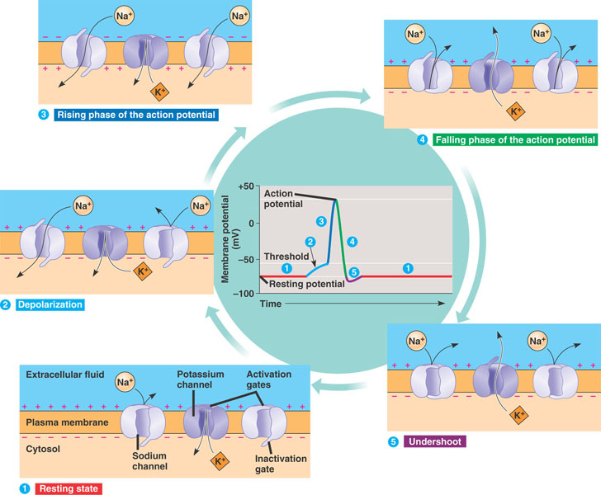

Slide 26
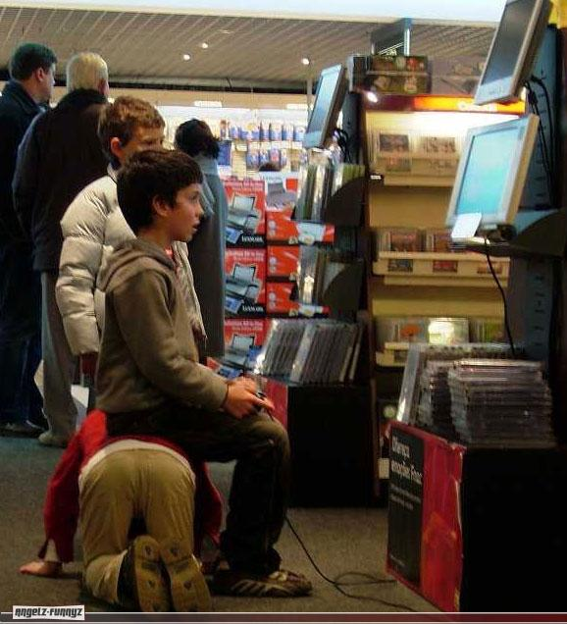
Your task – teamwork!
Using the previous two slides, write down the reasons for why the sodium or potassium channels are opening or closing.
Work in pairs – someone look at sodium channels and the other person look at potassium channels.
Once you have completed your share of the work, teach your partner and fill in the missing information.

Slide 27
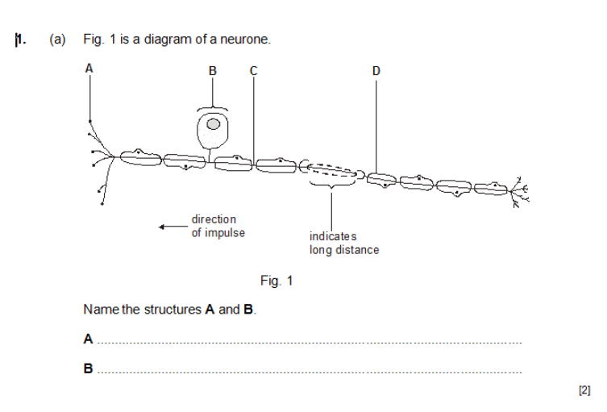
Axon terminal
Cell body (soma)

Slide 28
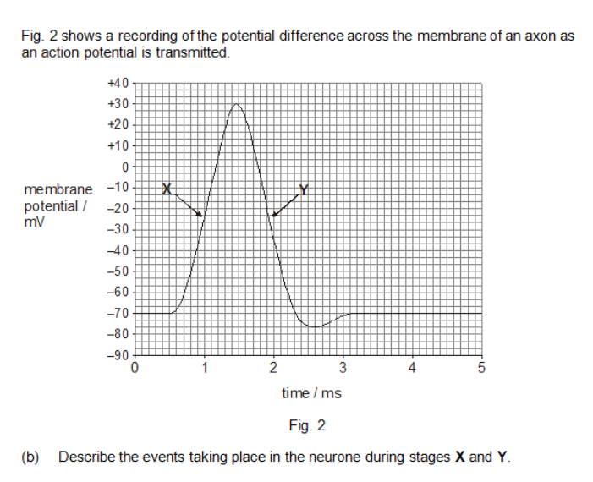
X = depolarisation of cell membrane.
Voltage-gated sodium channels open, flooding the cell with positively charged ions that change the membrane potential to +30mV from -70mV
Y = repolarisation of cell membrane.
Voltage-gated potassium channels open, allowing them to leave the cell by diffusion. This makes the potiential difference fall from +30mV to -76mV.
Sodium channels close.

Slide 29
