Slide 1
Transmission of Action Potentials
Miss Tagore
Year 13 Biology

Slide 2

Lesson Starter
In the resting phase of an action potential, what type of protein in the cell membrane is active?
The sodium potassium pump.
(Sodium channels are closed as are the majority of potassium channels)

Slide 3
Learning Outcomes
outline the significance of the frequency of impulse transmission;
compare and contrast the structure and function of myelinated and non-myelinated neurones

Slide 4
Transmission of action potentials
What we have learned so far…
The function of an action potential is to transmit information from one end of a neurone to another.
Action potentials work on the basis of active transport and voltage-gated ion channels (diffusion) of potassium and sodium ions across the cell membrane.
In this lesson we will look at HOW action potentials are transmitted along an axon and what the most efficient way of doing this is.

Slide 5
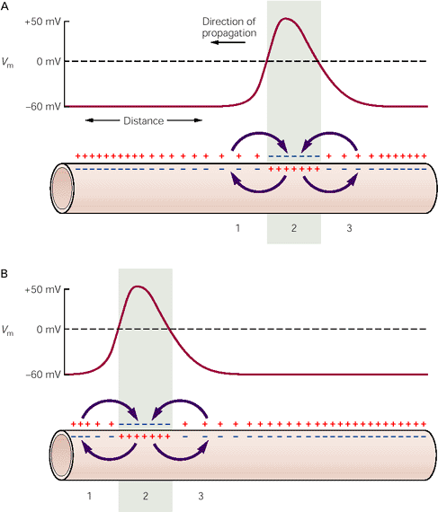
Local Currents
Sodium channels opening and allowing sodium ions into the cell creates a localised disruption to the balance created by the Na⁺/K⁺ pump.
This creates local currents in the cytoplasm of the neurone.
Local currents stimulate Na⁺ channels further along the membrane to open.

Slide 6
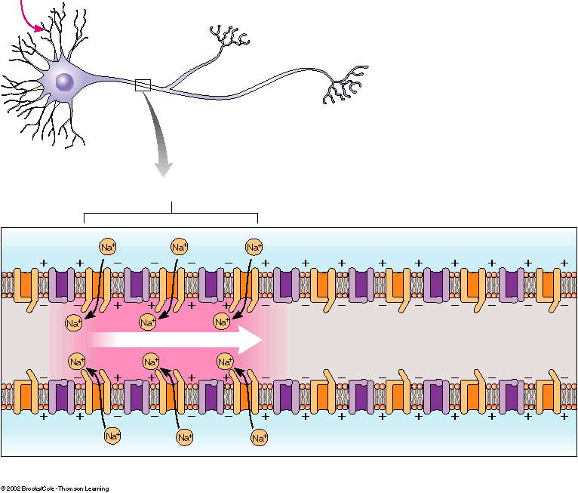

Slide 7
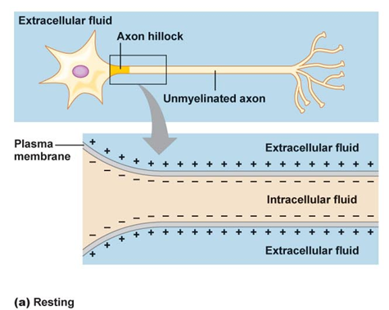

Local Currents
At the resting phase, no action potential has been reached and the cell is polarised.

Slide 8
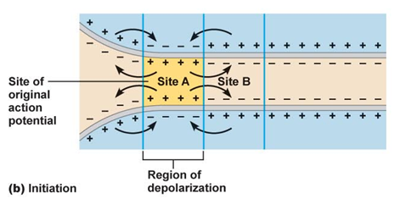
Local Currents
When an action potential has been fired, sodium ions diffuse into the cell across the membrane
This means that the ionic balance has been disrupted
High concentration of sodium ions inside the cell causes sideways diffusions of some sodium (moving from high to low concentration)

Slide 9
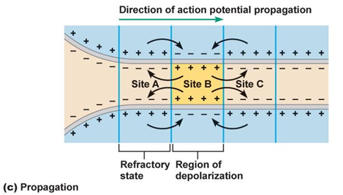
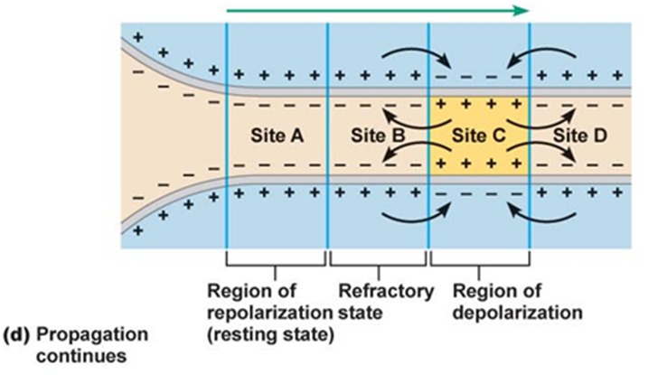
The movement of sodium ions along the neurone alters the potential difference across the membrane.
When a region becomes polarised, the sodium gates open, allowing sodium ions to enter the neurone at a point further along the axon.
The action potential has moved along the neurone.

Slide 10
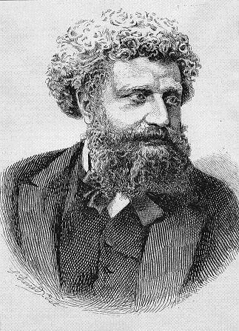
The Myelin Sheath
The myelin sheath is an insulating layer of fatty material.
Shawann cells make up the myelin sheath
Between the Schawann cells are tiny patches of bare membrane that do not insulate the electrical activity occurring in an axon. These areas are called nodes of Ranvier
In myelinated neurones, the sodium ions can only get through the membrane at the nodes of Ranvier

Slide 11
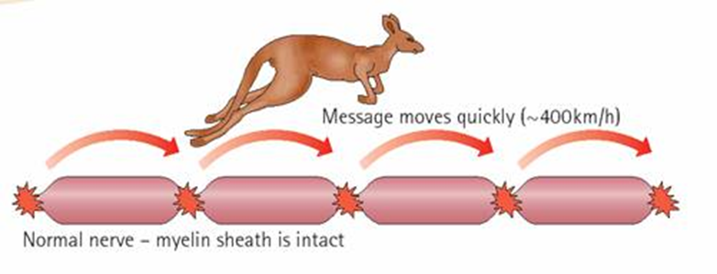
The Myelin Sheath
The neurone’s cytoplasm contducts enough electrical charge to depolarise the next node so the impulse “jumps” from node to node.
This is called saltatory conduction and is very fast.

Slide 12

The Myelin Sheath
In a non-myelinated neurone, the impulse travels as a wave along the whole length of the axon membrane.
This is slower than a saltatory conduction, but still fast!

Slide 13
Factors that speed up action potential conduction
Myelination
  Insulation of axon allows for faster conduction
Axon diameter
  Less resistance to flow of ions when there is a bigger diameter
  Less resistance means depolarisation reaches other parts of the neurone cell membrane quicker
Temperature
  Ions diffuse faster at higher temperatures BUT like proteins, the channels will denature above 40ºC

Slide 14
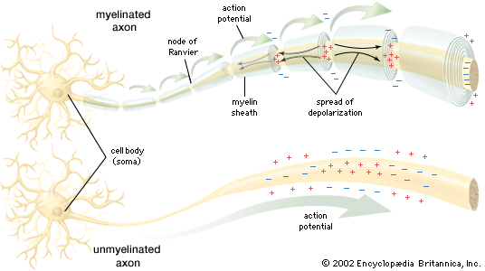

Slide 15
Exam questions
The table below shows how the speed of conduction of an action potential varies with the diameter of myelinated and non-myelinated axons in different organisms.
Describe the effect of myelination on the rate of conduction of an action potential and explain how this effect is achieved. (5)
In your answer, you should use appropriate technical terms, spelled correctly.
organism | type of axon | axon diameter / µm | speed of conduction / ms-1
crab | non-myelinated | 30 | 5
squid | non-myelinated | 500 | 25
cat | myelinated | 20 | 100
frog | myelinated | 16 | 32

Slide 16
Answer
Effect:
myelinated fibres conduct more quickly than unmyelinated / AW;
ref. to one set of comparative figures from table;
Explanation - max 4
1. myelin sheath acts as (electrical) insulator;
2. lack of sodium and potassium gates in myelinated region;
3. depolarisation occurs at nodes of Ranvier only;
4. (so) longer local circuits;
5. (action potential) jumps from one node to another / saltatory conduction.

Slide 17
Exam Question
In this question, one mark is available for the quality of spelling, punctuation and grammar.
In order to transfer information from one point to another in the nervous system, it is necessary that action potentials be transmitted along axons. In humans, the rate of transmission is 0.5 m s–1 in a nonmyelinated neurone, increasing to 100 m s–1 in a myelinated neurone.
Explain how action potentials are transmitted along a nonmyelinated neurone and describe which parts of this process are different in myelinated neurones.
No credit will be given for reference to events at the synapse.

Slide 18
Answer
1. sodium ions (inside axon), move/diffuse
2. towards, resting/negative region;
3. causes, depolarisation of this region/change of PD to reach threshold value;
4. (more) sodium channels open;
5. sodium (ions) move in;
marking points 3-5 only available if linked to sodium ions moving within axon
6. ref to local circuits;
7. one way transmission;
8. ref refractory period/region of axon behind AP recovering;
9. ref to insulating role of, myelin sheath/Schwann cells;
10. depolarisation cannot occur through myelin/impermeable to (Na+ and K+) ions/ora;
11. ref to nodes of Ranvier;
12. longer local circuits;
13. saltatory conduction/AW;
14. AVP; e.g. fewer (Na+ and K+) ion channels in myelinated region/ora.
15. AVP; ref. to absolute and relative refractory period, ref. to actual distance between nodes (1 – 3mm); max 7
QWC – legible text with accurate spelling, punctuation and grammar;1

