Slide 1
Title: Effect of exercise on the body
02 October 2014
Learning question: what effect does exercise have on the body?
Starter: write down the RQ values for carbohydrate and fat
A man walks into a bar and asks for a pint of Adenosine Triphosphate.
The barman says ‘That’ll be ATP please!!!’
How does pyruvate get to work?
On its Krebs cycle!

Slide 2
Learning Objectives
explain the short-term and long-term consequences of exercise on the body, with reference to the respiratory and cardiovascular systems and the structure of skeletal muscle;
(b) discuss how much exercise needs to be taken for significant sustained improvement in aerobic fitness;

Slide 3

Key words
Aerobic exercise
Vasodilation
Cardiac output
Diastole
Systole
Carbonic acid
Chemoreceptors
VO₂ max
Stroke volume
Heart rate
Vital capacity
Tidal volume

Slide 4



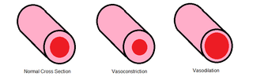

Effects of exercise
Short term
Long term
Make a mind map/list /table of as many different BIOLOGICAL effects of long and short term exercise as you can
Use biological language where possible!
explain the short-term and long-term consequences of exercise on the body, with reference to the respiratory and cardiovascular systems and the structure of skeletal muscle;

Slide 5
Short term effects of exercise
Adrenaline from adrenals
Stimulated by exercise
Stimulates increased HR
Sympathetic nervous system stimulated by adrenaline → increased HR
Vasodilation (muscles release NO) and Starling’s law
  Results in increased CO / systole / diastole

Slide 6
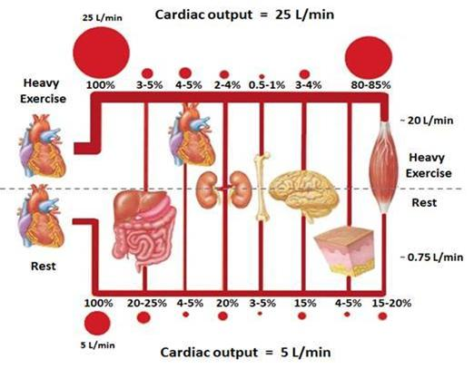
Distribution of blood flow during exercise
Answer the following questions
Describe what happens to blood flow during cardiovascular exercise
What areas of the body receive an increase/decrease in blood flow
Why does this happen?

Slide 7
Distribution of blood flow during exercise
Low O₂ levels activate production of nitric oxide in working muscle cells. This leads to vasodilation of arterioles. Overall effect is to increase CO (greater systole and diastole)
Blood flow increases to working muscle and diverted away from organs.
This occurs to provide oxygen and glucose to working muscle tissue

Slide 8
explain the short-term and long-term consequences of exercise on the body, with reference to the respiratory and cardiovascular systems and the structure of skeletal muscle;

Slide 9
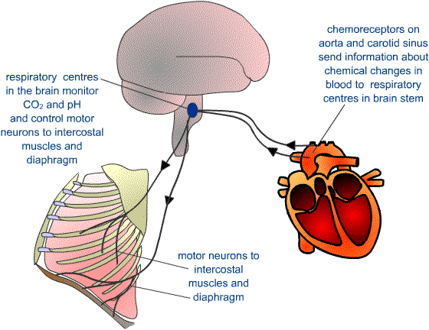
Respiratory system and CV exercise
Answer the following questions
Describe what happens to the respiratory system during cardiovascular exercise
What other areas of the body become involved?
Why does this happen?

Slide 10
Respiratory system and CV exercise
Rate and depth of breathing increases oxygen uptake for aerobic respiration. Simultaneously, carbonic acid is removed from blood as respiration increases CO₂ output
Carbonic acid lowers pH of blood – triggers chemoreceptors in the brain and aortic arch
Increase in overall breathing rate to increase O₂ and decrease CO₂ levels in blood

Slide 11
explain the short-term and long-term consequences of exercise on the body, with reference to the respiratory and cardiovascular systems and the structure of skeletal muscle;

Slide 12
Long term effects of exercise - muscles
Increased size and strength of muscles
Number of slow twitch muscle fibres increase
Number and size of mitochondria increase
Number of capillaries increase
Increase in myoglobin stores

Slide 13
Long term effects of exercise - muscles
Effect of exercise on muscles | Explanation for effect
Increased size and strength of muscles
Number of slow twitch muscle fibres increase
Number and size of mitochondria increase
Number of capillaries increase
Increase in myoglobin stores

Slide 14
Long term effects of exercise – heart and ventilation
VO₂ max increase
CO increase (transport of O₂)
Resting HR decrease
SV increased
Tidal volume increase during exercise (but decrease at rest)
Vital capacity increase during exercise

Slide 15
Long term effects of exercise – heart and ventilation
Effect of exercise on heart and ventilation | Explanation for effect
VO₂ max increase
CO increase (transport of O₂)
Resting HR decrease
SV increased
Tidal volume increase during exercise (but decrease at rest)
Vital capacity increase during exercise

Slide 16
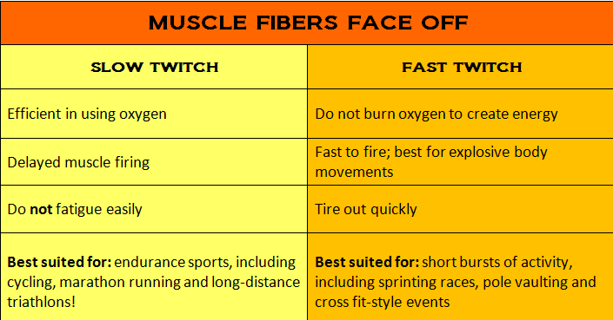
Fast and slow twitch muscle fibres
Which type of muscle fibre would be good at breaking down fats for energy and why?
Which type of fibre relies on ATP for energy? Give a reason for your answer

Slide 17
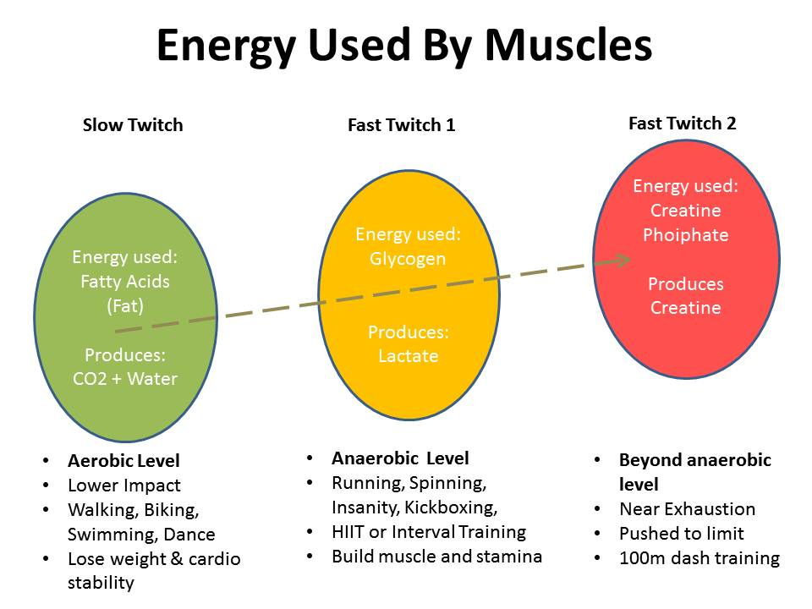
FOG ☺
Creatine phosphate
FG ☹

Slide 18


Effects of exercise
Short term
Long term
Make a mind map/list /table of as many different BIOLOGICAL effects of long and short term exercise as you can
Use biological language where possible!
Add to your list and draw links
explain the short-term and long-term consequences of exercise on the body, with reference to the respiratory and cardiovascular systems and the structure of skeletal muscle;

Slide 19
(b) discuss how much exercise needs to be taken for significant sustained improvement in aerobic fitness;
A long term, sustained training programme that exceeds the bare minimum requirements must be employed for significant improvements in exercise performance.
Government guidelines – what are they?

Slide 20
Questions
How can nitric oxide help people suffering from Angina attacks?
How is breathing rate monitored in the body?
Short twitch muscle fibres tend to be dark red in colour. Why do you think this is?

Slide 21
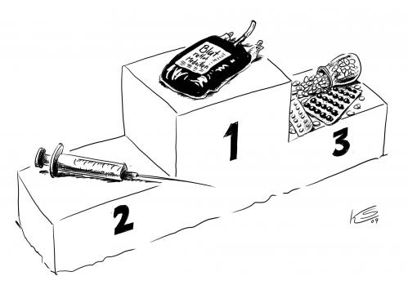
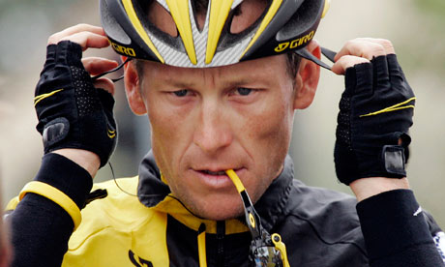
Changing diets to enhance sporting performance

Slide 22
Aims from specification
(c) discuss the benefits of the use of carbohydrate loading diets to improve athletic performance (HSW6a, 7b);
(d) outline alternative methods of enhancing performance, with reference to recombinant erythropoietin (RhEPO), blood doping and use of steroids (HSW6a, 6b, 7c);

Slide 23
Key words
Carbohydrate loading
RhEPO
Blood doping
Glycogenolysis
Steroid enhacement

Slide 24
Carbohydrate loading
Evaluate the benefits of carbohydrate loading in athletes competing in:
100m race
Marathon

Slide 25
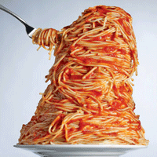
Carbohydrate loading
Answer the following questions:
How are carbohydrates stored in the human body?
Where are these carbohydrates stored?
What chemical reaction breaks this storage molecule down?
What smaller sub units is this storage molecule made of?
What is produced as a result of sub unit breakdown?

Slide 26
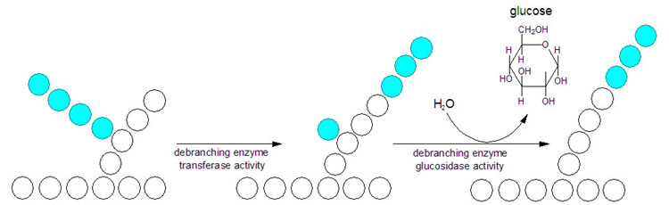
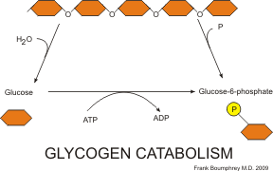

Slide 27
RhEPO and blood doping
What is EPO and blood doping?
Why do athletes use their own blood when doping?
Explain why athletes must remove blood for doping a few months before an event.
What is the medical use of EPO?

Slide 28
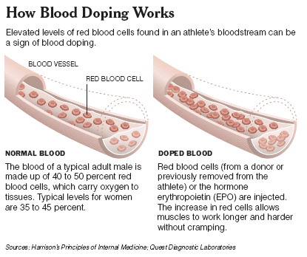

Slide 29
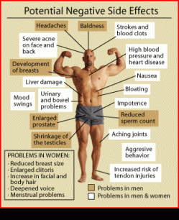
Steroid enhancement
Anabolism – synthesis from smaller molecules
Anabolic steroids – artificially produced steroids
  Structurally and chemically similar
  E.g. nandrolone – acts like sex hormone
  Diffuses through cell membrane and promotes protein synthesis in target cells → competitive, aggressive, train for longer

Slide 30
Steroid question
Describe why steroids are able to pass through cell membranes easily and influence cell synthesis.

