Slide 1

Drugs in Sport

Slide 2
Some people think that athletes who take drugs should be banned from competing for life.
Some people think that athletes should be allowed to take any drugs that they want to.
What do you think?

Slide 3
Sort the WHITE cards into two piles
Yes they can take performance enhancing drugs
No they shouldn’t take performance enhancing drugs

Slide 4
Task one: use the internet to research and complete this table on some of the drugs used in sports.
Type of drug | Effect on performance | Side effects | Sports used in
Stimulants |  |  | Tennis players Footballers
Steroids |  |  | Weight lifters
Diuretics |  |  | Jockeys
EPO |  |  | Cyclists
Beta-blockers |  |  | Snooker players

Slide 5
Task one: use the internet to research and complete this table on some of the drugs used in sports.
Type of drug | Effect on performance | Side effects | Sports used in
Stimulants | Makes athletes feel more alert | Heart failure and addictive | Tennis players Footballers
Steroids | Build muscles, help train harder | Increased aggression and kidney damage | Weight lifters
Diuretics | Removes fluid from the body. Used to hide drug use. | Severe dehydration | Jockeys
EPO | Gives more energy | Stroke, heart problems | Cyclists
Beta-blockers | Keep heart rate low and reduce tremble in hands |  | Snooker players

Slide 6
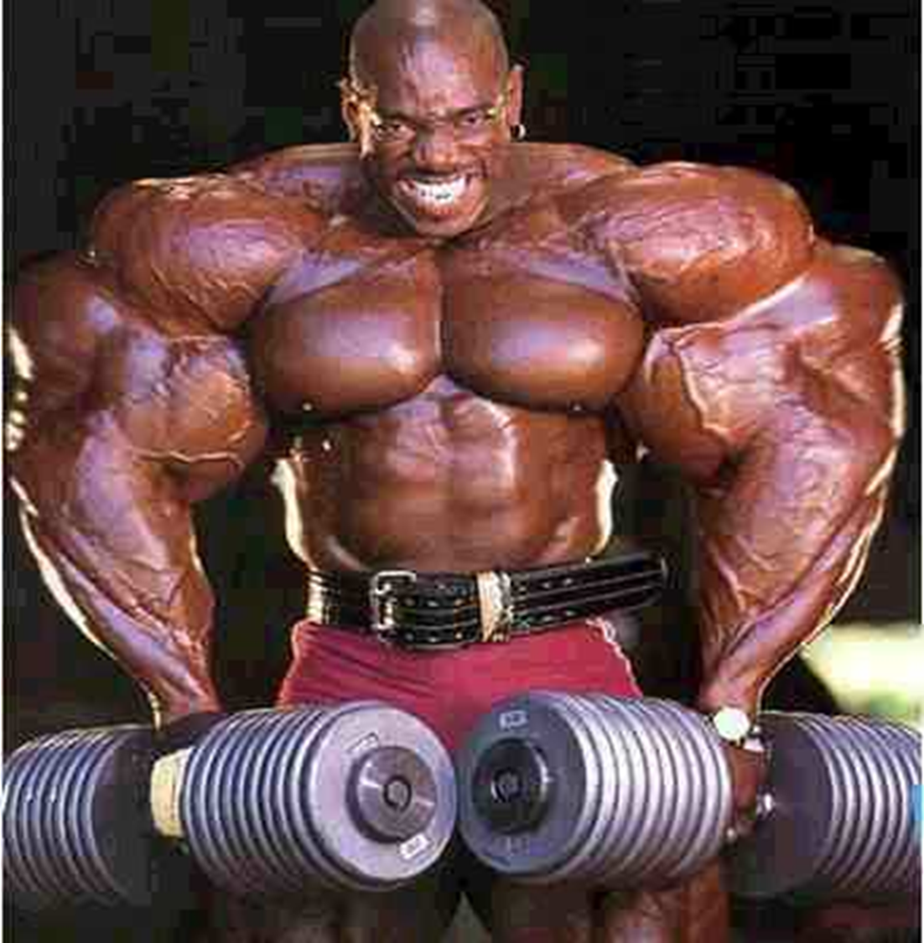
Task two: how guilty?
The next slides give examples of some well-known athletes who have been caught using banned drugs.
You are going to find out about what happened to them.
Use the internet to do research and answer the questions.
You MUST write in your own words; any work that you copy and paste will be thrown away!!!!

Slide 7

How guilty? Lance Armstrong
What type of drugs was Lance Armstrong accused of taking?
What effect would these drugs have had on his performance?
What punishment has been given to Lance Armstrong?
How fair do you think this is? Explain why you think this.
Click here to get started

Slide 8
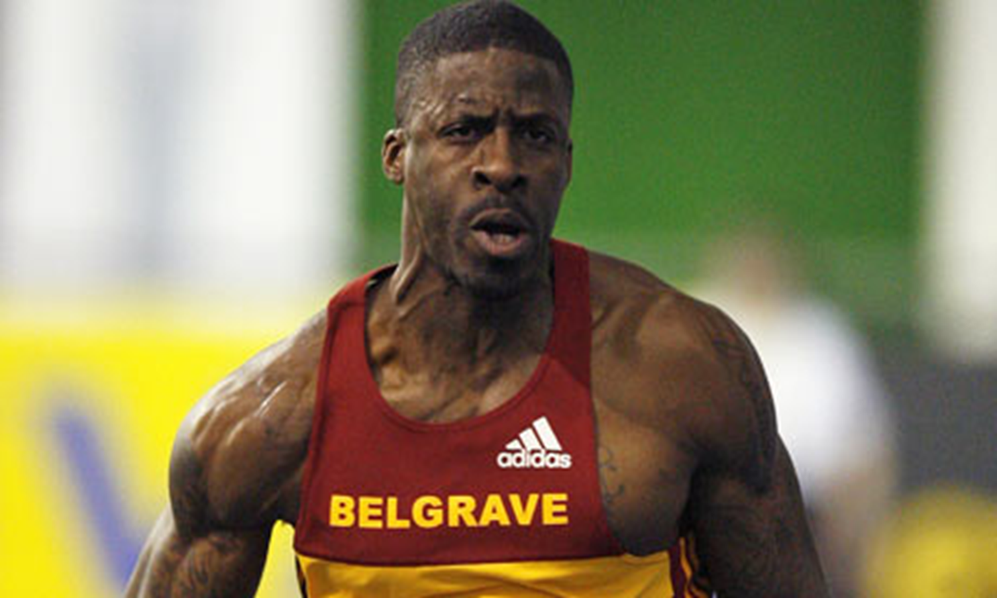
How guilty? Dwain Chambers
What type of drugs was Dwain Chambers accused of taking?
What effect would this drug have had on his performance?
What punishment was given to Dwain Chambers?
How fair do you think this was? Explain why you think this.
Click here to get started.

Slide 9
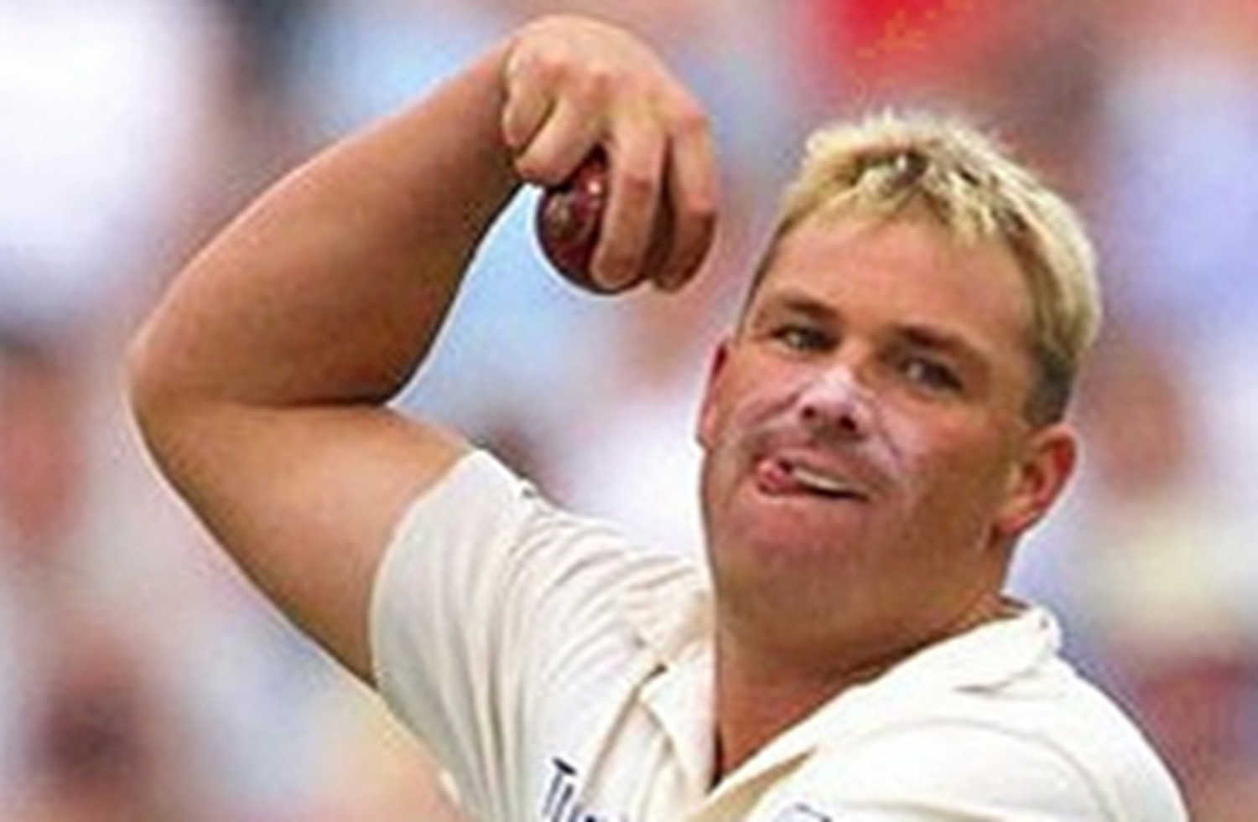
How guilty? Shane Warne
What type of drugs was Shane Warne accused of taking?
What effect would this drug have had on his performance?
What punishment was given to Shane Warne?
How fair do you think this was? Explain why you think this.
Click here to get started.

Slide 10
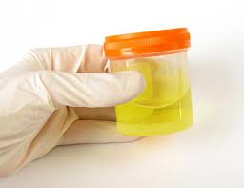
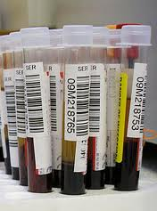
Extension: catching drugs cheats
Use the internet to find out about how scientists try and catch drugs cheats.
What problems do the scientists have?

Slide 11
Title: Drugs in Sport
June 15, 2015
COULD What are the ethical issues
of athletes using banned drugs?
SHOULD What are the health risks of
performance-enhancing drugs in sports?
MUST What are the effects of some
performance-enhancing drugs in sports?

