Slide 1
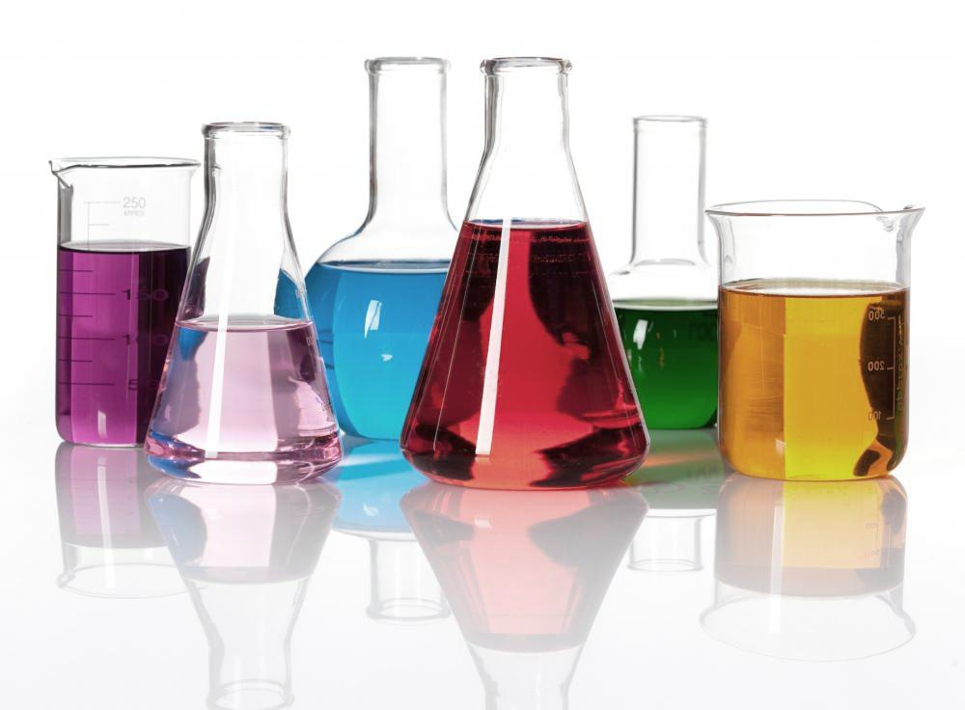
Introduction to chemistry
Year 8 Chemistry

Slide 2
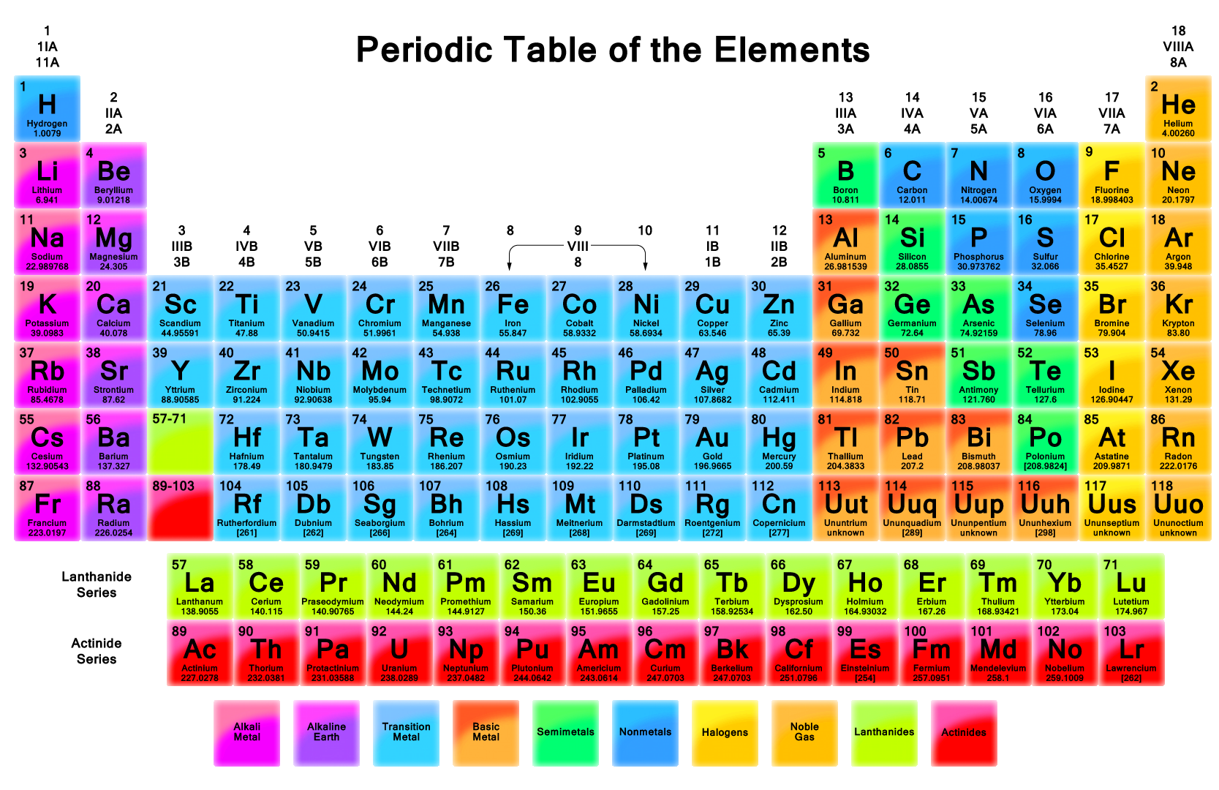
CHEMISTY-YEAR 8 SCIENCE

Slide 3
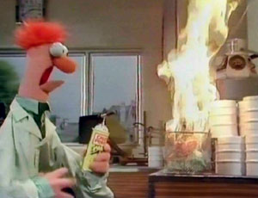
Safety in the lab
Today we are going to explore safety in the lab and why it is so important

Slide 4
Safety in the lab
When we do experiments, what things do we need to keep in mind when thinking about safety?
Know what container labels mean
Demonstrate the safe & responsible use of a range of chemicals in the laboratory
Demonstrate the safe use of a bunsen burner
Demonstrate the safe handling of substances when they are used in experiments e.g. when heating & transferring materials
Safely dispose of common substances, depending on their physical & chemical properties e.g. flammable liquids, broken glass, acids

Slide 5
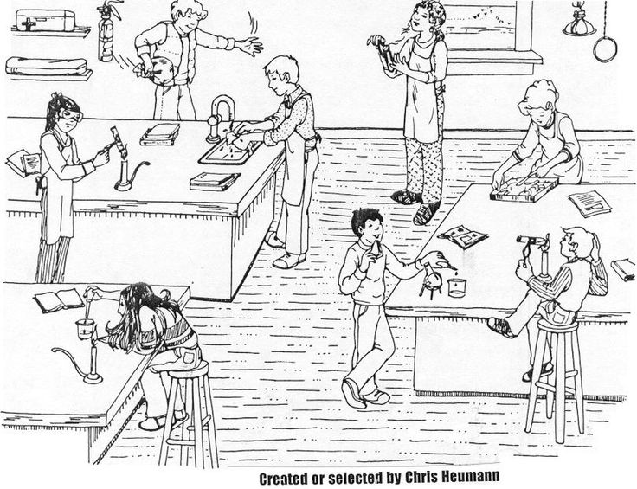
Circle as many hazards as you can

Slide 6





Symbols for Hazardous Substances
What do these hazard symbols mean?
How might these hazards relate to you working in your Science lab?
Collect a hazard worksheet and complete it using information online to help you

Slide 7
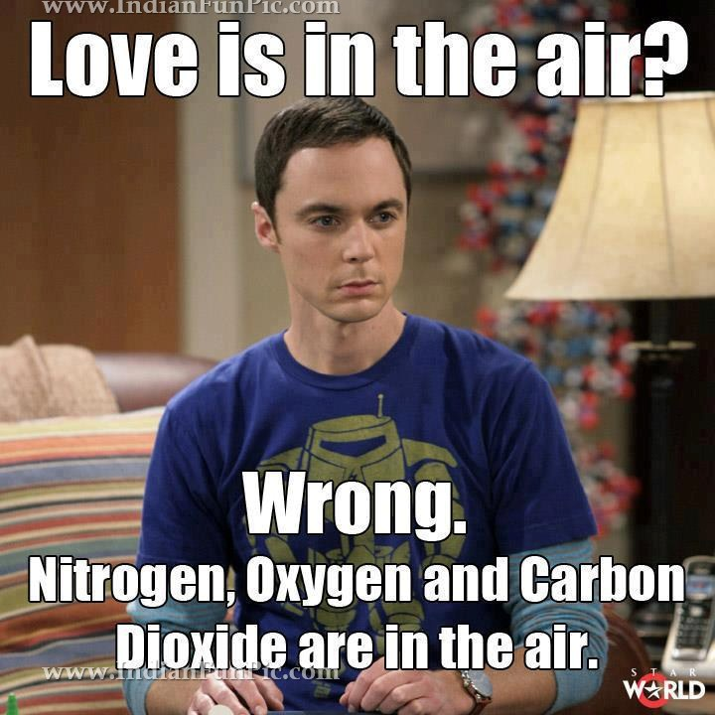
Chemistry
Throughout the term we will look at the science of matter, its chemical reactions, composition, structure and properties.
It is often called the "central science" because it connects physics with other natural sciences like geology and biology.
We will be looking at the
following topics:
Atoms
Elements
Compounds
States of Matter
Phases of Change
Physical Changes
Chemical Changes
Chemical Reactions

Slide 8
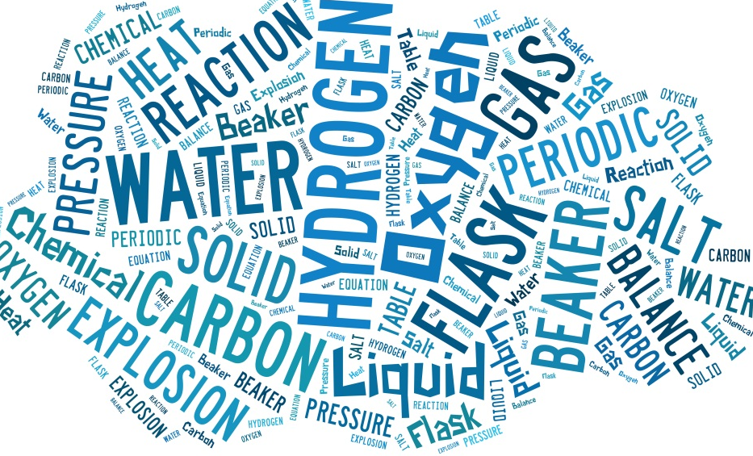
What’s that word?
Your task today is to find the meaning for the following words and put them into a science sentence.
Identify
Assess
Propose
Catalyst
Exothermic reaction
I have given you a sheet that you can complete this task on.

Slide 9
Example
Solution:
  In chemistry, a solution is a homogeneous mixture composed of only one phase.
Science Sentence:
  The solution of magnesium chloride was hidden on the top shelf.

Slide 10

Our friend bill

