Slide 1
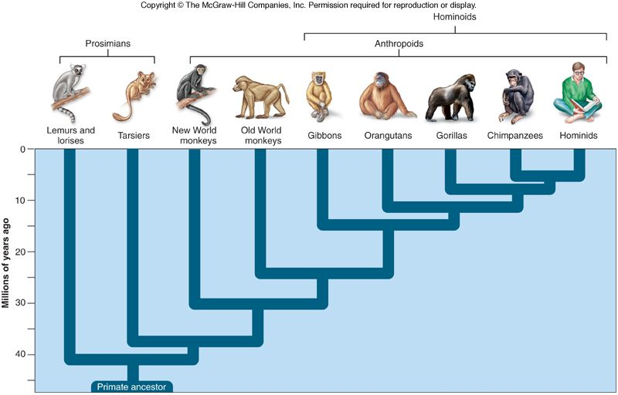
Title: Primate Evolution Thursday, 06 August 2020

Slide 2
Learning Objectives
Outline the taxonomic classification of Homo sapiens
Describe the characteristics and evolutionary trends within the primates
Describe the features that are similar between the members of the great apes
Outline the advantages of bipedalism
Describe the evolutionary changes of the great apes in terms of:
  Relative size of cerebral cortex
  Mobility of the digits
  Locomotion – adaptations to bipedalism and quadrupedalism
  Prognathism and dentition

Slide 3

Key words:
Arboreal
Opposability
Friction
Precision grip
Dental formula
Stereoscopic vision
Convolutions
Gestation

Slide 4
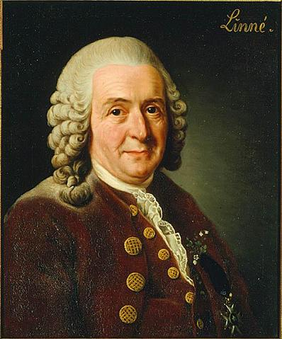
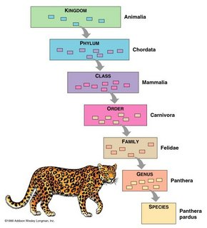
Binomial Nomenclature (FYI only!)
1730s – swedish botanist – Carolus Linnaeus – developed 2-word naming system
In binomial nomenclature, each species is assigned a 2-part scientific name.
Written in italics
First word begins with a capital letter = genus to which organism belongs
  Genus – group of similar species
Second word is lowercased = unique to each species
  Species – group of individuals capable of interbreeding and producing fertile offspring
  Often description of important trait or habitat

Slide 5
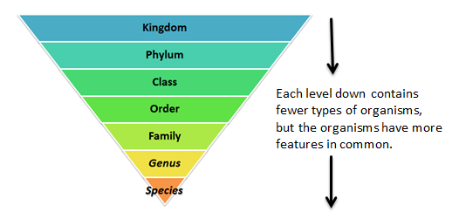

Slide 6
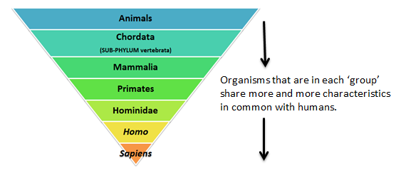

Slide 7
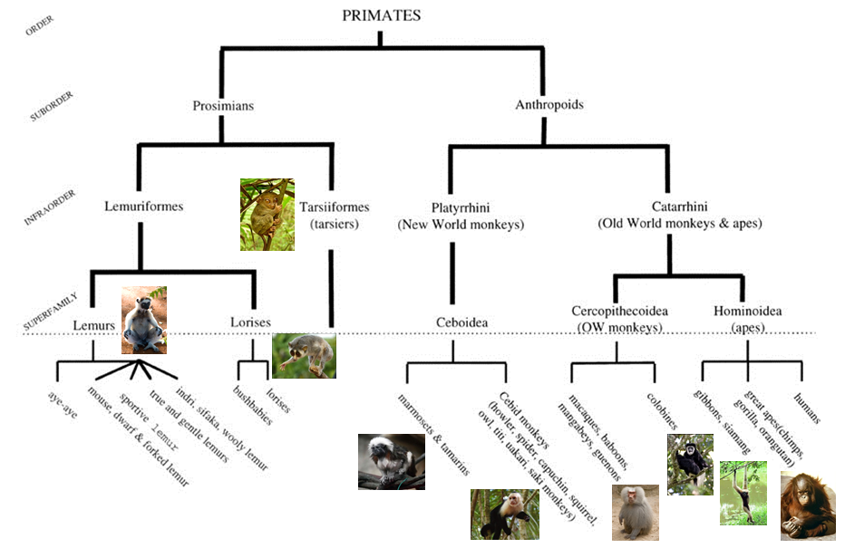

Slide 8
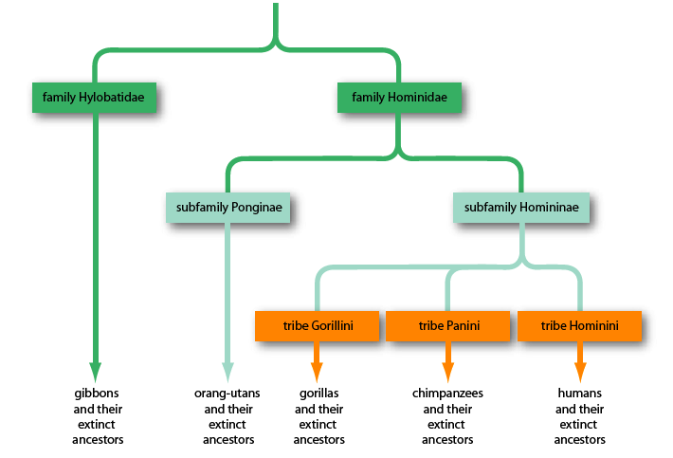
Classification

Slide 9
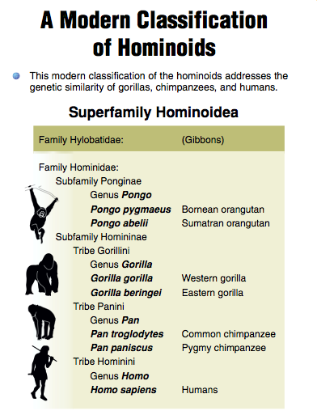

Slide 10
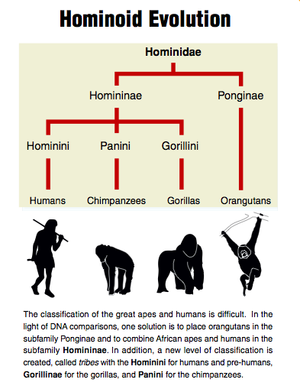

Slide 11
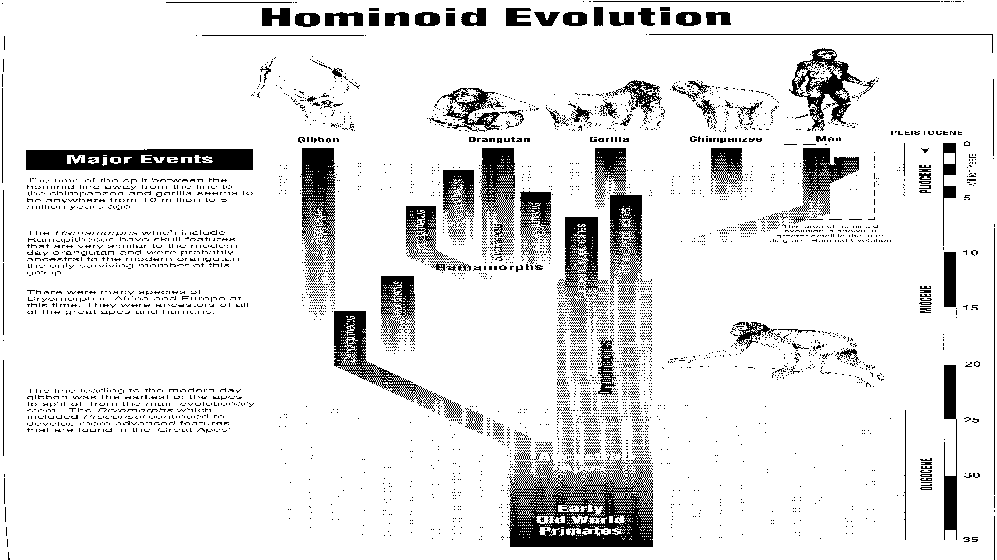

Slide 12
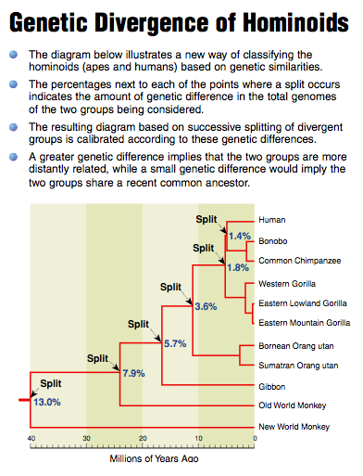

Slide 13
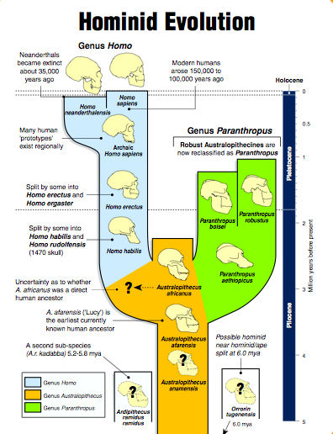

Slide 14
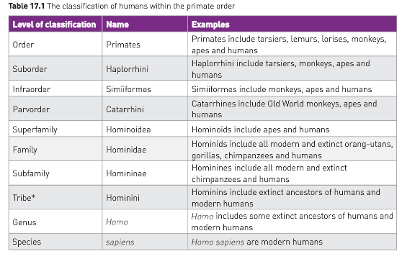
Evolutionary trends within primates
Defining features of primates
  Arboreal (tree-dwelling)
  Grasping fingers and toes
  Overlapping vision
  http://tolweb.org/treehouses/?treehouse_id=3029
https://www.twig-world.com/film/chimps-our-closest-relatives-1131/

Slide 15
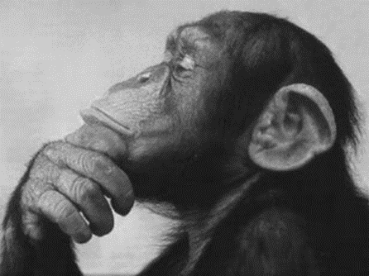
Evolutionary trends within primates
Gradual change in characteristics from lemurs all the way to humans
Series of characteristics and their changes suggest evolutionary trends
  Digits
  Dentition
  Vision
  Cerebral cortex
  Gestation period
https://www.twig-world.com/film/chimps-our-closest-relatives-1131/

Slide 16
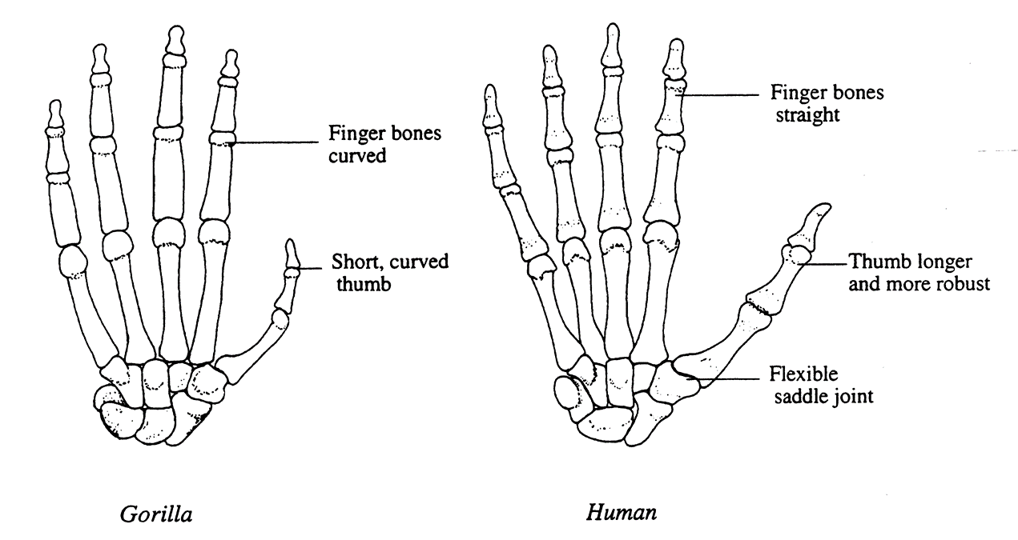
Human Hands
Short
Broad
Long strong more mobile thumb
Very mobile digits
Precision grip

Slide 17
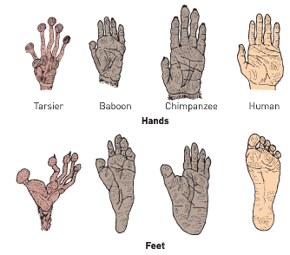
Digits
5 digit hands w/ opposable thumb
No specialization (no flippers, claws, etc.)
Limb flexibility (rotate arms, hands 180 degrees)
Nails rather than claws
Pentadactyl (5 digits on each limb) that are prehensile (grasping) essential for climbing

Slide 18
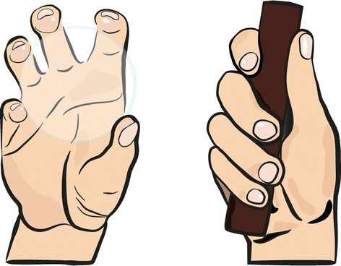
Prehensile and Precision Grips
Prehensile means grasping or gripping by wrapping around an object.
Opposable means that the first digit can be moved so that it can touch all other digits one at a time, and it is also able to wrap around an object in the opposite direction to the fingers.
Opposability is an important factor – thumb can move to touch other digits
  Degree of opposability varies between species and depends on length of first digit compared to other four
  Human degree of opposability has allowed us to manipulate objects with our hands
  Primates demonstrate some opposability with big toe – humans do not have this

Slide 19
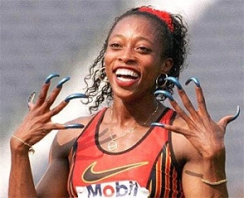
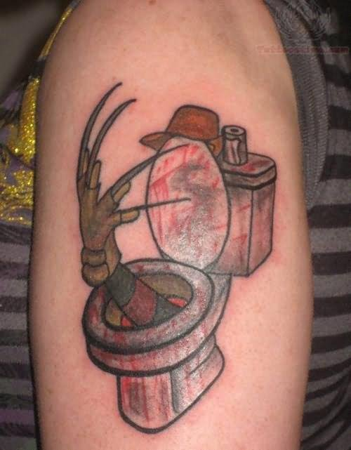
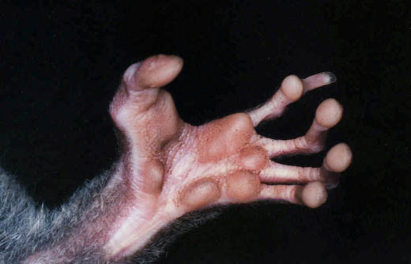
Digits
For secure grip, most primates have evolved nails from claws
  Claws limit grasping
  Greater surface area for opposable surfaces with nails
Sensory receptors are found on the ends of digits for grip and manipulation of objects
Nails and tactile pads developed at the same time
  Pads developed small friction ridges (fingerprints!) to increase grip

Slide 20
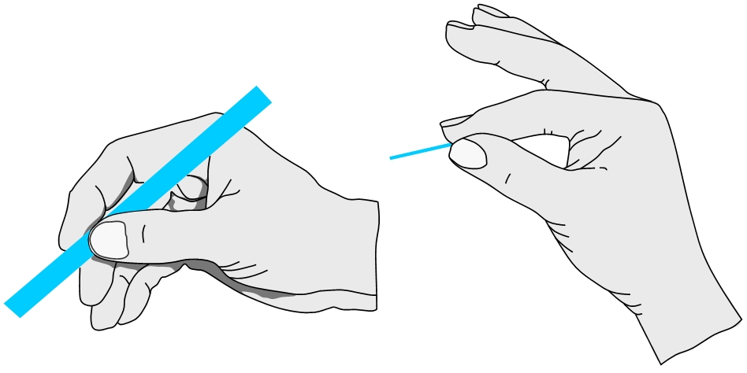
Digits
Humans and Old World Monkeys (baboons, madrills and macaques) have a high level of opposability that allows a precision grip (holding objects between thumb and forefinger)
Allows delicate and precise tasks to be carried out effectively
Complete the task on pages 7-8 of your booklet

Slide 21
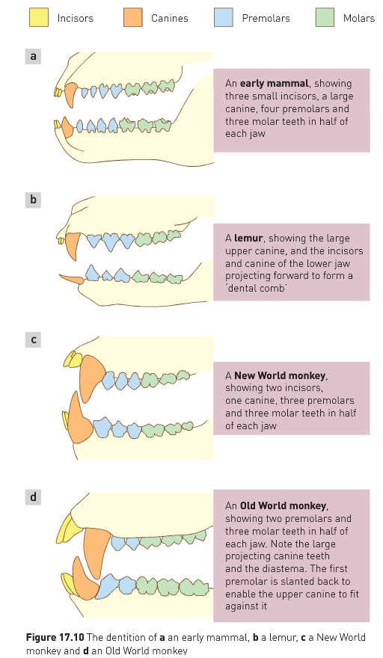
Dentition
Number and structure of teeth have changed with evolution

Slide 22
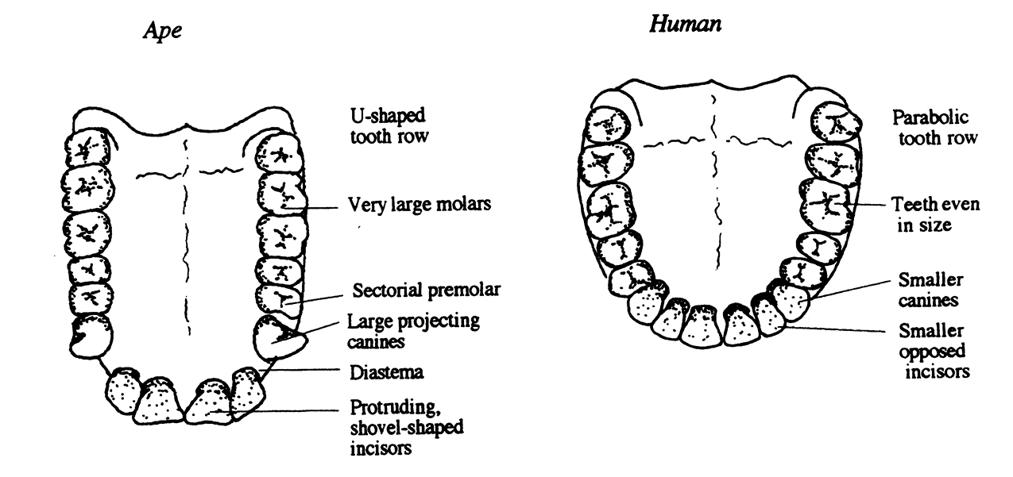
Teeth
Smaller canines
Trend towards smaller teeth generally
Reflecting diet of softer foods more meat
V shape dental arcade rather than U shape

Slide 23
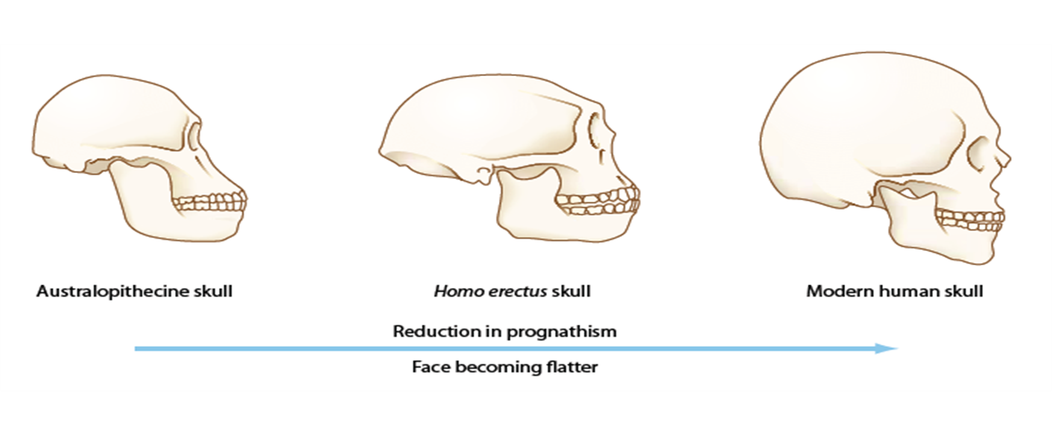
Reduced Prognathism
Smaller jaw
Flatter face
High forehead (frontal lobe)
Chin
Prominent nose

Slide 24
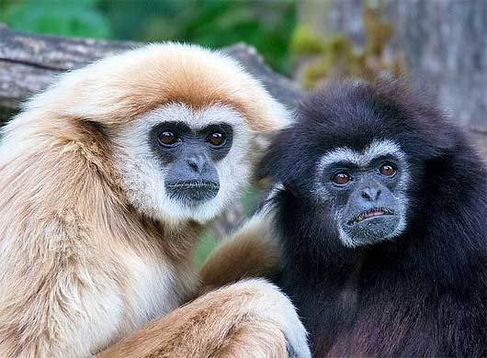
Vision
Living in trees has lead to greater evolution of vision and less emphasis on olfaction (sense of smell)
Area of brain dedicated to vision has increased, as well as other morphology
  eyeballs encased in body socket
  neck that can rotate round to compensate for narrower field of vision
  Increased stereoscopic vision (essential for depth perception)
  Forward-facing eyes
  Increased number of rods AND cones in (most) primate retinas for night and colour vision
  Increased nervous connection between eyes and brain for better vision

Slide 25
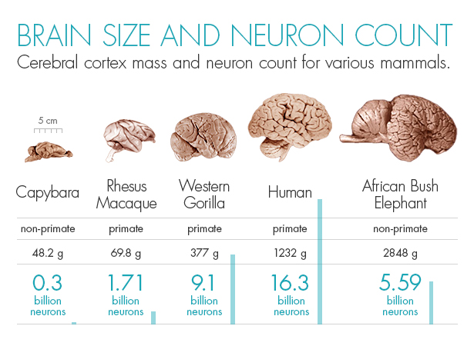

Slide 26
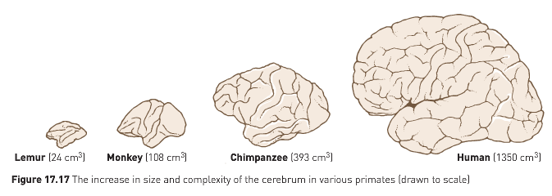
Relative size of cerebral cortex
One of the most significant features in primate evolution
Cerebrum has progressively increased in size, especially the cerebral cortex
  Concerned with higher order functions such as vision, reasoning, memory, manipulative ability

Slide 27
Relative size of cerebral cortex
Natural selection has led primates to develop larger brains
Arboreal environment requires skill, precision and coordination that demands higher order thinking
Cerebral cortex expansion is most notable in humans and apes than in monkeys
Greater convolutions (folds) indicate a larger surface area for neurons
Effects of this can be seen in social activities, hunting, food location and other special skills

Slide 28
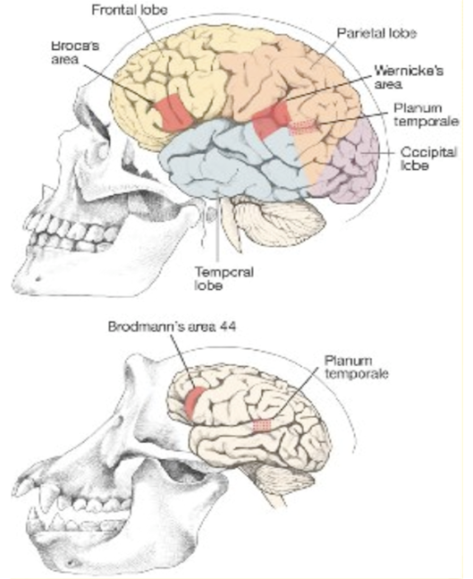
Brain
Large
Greater proportion of cerebrum, cerebral cortex
Increased convolutions
Larger frontal lobe, thinking, reasoning, planning, processing
Evolved after bipedalism

Slide 29
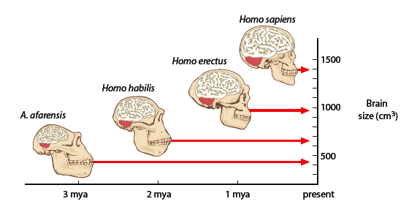

Slide 30
Cranial capacity
The volume of the inside of the cranium
Endocasts of fossil cranium gives us the information about brain size and shape
Examples of cranial capacity:
  Orangutans: 275–500 cc
  Chimpanzees: 275–500 cc
  Gorillas: 340–752 cc
  Humans: 1200–1850 cc
  Neanderthals: 1100–1900 cc

Slide 31
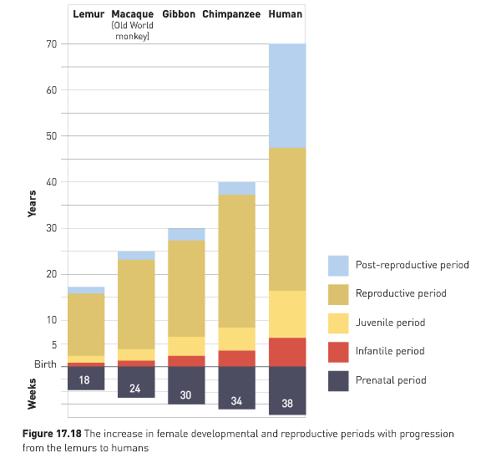
Gestation and parental care
Not restricted to reproductive seasons – rhythmical cycle of fertility
Primates usually only have one offspring at a time – arboreal lifestyle and length of maturation period could be factors
Higher order primates (apes) and humans have a delay in maturation and require more parental care
Sexual maturity is reached much later than in lower primates
  Period of learning is greatly extended as a result

Slide 32
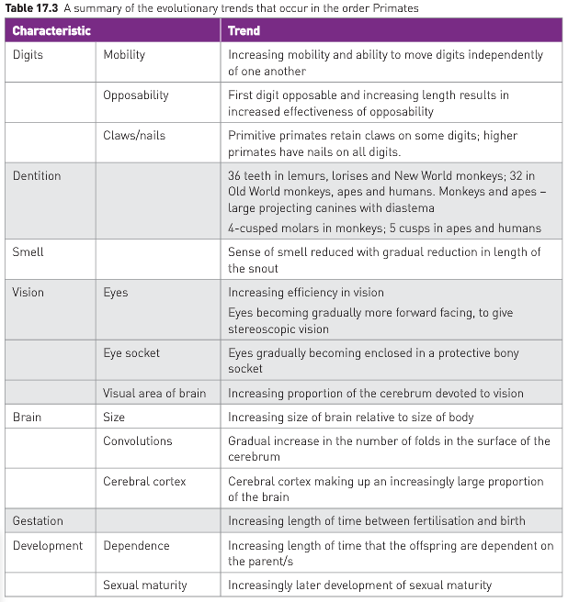
Summary

Slide 33
Feature | Orangutan | Gorilla | Chimpanzee | Humans
Relative size of the cerebral cortex | 275–500 cm³ | 340–752 cm³ | 275–500 cm³ | 1,085–1,581 cm³
Mobility of digits | Good prehensile grip, but lack of opposable thumb means precision grip cannot be achieved |  |  | Opposable thumb leads to higher degree of mobility and more precise actions can be carried out
Prognathism (projection of lower face) | Yes | Yes | Yes | No
Dentition | Jaws narrower than gorilla, but same size teeth, large molars, thinnest enamel, 2.1.2.3 formula | Large jaws and teeth, diastema, large molars, 2.1.2.3 formula | Large jaws and teeth, diastema, 2.1.2.3 formula | Smaller teeth, more than other great apes, no diastema, more enamel, 2.4.4.6 formula
Locomotion | Quadrupedal | Quadrupedal | Quadrupedal | Bipedal

Slide 34

https://www.youtube.com/watch?v=dUKV02uYEu0

