Slide 1
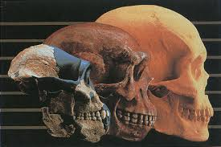
Evolutionary trends in hominids Sunday, 09 August 2020

Slide 2
Learning Objectives
Describe the features that are similar between the members of the great apes
Outline the advantages of bipedalism
Describe the evolutionary changes of the great apes in terms of:
  Relative size of cerebral cortex
  Mobility of the digits
  Locomotion – adaptations to bipedalism and quadrupedalism
  Prognathism and dentition

Slide 3

Key words:
Tribe
Bipedal locomotion
Adaptation
Foramen magnum
Prehensility
Longitudinal arch
Transverse arch
Striding gait

Slide 4
Lesson Aim
Complete pages 23-25 of your booklet, summarising the differences between great apes and humans.
Use the link below (source for some pages in the booklet)
  https://www.pathwayz.org/Tree/Plain/APE+VS.+HOMININ+SKULLS
Your notes from your booklet should be completed
  You MUST know that humans are in the Great Ape category
  You must be able to compare the similarities and differences between humans and other great apes

Slide 5
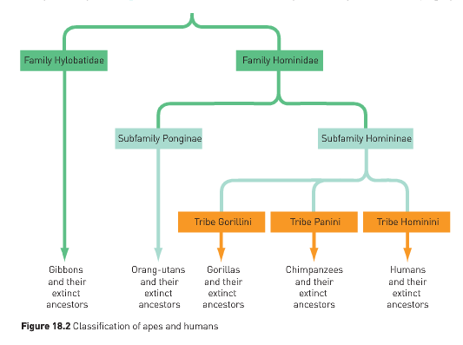
Classification of apes and humans

Slide 6
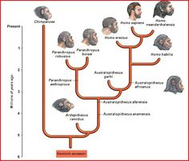
What is a Hominin?
Humans have similar characteristics as Apes and are together they are classified in the family Hominidae.
However humans differ from Apes in their appearance, structure and behaviour.
Humans are classified into their own group known as the Hominins.

Slide 7
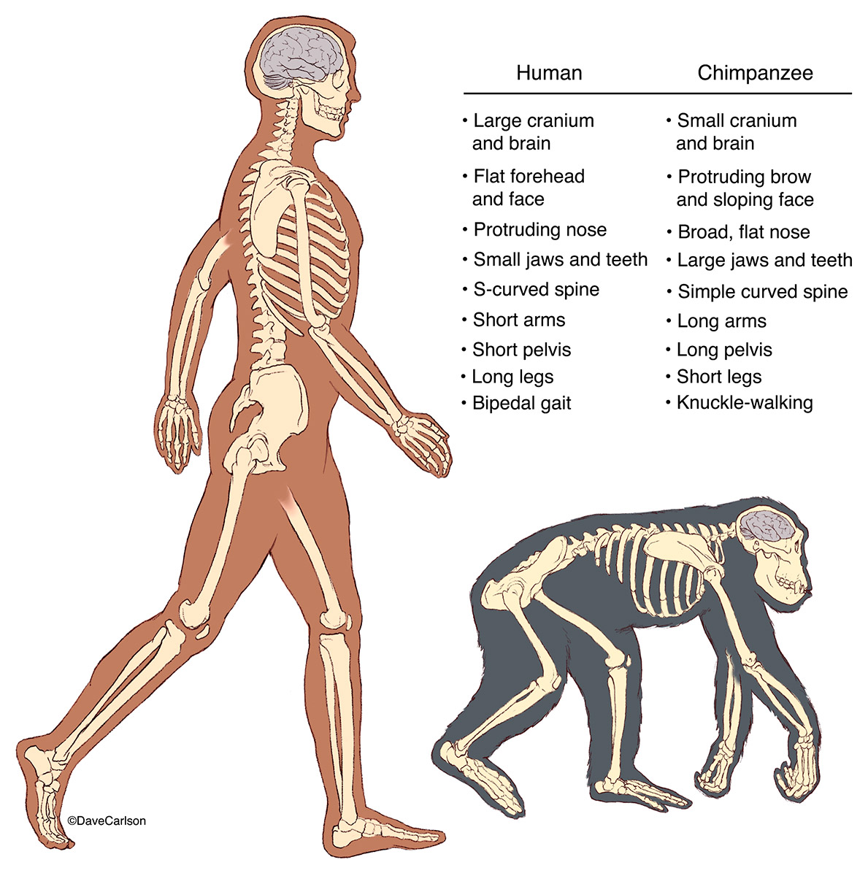

Slide 8
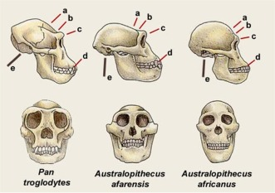
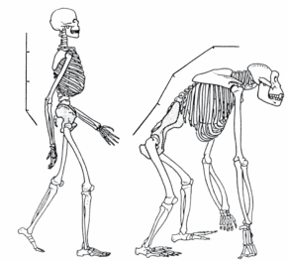
Adaptations for an erect posture
Position of the foramen magnum
  Where the brain joins the spinal cord is a hole called the foramen magnum
  Erect posture in humans and apes has meant that it has moved to the base of the skull
  Quadrupeds have the hole at the back of the skull

Slide 9
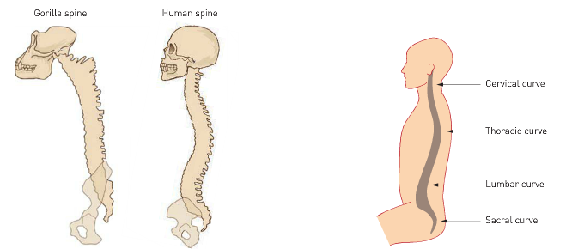
Curvature of the spinal column
Humans have a double curvature of the spine, forming an S-shape that helps with bipedalism
Lumbar curvature (lower part of spine) aids balance and allows head to balance on top of neck
Cervical curve in neck brings vertebral column under centre of gravity of the skull

Slide 10
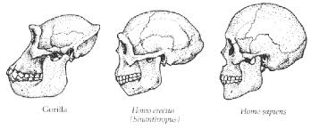
The jaw
Human facial profile is much flatter than apes
Evolution has led to the size and position of the jaw to gradually reduce
Weight distribution on the front and back of the skull means the foramen magnum is balanced without the need for large supporting muscles

Slide 11
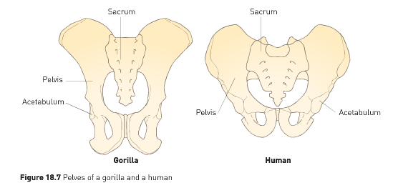
The pelvis
Human pelvis is broader and shorter than that of apes
Bowl-shaped pelvis supports abdominal organs when standing upright
In females, it supports the developing foetus during pregnancy (female pelvis tends to be broader than in males)
Broad hip bones allow attachment of large buttock muscles for leg movement and keeping upper body erect

Slide 12
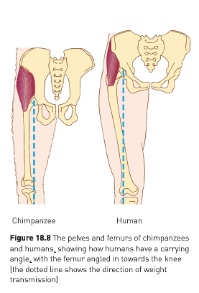
The carrying angle
Hip sockets in humans are wide apart, but the femur (thigh bone) converges towards the knee
Leads to the carrying angle which ensures weight distribution is towards the central axis of the body
Creates greater stability and a striding gait, rather than a swaying one, as seen in apes
Weight transmission falls to the outside of the femur in humans, compared to the inside in chimps

Slide 13
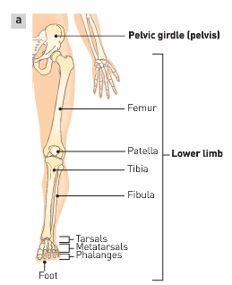
The knee
Knee joint has two hinges – inner and outer – with ligaments in the middle
Outer hinge is larger as weight is transmitted down the outside of the femur
Ligaments supporting knee joint stop forces bending knee backwards
Natural resistance in the knee means no energy is required to support the body in standing positions

Slide 14
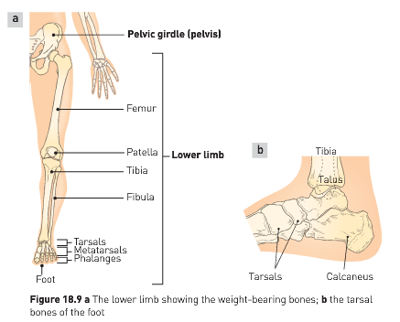
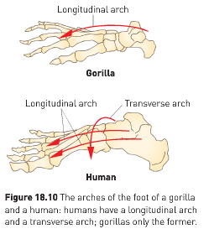
The foot
Transverse and longitudinal arches make the human foot unique and perfect for bipedal locomotion
Bones of foot between toes and ankle – the metatarsals – are shaped in such a way that they form the two arches
Humans walk using a striding gait, where the hip and knee are fully extended

Slide 15
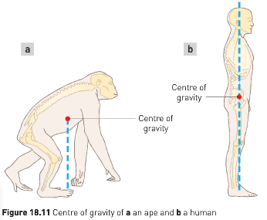
Centre of gravity
Centre of gravity is lower in humans than in apes – contributes to stability when walking upright or standing erect
Human legs are (usually!) longer than arms which help to lower the centre of gravity

Slide 16
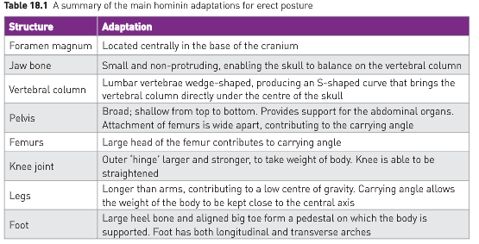

Slide 17


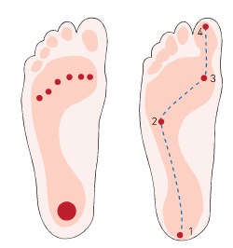
Stance and locomotion
Muscle tone is essential for walking upright
Partial contraction of skeletal muscles helps to keep head erect and support the body in an upright position
Body weight distribution through feet has evolved for bipedalism
Swinging arms keeps shoulders at right angles to direction of movement and reduces energy expended

Slide 18
Relative size of cerebral cortex
Increase in cerebrum size due to development of cerebral cortex
Lead to greater convolutions in the brain, which increased brain surface area (up to 50% compared with no convolutions)
Larger brains required larger craniums to house them
Lead to brown becoming more vertical and a shortening of the snout
Increase in brain size is an evolutionary trend in hominins – known by measuring cranial capacity

Slide 19
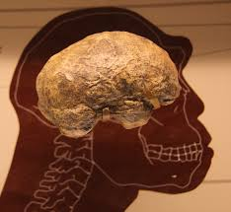
Relative size of cerebral cortex
Endocasts have determined the size and shape of the brain. These are impressions made from inside the skulls
Endocasts may occur naturally, or made using skulls that are found
Endocasts of Australopithecines indicate brain size was similar t that of an ape, but foramen magnum was more forward, indicating bipedialism
Sometimes only skull fragments are found, so determining brain size can only be estimated

Slide 20
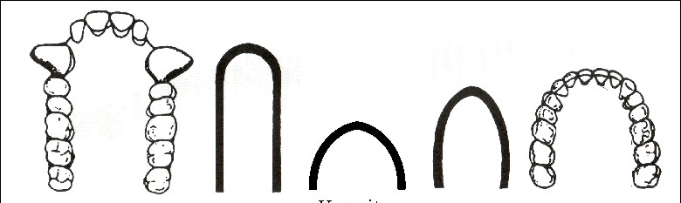
Dentition
Dental arcade is the shape of the tooth row.
This has changed from a more U-shape seen in apes to a parabolic shape in humans.

Slide 21

Dentition
Change in shape is associated with a reduction in the size of canines, no need for diastema.
Molars and pre-molars have become smaller.

Slide 22
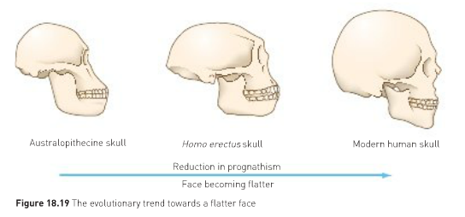
Prognathism
Prognathism refers to a protruding or jutting jaw.
As teeth size reduced, the face became flatter, a chin was developed, and a more prominent nose.

Slide 23
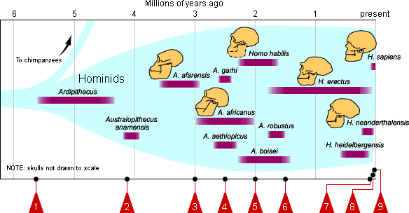

Slide 24

What was this first human like?

