Slide 1
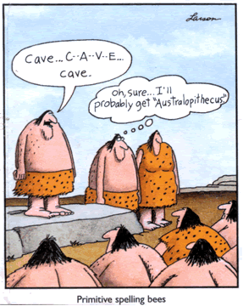
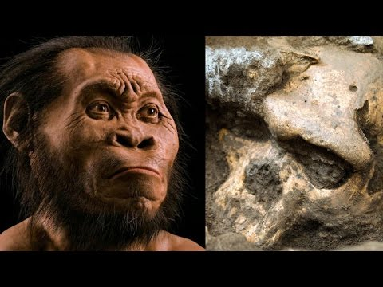
Human Ancestors Thursday, 13 August 2020
Learning question: What were early humans like?

Slide 2
Learning Objectives
Describe how evidence from comparisons of modern humans and the great apes with fossils determines relatedness and possible evolutionary pathways by looking at the following fossils:
  Australopithecus afarensis
  Australopithecus africanus
  Paranthropus robustus
  Homo habilis determining relatedness and possible evolutionary pathways for hominins uses
  Homo erectus
  Homo neanderthalensis
  Homo sapiens

Slide 3
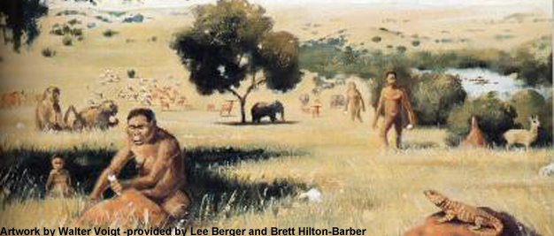
Environment and hominin evolution
Woodland/forest environment meant early hominins were ape-like with arms and hands that retained features suited to tree dwelling e.g. modern orang-utans
Arboreal hominins developed bipedalism for travelling across open ground through natural selection

Slide 4
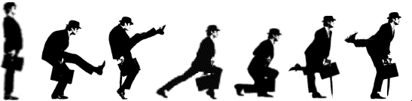
Advantages of bipedalism
Can see over tall grass
Reduces absorption of sun’s heat
More efficient dissipation of excess body heat
Can walk and run greater distances because longer strides expend less energy
Frees hands to specialize in carrying and manipulating objects such as tools and food
Early thinking was that bipedalism probably evolved in the savannah as the forest receded.
Recent evidence indicates that bipedalism may have originated in the forest rather than the savanna [still argued].

Slide 5
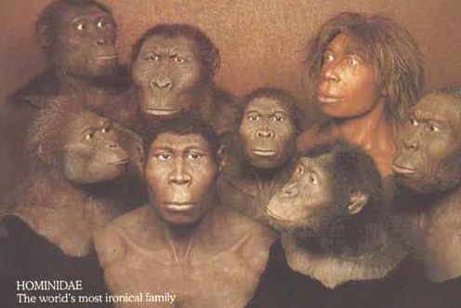
Human Evolution - the short version
Many hominin species are known.
Form a very bushy family tree, not just a linear sequence
Spans almost 7 million years of human evolution
Most found in Africa

Slide 6
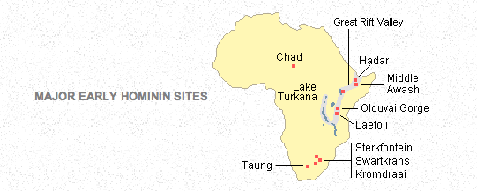
Early Hominin sites

Slide 7
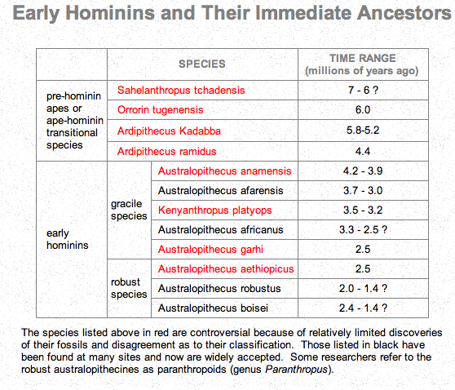

Slide 8
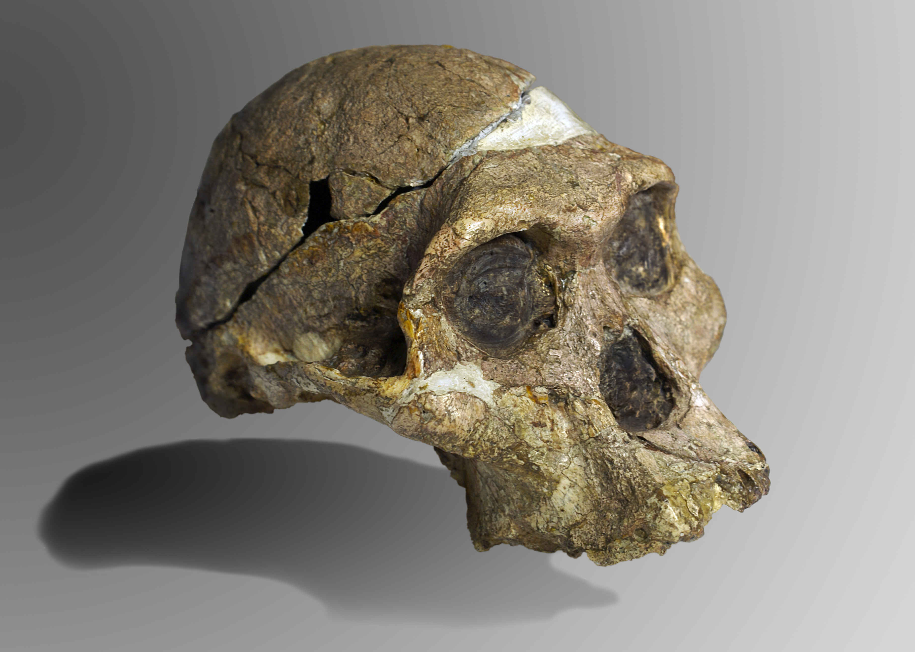
Australopithecines
First fossil found in 1920s – initially believed to be that of a young gorilla, but several anatomical features dispelled this:
  Position of foramen magnum was shifted forward
  Dental arcade and jaw position
Australopithecus Africanus: ‘the southern ape of Africa’

Slide 9
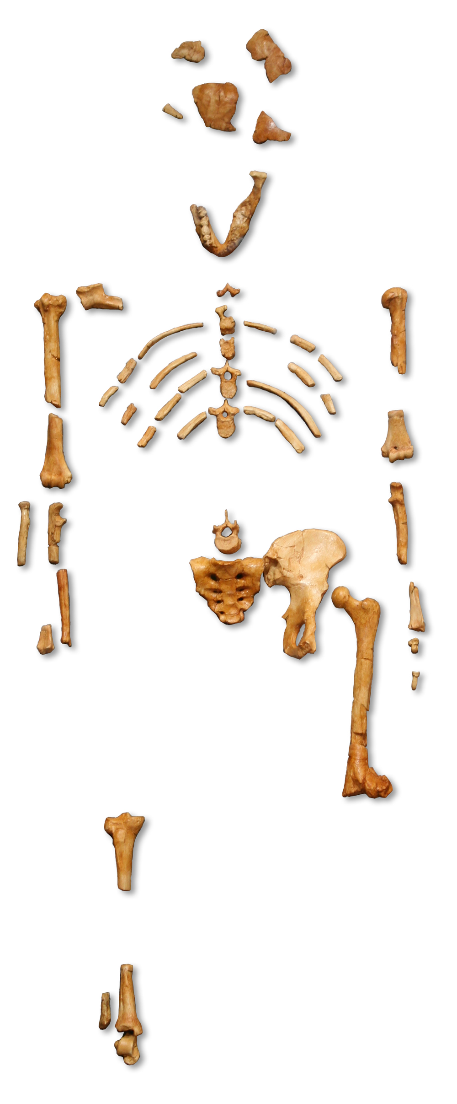
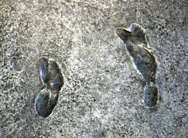
Australopithecines
More fossil remains found, including ‘Lucy’, thought to below to a species that was alive 3-3.6 MYA
Laetoli footprints are further evidence of early hominin in the same time period that exhibited bipedalism:
  heel hitting the round first
  lateral transmission of weight from heel to ball of foot
  Well developed longitudinal arch
  Big toe parallel to other digits
  Deep impression where big toe pushes off for next stride

Slide 10
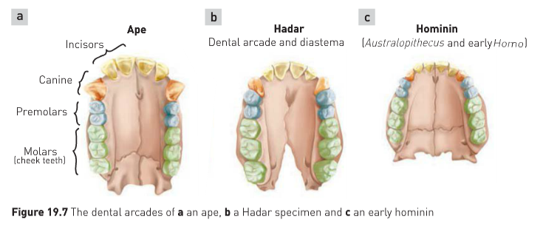
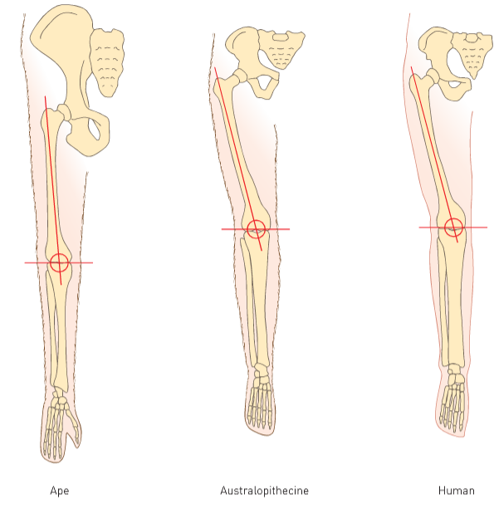
Australopithecines
http://humanorigins.si.edu/evidence/human-fossils/species/australopithecus-afarensis
Lucy was deemed to be Australopithecus afarensis based on evidence, comparing dental arcades of apes and early hominins
Early hominins were truly bipedal, although gait may have been slightly different
Cusps on cheek teeth – intermediate between apes and hominin
First premolar – ape-like
Large flat cheek teeth - hominin

Slide 11
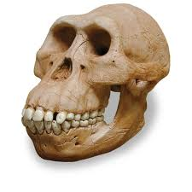
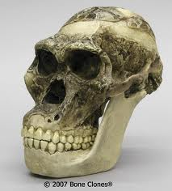
Australopithecus afarensis vs. africanus

Slide 12
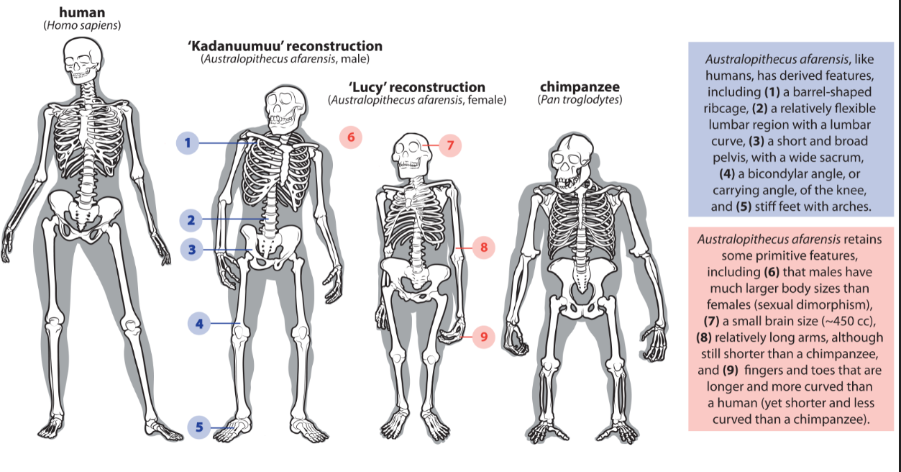

Slide 13
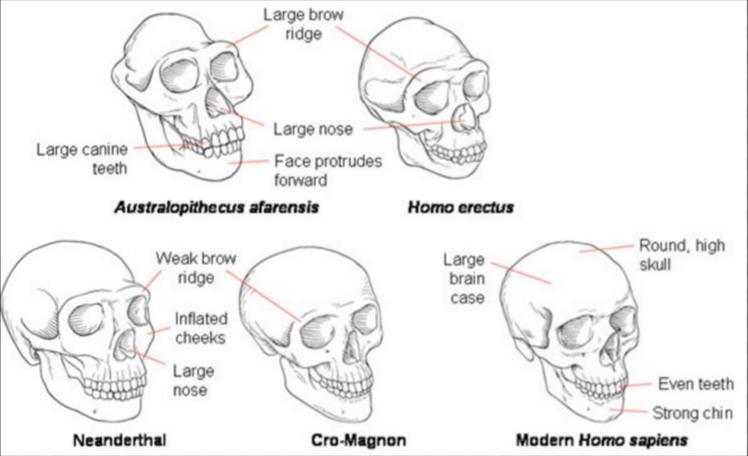

Slide 14
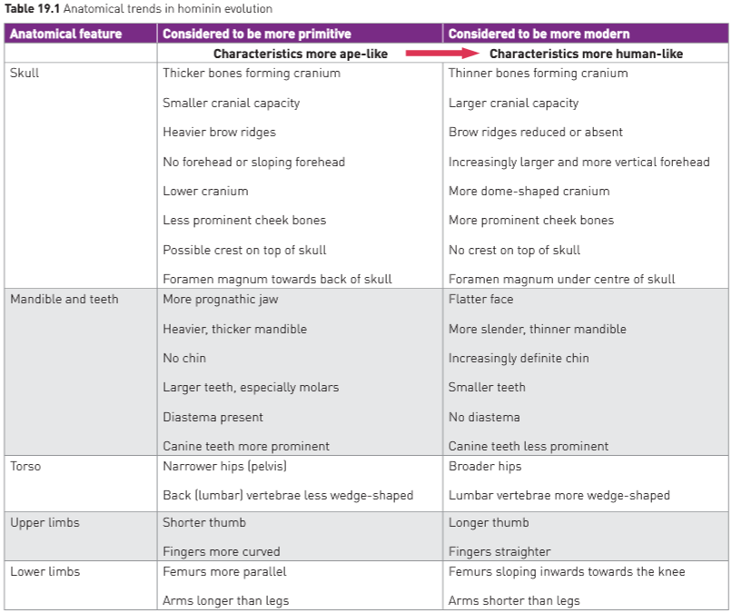

Slide 15
Australopithecines
Gracile
120-140cm and 25-35kgs
Teeth more in proportion to each other and jaw muscles were smaller
Robust
(now classified as a separate genus – Paranthropus)
(150-170cm) 30 cm taller than Gracile
40kgs heavier
Large, broad molar teeth and small incisors and canines.
Powerful chewing muscles – skull had bony crests and buttresses for attachment

Slide 16
Trends in Hominids
Use these links to find out about the different hominids and complete your table.
  Australopithecus aferensis human-fossils/species/australopithecus-afarensis
  Australopithecus africanus http://humanorigins.si.edu/evidence/human-fossils/species/australopithecus-africanus
  Paranthropus robustus http://humanorigins.si.edu/evidence/human-fossils/species/paranthropus-robustus
  Homo habilis http://humanorigins.si.edu/evidence/human-fossils/species/homo-habilis
  Homo erectus http://humanorigins.si.edu/evidence/human-fossils/species/homo-erectus
  Homo neanderthalensis http://humanorigins.si.edu/evidence/human-fossils/species/homo-neanderthalensis
  Homo sapiens http://humanorigins.si.edu/evidence/human-fossils/species/homo-sapiens

Slide 17
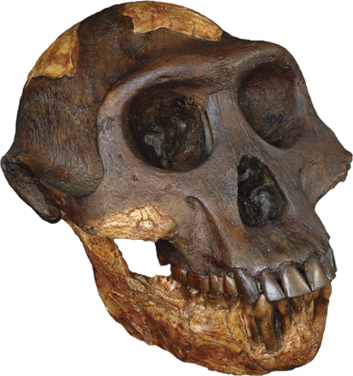
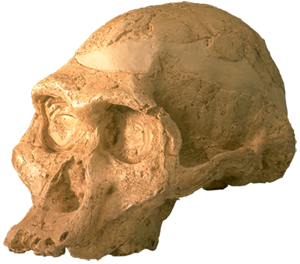
The Australopithecines
A. afarensis
A. africanus
Photos courtesy of: SkullsUnlimited.com

Slide 18
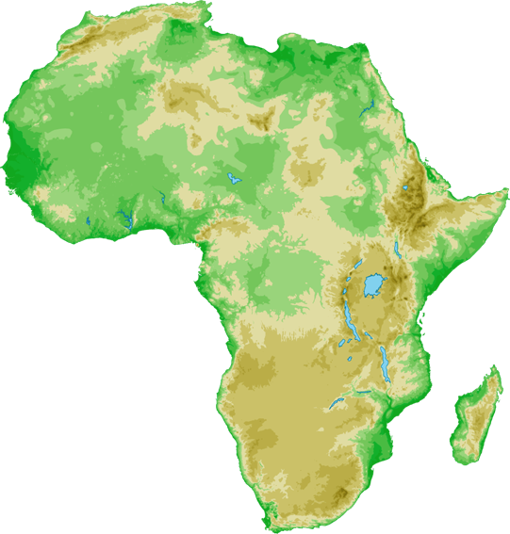
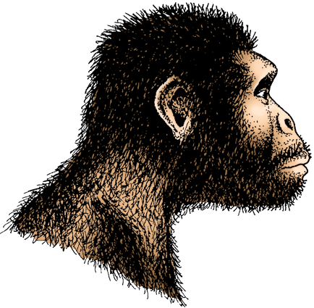
Australopithecus afarensis
Lucy, the First Family, and the Laetoli footprints are assigned to A. afarensis.
  Small, gracile, small-brained biped. Brain volume estimated at between 375-550 cc, but generally <500 cc. Lived 3.9-2.5 MYA.
  The skull is similar to that of a chimpanzee, except for more human-like teeth.
  The human-like pelvis and leg bones confirm they were bipedal.
  Height ranges from 1.0 to 1.5 m (sexual dimorphism*).
* Some researchers claim such differences in height suggest two separate species, not sexual dimorphism.

Slide 19
Australopithecus afarensis
Other name | ‘Lucy’, ‘First Family’
Known date | 3.9 – 2.5 million years ago
Brain size | 400– 500 cc but generally <500 cc
Height | 1.10 – 1.50 m
Physique | Light build. Some apelike features: relatively long arms, long curved fingers and toes, shorter less mobile thumb,
Skull shape | Apelike face, low forehead, bony brow ridge, flat nose, no chin, foramen magnum not quite central
Teeth and jaws | Human-like teeth, canines smaller than apes, larger than humans. Jaw shape is halfway between that of an ape and a human. Diastema often present. Prognathic Large, thickly enameled molars
Geographical distribution | Eastern Africa
Culture | Scavenging and foraging
Photos courtesy of: SkullsUnlimited.com

Slide 20
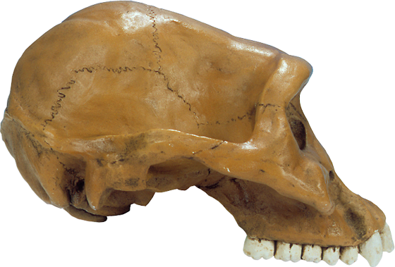
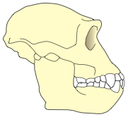
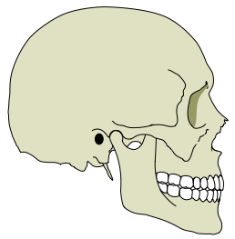
Australopithecus afarensis
Sagittal crest in males
Small brain
400-500 cc
Low forehead
Foramen magnum not quite central
Brow ridge
Large, dish-
shaped face
Wide midface
Flat nose
Big, ape-like incisor
Little of the skull is behind the foramen magnum
Prognathic
Diastema (gap)
Large, thickly
enameled molars
Canines larger
than in humans
A modern human skull
(for comparison)

Slide 21
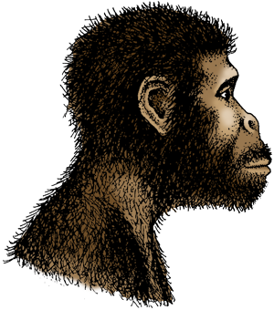
Australopithecus africanus
A. africanus existed between 3.9 and 3.0 MYA.
Similar to afarensis, it was also small, gracile, and bipedal.
Brain size may have been slightly larger of average, ranging from 420 to 500 cc.
Generally considered to be specific to South Africa.
Differs from the early australopithecines in east Africa by having larger back teeth and smaller canines. The jaw shape is fully human-like.

Slide 22
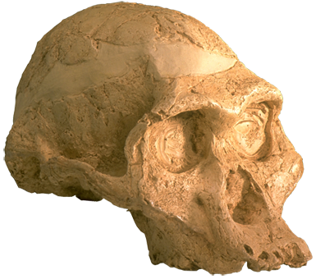
Australopithecus africanus
Other name | None
Known date | ~3.0 - 2.3 million years ago
Brain size | 420 – 500 cc
Height | 1.1 – 1.4 m
Physique | Light build. Some apelike features: relatively long arms, long curved fingers and toes, shorter less mobile thumb,
Skull shape | Apelike face, low forehead (not quite as low as africanus), bony brow ridge (but less prominent), flat nose, no chin, foramen magnum not quite central higher forehead and shorter face.
Teeth and jaws | Human-like teeth, canines smaller than apes, larger than humans. Jaw shape is half way between that of an ape and a human Prognathic Large, thickly enameled molars
Geographical distribution | Southern Africa
Culture | Scavenging and foraging

Slide 23
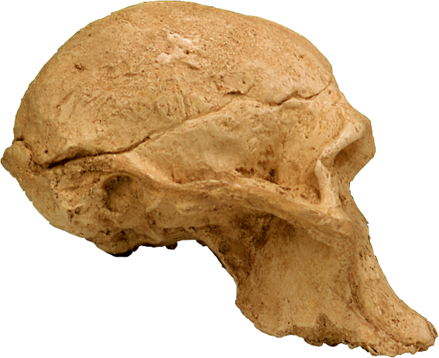
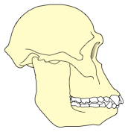
Australopithecus africanus
Small brain
420-500 cc slighter larger than
afarensis
Foramen magnum not quite central
No sagittal crest
Brow ridge-less prominant
Low facial angle
Decrease zygomatic arches
Lower face
protrudes forward
into a snout
(prognathism)
Very large molars compared with modern humans (not shown here)
A Modern Human Skull
(for comparison)

Slide 24
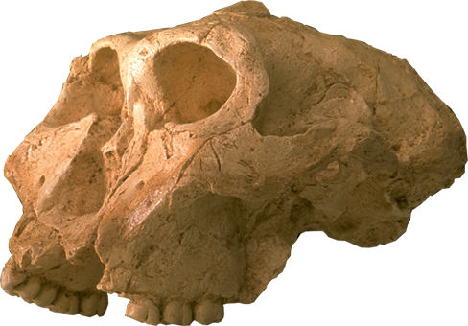
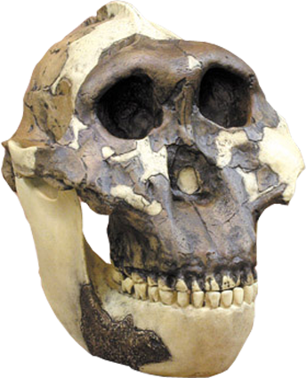
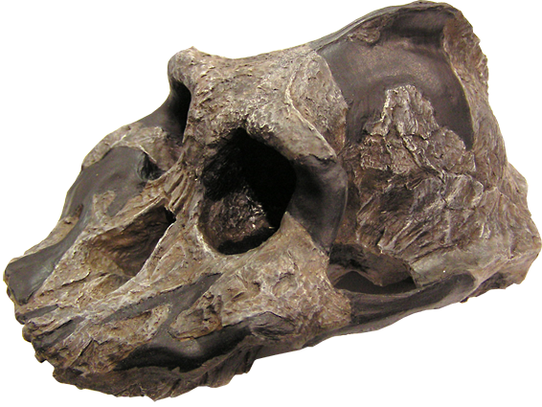
Genus Paranthropus
P. robustus
P. boisei
P. aethiopicus
Photo courtesy of: SkullsUnlimited.com

Slide 25
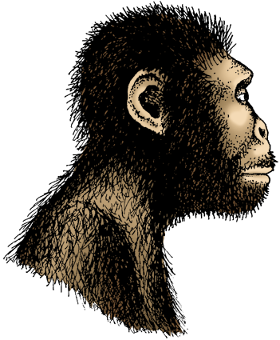
Paranthropus robustus
Existed between 2.0 and 1.5 MYA
Had a similar body to that of
A. africanus, but a larger and more robust skull and teeth.
The massive face was flat or dished, with large brow ridges
and no forehead.
Massive grinding teeth set in a large jaw suggest that it probably fed on a diet of tough, coarse plant food that needed a lot of chewing.
May have used bones as digging tools.

Slide 26
Paranthropus robustus
Other name | Australopithecus robustus
Known date | 2.2 - 1.5 million years ago
Brain size | 530 cc
Height | 1.1 - 1.3 m
Physique | Heavy build. Relatively long arms.
Skull shape | Sagittal crest Heavy brow ridge Low forehead Central foramen magnum Large zygomatic arch
Teeth and jaws | Jaw b/w U & parabolic Very thick massive jaws small incisors and canines; very large molars prognathic
Geographical distribution | Southern Africa
Culture

Slide 27
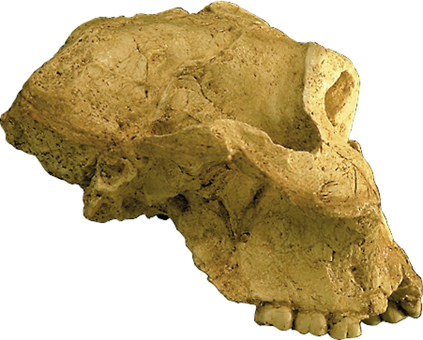
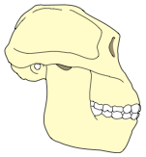
Paranthropus robustus
Very prominent sagittal crest for the attachment of powerful jaw muscles
Low / flat forehead
Small brain
(530 cc)
Heavy brow ridge
Part of the rear
and top of this
skull is missing
Low facial angle
Massive jaw
Massive
zygomatic arch
and cheek bones
Little of the skull is behind the foramen magnum
Small incisors (missing in this specimen)
Central foramen magnum
Massive molars have thick enamel and are well worn, suggesting a tough vegetarian diet
A modern human skull(for comparison)

Slide 28
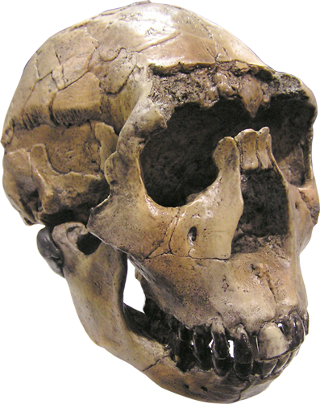
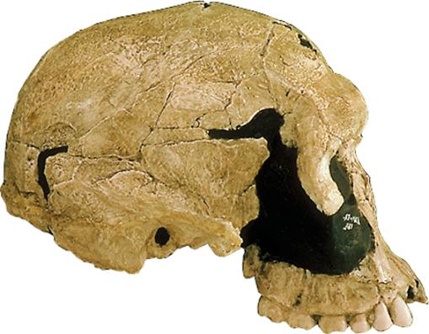
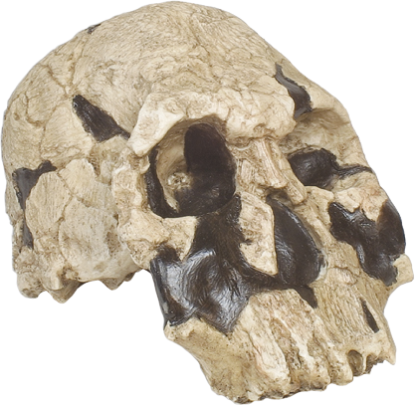
Once We Were Not Alone
There is good fossil evidence that four kinds of hominin lived about 1.8 MYA in what is now part of northern Kenya.
They foraged in the same area around Lake Turkana.
We have no idea how, or if, these different species interacted.
P. boisei
H. habilis
H. rudolfensis
H. ergaster
Photos courtesy of: SkullsUnlimited.com

Slide 29
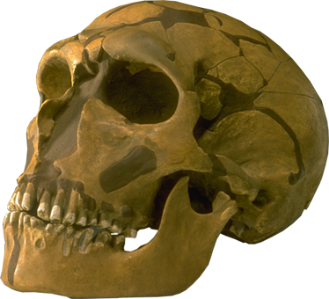
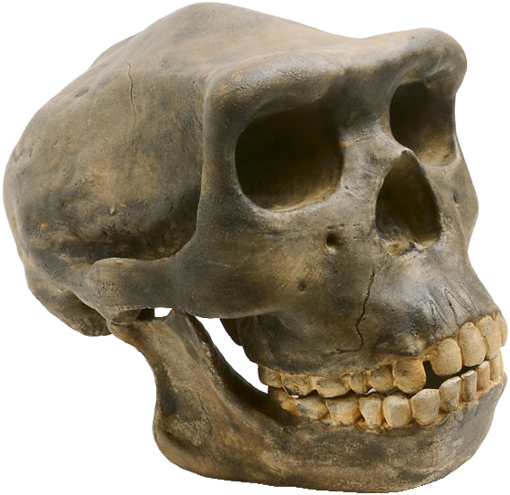
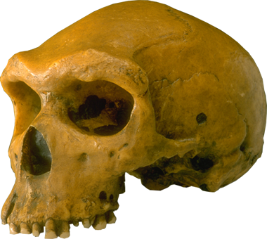
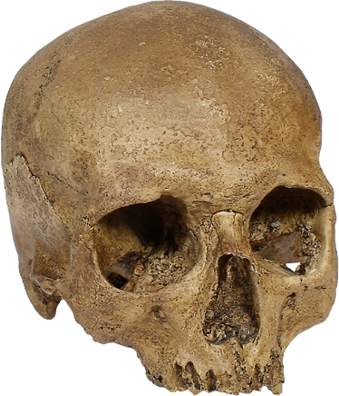
Genus Homo
Homo habilis
2.4 MYA - 1.6 MYA
Eastern, and possibly
Southern Africa
Homo ergaster
1.8 MYA - 1.4 MYA
Africa, possibly western Asia
Homo neanderthalensis
150,000 – 30,000 years ago
Europe and western Asia
Homo erectus
1.8 MYA- 300,000 years ago
Africa, Asia, Indonesia and
possibly Europe
Archaic Homo sapiens
400,000 – 100,000 years ago
Africa, Asia and Europe
Homo sapiens
130,000 years ago - Present
Africa and western Asia, then global
Photo courtesy of: SkullsUnlimited.com

Slide 30
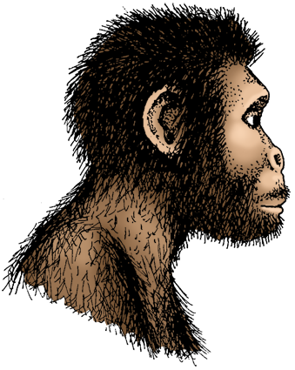
Homo habilis
Existed between 2.5 and 1.5 MYA.
Although similar to australopithecines in many ways, their brain size was considerably larger.

Slide 31
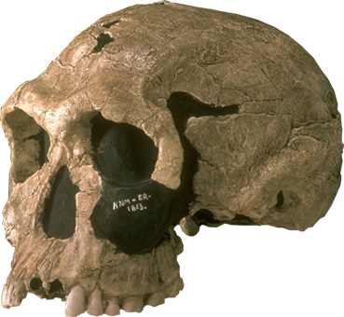
Homo habilis
Other name |  | Handy man
Known date |  | 2.5 - 1.5 million years ago
Brain size |  | 500 - 650 cc
Height |  | 1.0 m
Physique |  | Small & slight Relatively long arms Less curved fingers Short, more opposable thumb
Skull shape |  | Small face with developed nose Decrease prognathism Decrease brow ridge
Teeth and jaws |  | Smaller, narrow molars; thinner jaw parabolic
Geographical distribution |  | Eastern, and possibly Southern Africa
Culture |  | Oldowan / pebble culture Scavenger/ hunter-gatherer

Slide 32
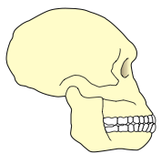
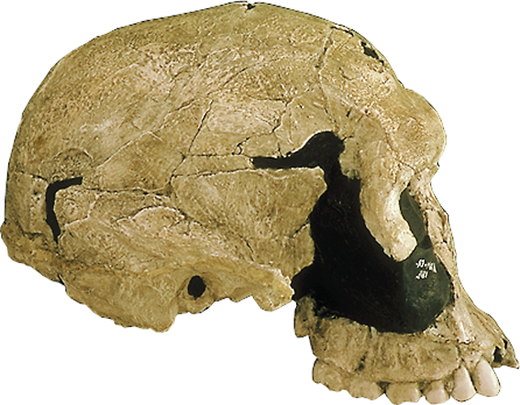
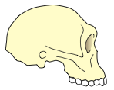
Homo habilis
Bigger brain
(500-650 cc for small variant)
Rounded cranium with no sagittal crest
Bulge in the Broca's area of the brain for speech production
Brow ridge
Large variant
Smaller, narrower face than the australopithecines
Flat nose
Small variant
Projecting jaw
(prognathism)
More of the skull is behind the foramen magnum
Jaw is less massive than in the australopithecines
Tooth row displays a modern curve, with narrow molars
A modern human skull(for comparison)

Slide 33

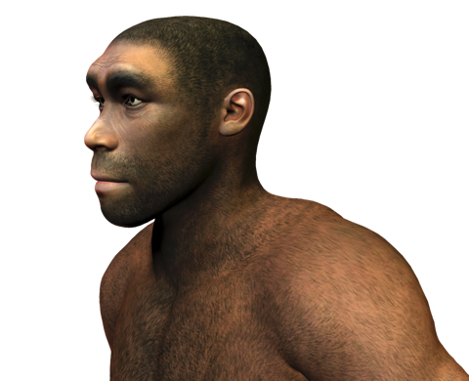
Homo erectus
Homo erectus is reserved for the later Asian forms (shown here), with dates ranging from 1 million to 300,000 years ago.
Thought to be the first humans to venture out of Africa.
Skulls were strongly buttressed with ridges of bone, skull walls greatly thickened, and larger brain volumes.
These simple hunter-gatherers used stone tools and fire.
By this group of hominins, the environment as a selective agent was diminishing. These hominins were now modifying their environment to suit their own purpose. The use of fire, the building of shelters and a range of sophisticated tools enabled H. erectus to become more independent of the environment.

Slide 34
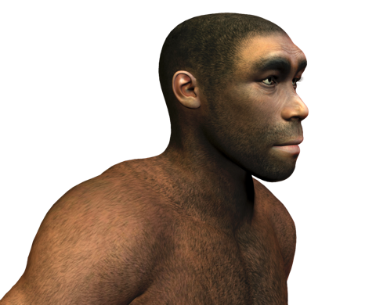
Homo erectus
Other name | Upright man
Known date | 1.8 - 0.3 million years ago
Brain size | 1000- 1250 cc
Height | 1.3 - 1.5 m
Physique | Robust but ‘human’ skeleton Long legs:arms Modern human foot-like anatomy
Skull shape | Flat, thick skull with sagittal keel large brow ridge Slight prognathism
Teeth and jaws | Smaller teeth than H. habilis, robust jaw in larger individuals Receding chin
Geographical distribution | Africa, Asia, Indonesia, and possibly Europe
Culture | Acheulin tools Control fire Hunter/ gatherer

Slide 35
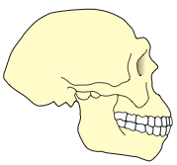
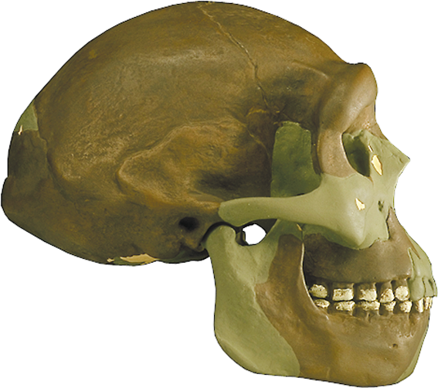

Homo erectus
Bigger brain with increase over time, although body size was also increasing
1000-1250 cc
Bulge in the Broca's
area of the brain for
speech production
Long, flattened cranium with a distinctive keel along the top
Bulge in Wernicke's area of the brain for speech recognition
Shelving forehead
More recent Asian forms
Thick brow ridge
Flat face
Older
African forms
)
Projecting
jaw
Attachment for strong neck
muscles to stop the head
from sagging forward
Teeth are smaller than
H. habilis, but more
massive than our own
A modern human skull
(for comparison)
No chin

Slide 36


Homo neanderthalensis
Neanderthals existed between 230,000 and 30,000 years ago.
They had short, squat, cold-adapted bodies with thick and heavy bones.
Recent research suggests that the Neanderthals split off from the line to modern humans nearly 600,000 years ago.
For this reason they are no longer classified as a subspecies of Homo sapiens (previously Homo sapiens neanderthalensis).
Debatable – some believe parallel species

Slide 37

Homo neanderthalensis
Other name | The Neanderthals; H. sapiens neanderthalensis
Known date | 230,000 - 30,000 years ago
Brain size | 1200 - 1750 cc (average 1450 cc)
Height | 1.5 - 1.7 m
Physique | Robust but ‘human’ skeleton, adapted for cold climates
Skull shape | Double-arched heavy brow ridge , high rounded orbits, mid-face projection, weak chin, long low skull
Teeth and jaws | Extreme prognathism Similar to Archaic H. sapiens; except for incisors, smaller teeth.
Geographical distribution | Europe and western Asia.

Slide 38


Homo neanderthalensis
Large brain (1200-1750 cc)
Larger than a modern
brain but organized differently
Low, long cranium
Sloping forehead
Large brow ridges
Occipital lobe
(bun-like
swelling)
Large prominant nose and mid-facial projection
Swept back,
lightly built
cheek bones
Skull widest at the base (unlike modern skulls which are widest near the top)
Powerful jaw but
reduced compared
to H. erectus
Weak chin
Teeth are smaller
than H. erectus, but
bigger than our own
A modern human skull(for comparison)

Slide 39

Neanderthal Skeleton
Clavicle: long
Shoulder joint: large
Rib cage: Large and wide
Scapula : wide with more muscle
Hips: wide
Elbow joint: large
Hip joint: large, rotated outward
Forearm: bowed and short
Hand: with strong grip and wide fingertips
Femur shaft: thick walled, rounded and curved
Patella: large and thick
Tibia: thick-walled, short and flattened
Toe bones: wide and strong
Ankle joint: large
Photo courtesy of: Bone Clones®

Slide 40


Homo neanderthalensis
The chest of neanderthals is considerably narrower at the top, compared to modern humans.
The pelvis, femur and humerus of neanderthals and moderns compared:
Dark bones = Neanderthal
Light bones = Modern human
Neanderthal spine and rib cage
Photos courtesy of: Bone Clones®

Slide 41

Homo sapiens
The first anatomically modern humans appear about 160,000 years ago in southern African and the Middle East.
They underwent a sudden cultural revolution about 40,000 years ago, with the appearance of Cro-Magnon culture.
Using a wider range of materials, their tools kits became markedly more sophisticated.
They were skilled hunters, tool-makers and artists (cave art and music).

Slide 42
Homo sapiens
Other name | Early anatomically modern humans; Homo sapiens sapiens
Known date | 195,000 - 60,000 million years ago (for early humans)
Brain size | 1200 - 1700 cc
Height | 1.6 - 1.85 m
Physique | Modern skeleton possibly adapted for warmth
Skull shape | Small or no brow ridge; shorter and higher skull
Teeth and jaws | Teeth may be smaller; shorter jaws than Neanderthals; chin developed
Geographical distribution | Africa and western Asia (for early forms)
Photo courtesy of: SkullsUnlimited.com

Slide 43


Homo sapiens
Large brain
(1200 - 1700 cc)
Convex cranial vault
Skull widest
high up
High, vertical
forehead
No brow ridge, just a slight swelling of the glabella
Vertical
face
No muzzle
(no prognathism)
Reduced tooth size
with thinner enamel
Sizable jaw with
projecting chin
A modern human skull(for comparison)

Slide 44
The Origin of Modern Humans
There are two theories accounting for the origin of anatomically modern humans (Homo sapiens):
Multi-regional Hypothesis
Replacement Hypothesis
(Out of Africa / Eve Hypotheses)
Present
Modern
Homo sapiens
Archaic
Homo sapiens
Extinction
0.5 MYA
Gene flow
Homo erectus
1.0 MYA
African origin
African origin

Slide 45


Slide 46


