Slide 1
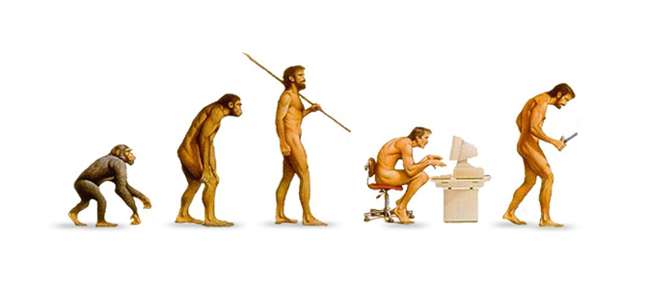
Cultural evolution Sunday, 16 August 2020
Learning question: how has culture evolved with hominids?

Slide 2
Learning Objectives
Describe the trends which are seen in the changes in manufacturing techniques and the materials used in the tool cultures of
  Homo habilis
  Homo erectus
  Homo neanderthalensis
  Homo sapiens
Tool culture is identified by materials used in manufacture, the specificity of tools and complexity of tool making techniques for each of these Homo species
Each Homo group is associated with a culture:
  Oldowan - Homo habilis
  Acheulean - Homo erectus
  Mousterian - Homo neanderthalensis
  Aurignacian Solutrean, Magdalenian - Homo sapiens

Slide 3
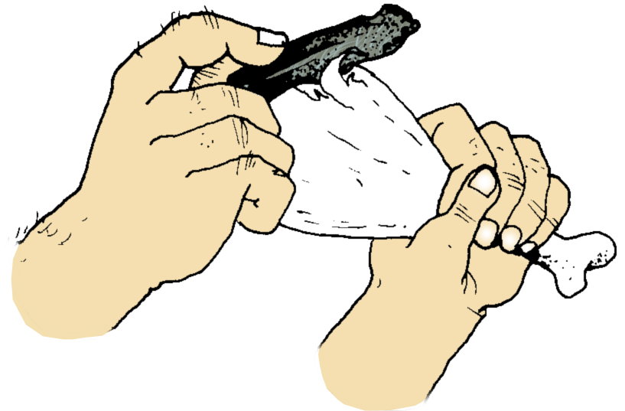
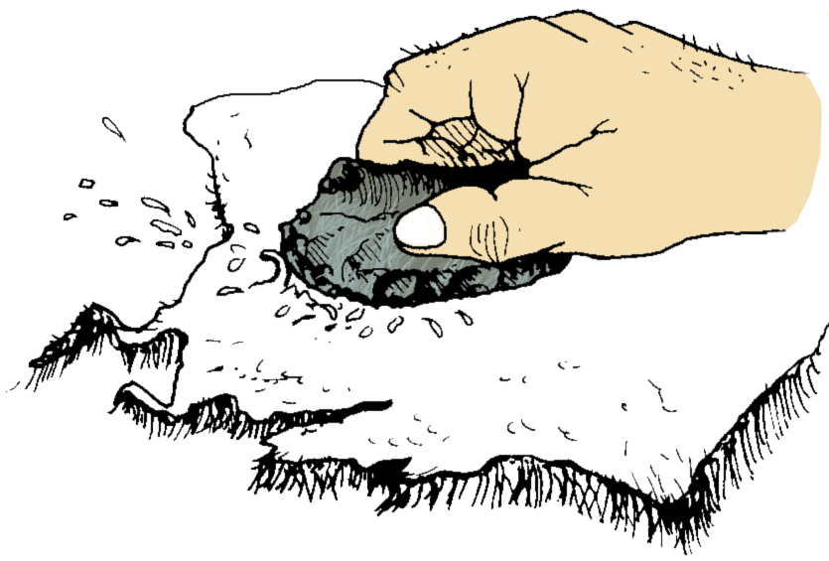
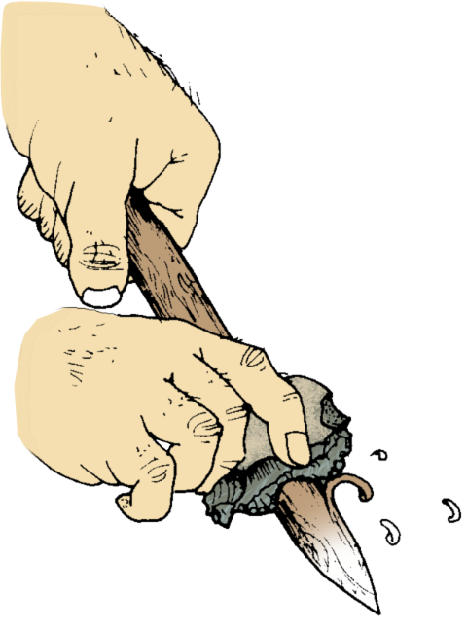
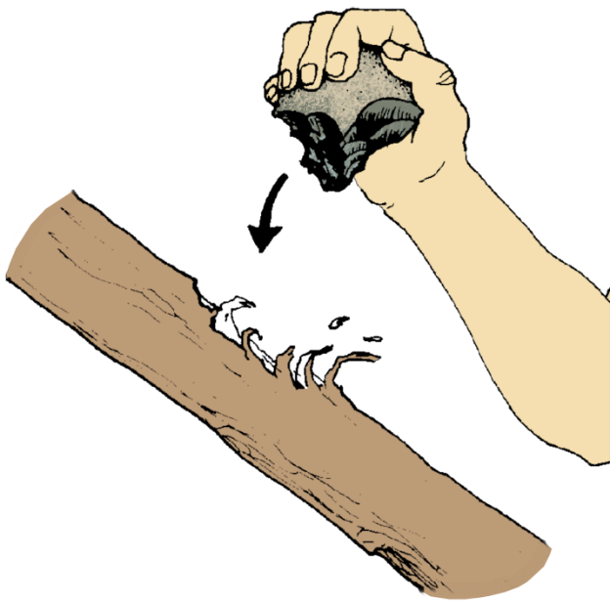
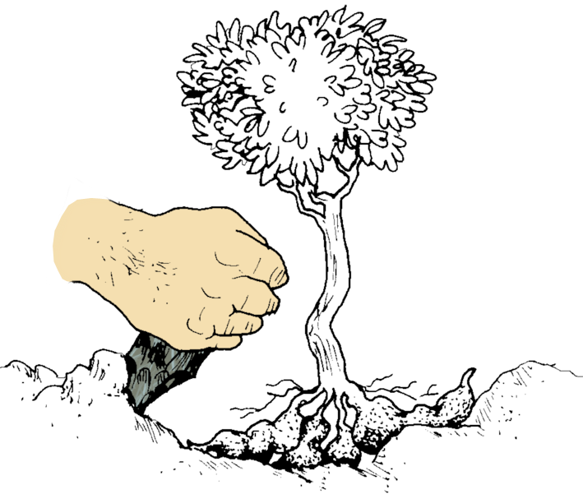
Paleolithic Tool Use
Backed flake
for cutting
Side scraper
Used as a knife. One side had a cutting edge so that pressure could be applied to the blunt edge.
Scraped fat and sinew from a carcass in preparation for curing.
The curved sharp edge carved wood chips from spear heads.
Denticulate tool
Chopper
Early hand-axe
A pick-like tool to expose root tubers.
A simple tool used as an axe.

Slide 4
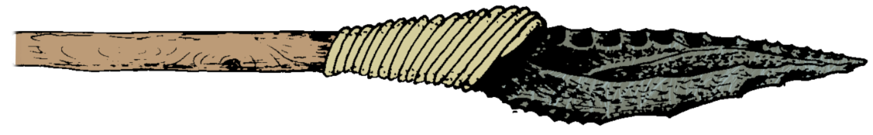
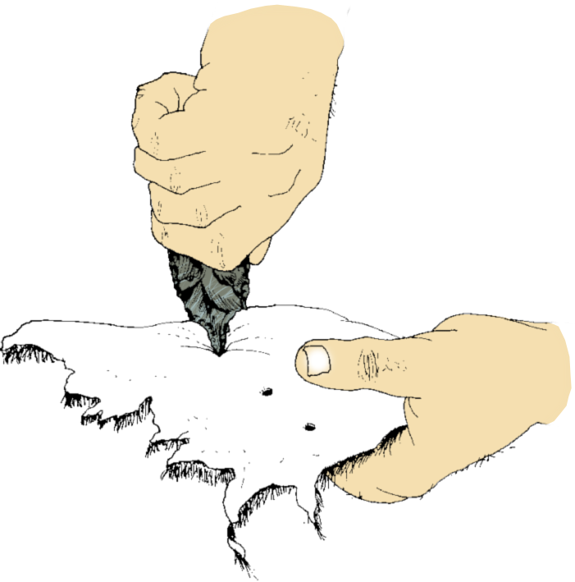
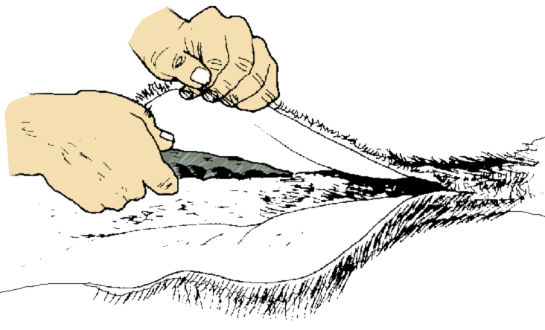
Paleolithic Tool Use
Spear point
This flint tool would have provided an effective cutting edge for a spear. It would have been hafted to a pole with greased sinew or plant fiber.
Borer (burin)
Late hand-axe
The sharp narrow point of this tool made it an effective drill when twisted back and forth. In this way, holes could be made in materials such as hide, wood, and ivory.
Later forms of hand-axes were used to skin and dismember carcasses.

Slide 5
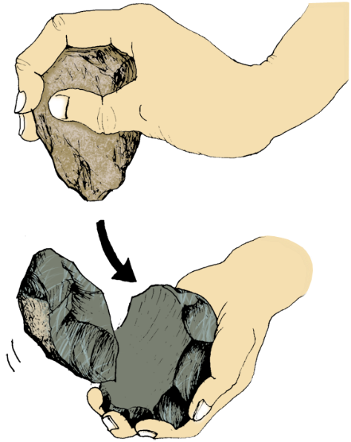
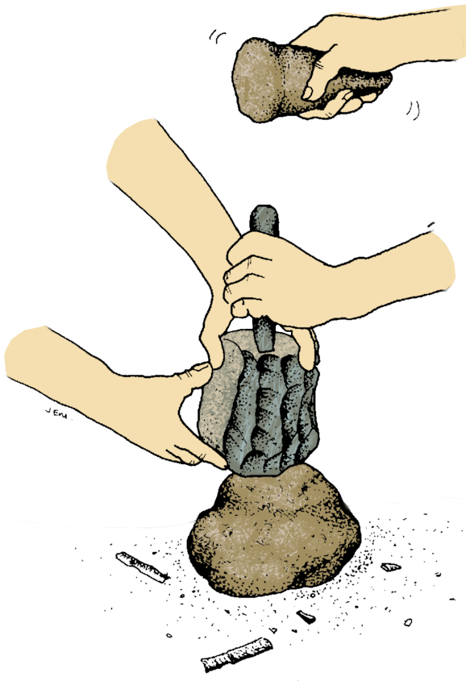
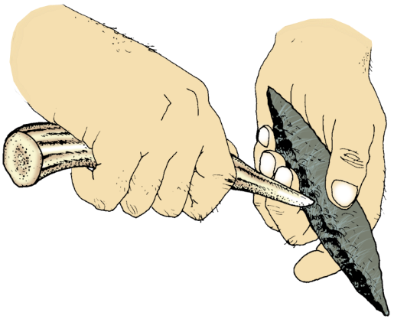
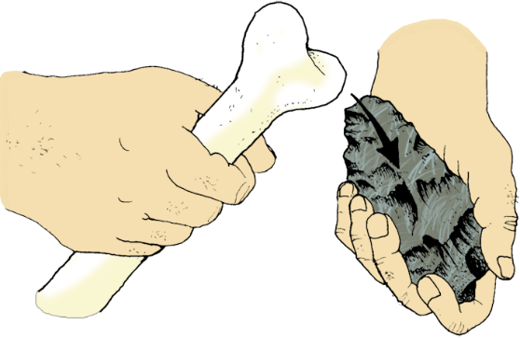
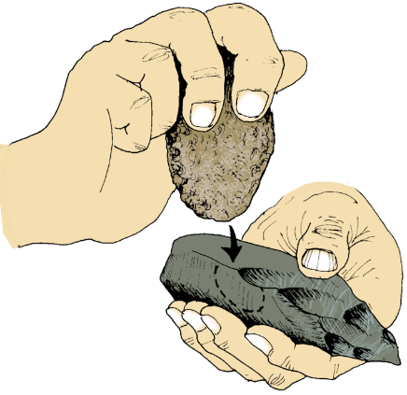
Tool Making Methods
A variety of stone tool manufacturing methods have been used throughout the history of tool making.
Some of these methods (particularly hard hammer and soft hammer percussion) were probably combined with other methods in the manufacturing process.

Slide 6
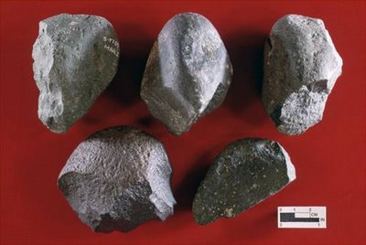
Australopithecine culture
Evidence of a home base
Hunted and foraged for food – no use of fire
Used pebble tools – choppers, scrapers, chisels and flakes
Oldowan tools
- Pebble tools changed the way hominins interacted with the environment (crude, many roles for few simple tools)
-tools = exploitation of broader habitats
-migration out of Africa – possibly due to search for productive environments
- Caused evolution ; taller, larger brained, able hunters

Slide 7
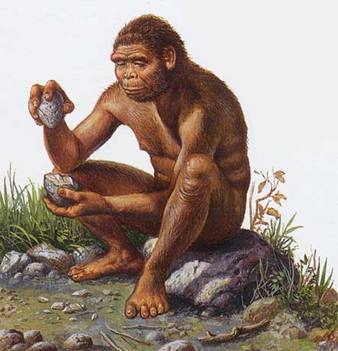
Homo habilis
Home bases
No shelter
Slept in trees
Division of labour
Hunter-gatherers
Men = hunt/scavenge meat
Women = gather plant material
Family groups
Food sharing – small groups
Social and economic advantages to living in a close knit group
Language – brain says yes, larynx says no
Pressure to communicate – development of spoken language of some description
Evidence of pebble tools made from stone
(Oldowan)
Very simple and crude
Few tools, many jobs
Made by: Smashing stones = one jagged side
Choppers, scrapers, flakes, chisels
Used for: Dig for roots and tubers; Meat

Slide 8
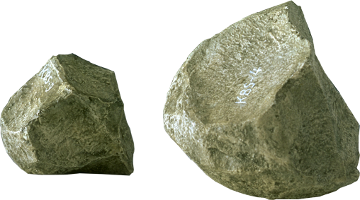
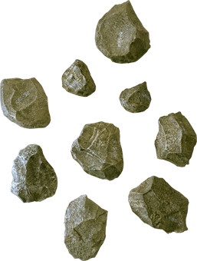
Oldowan Tool Culture
First Appeared: 2.5 MYA
Associated hominin: Homo habilis
  These tools were simple river-worn pebbles that were crudely fashioned with only a few flakes being removed.
  These tools typically had flakes knocked from several angles to produce a core with a cutting edge (e.g. chopper, discoid, polyhedron) on one side only.
  Although the cores may have been used as tools, it is known that the sharp flakes were also useful in cutting.

Slide 9
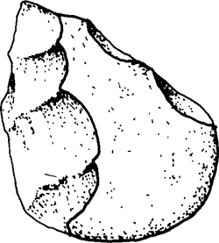
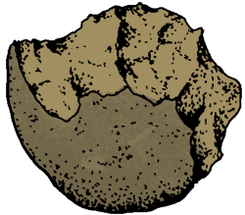
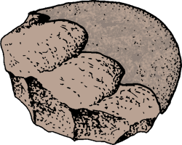
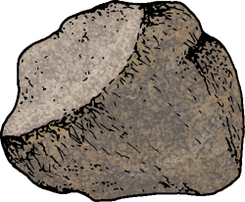
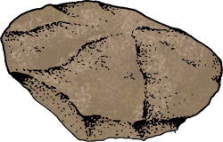
Oldowan Tool Culture
Flakes removed from 2 sides
Flakes removed from 1 side only
Core
Proto-biface
Choppers
Flakes removed from all sides
Core
Polyhedron
Discoid

Slide 10
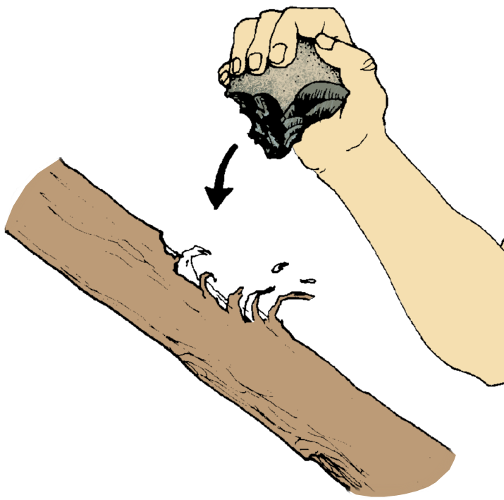
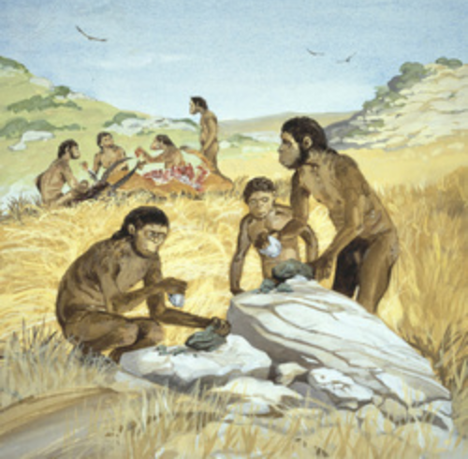
Oldowan Tools
Chopper
A simple tool used as an axe.

Slide 11
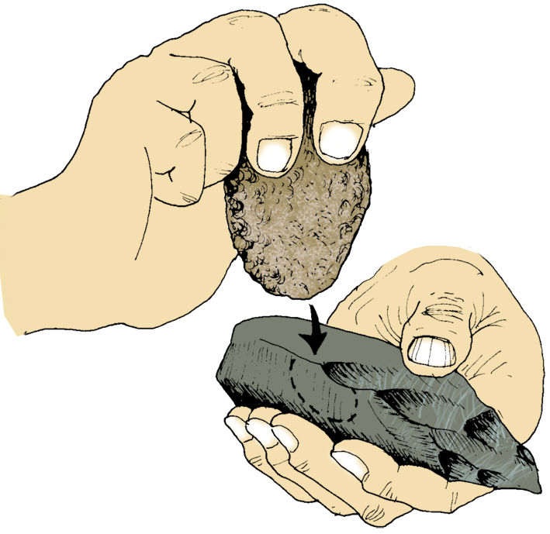
Tool Making Methods
  Hard hammer percussion to “work” the stone
  (Oldowan and Acheulian)
Hammer stone
Flake about to be chipped off from core
Tool partly completed as the core is ‘worked’

Slide 12
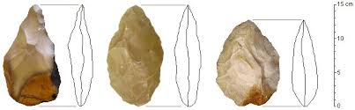
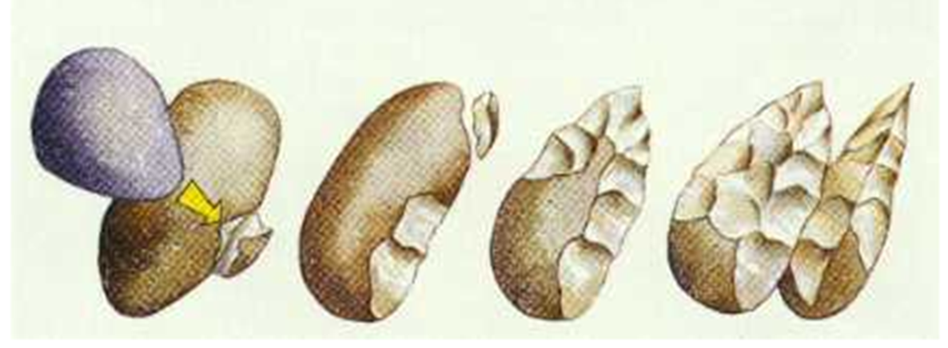
Homo erectus
FIRE!
protection; warmth; light; ‘drive’ animals; cook
Caves for shelter
Built shelter - huts
Skillful and organised hunting expeditions
Verbal communication was likely – due to above
Able to exploit many environments due to fire – migration to Europe
Acheulean tools
Made from: Stone and Bone
Sophisticated – made to plan
Many tools, limited jobs
Made by: Large flake from a boulder, then shaped to form oval/pear shape with point
All edges shaped and sharp = hand axe
Used for: Hunting; Butchering; Stabbing; Bone/antler used to help make tools

Slide 13
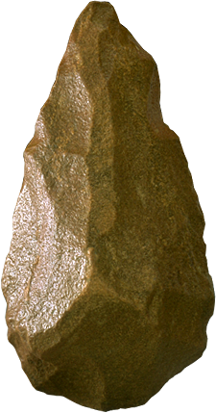
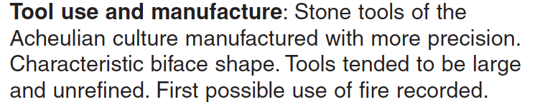
Acheulian Tool Culture
First Appeared:1.76 MYA
Associated hominin: Homo erectus
These tools were flaked all around the edges, first in one direction, then in the other, until they formed roughly two –faced lumps, approximately tear dropped in shape - a slight bulge on each broad surface (called a 'bi-face’).
They ranged greatly in their size and are often called 'hand axes’ and may have been used as a pick-like tool to expose root tubers.
They differ markedly from the earlier pebble tools in that there appears to be a standard “design” and each tool is manufactured using a great many more blows to remove flakes.

Slide 14
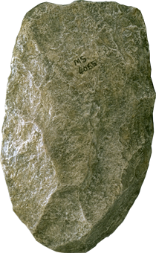
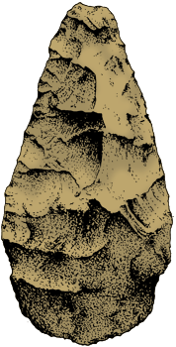
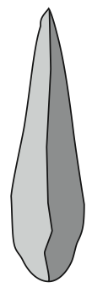
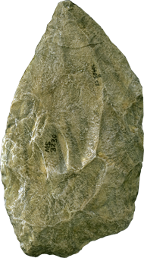
Acheulian Tool Culture
Hand axe
Typical 'tear-drop' shape of an Acheulian biface tool
The core is the tool
Flatter and more ‘blade-like’
The core is the tool
‘Biface’ shape – bulges outwards on both sides and has ‘tear drop’ shape
Cleavers
Side-on view

Slide 15
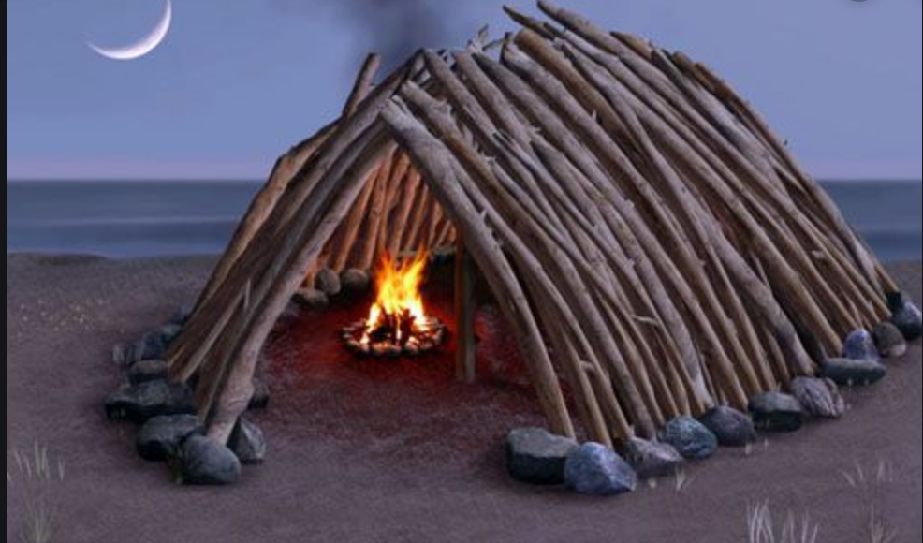
Early hand-axe
A pick-like tool to expose root tubers.

Slide 16
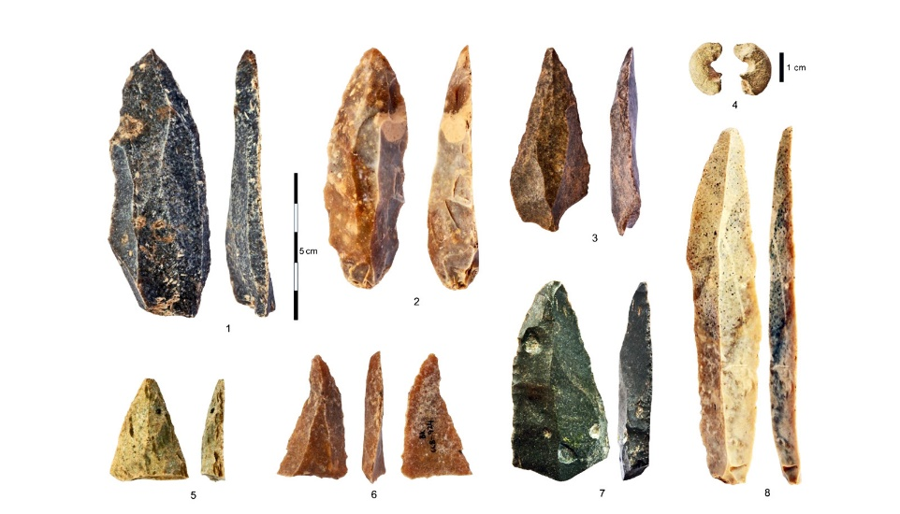
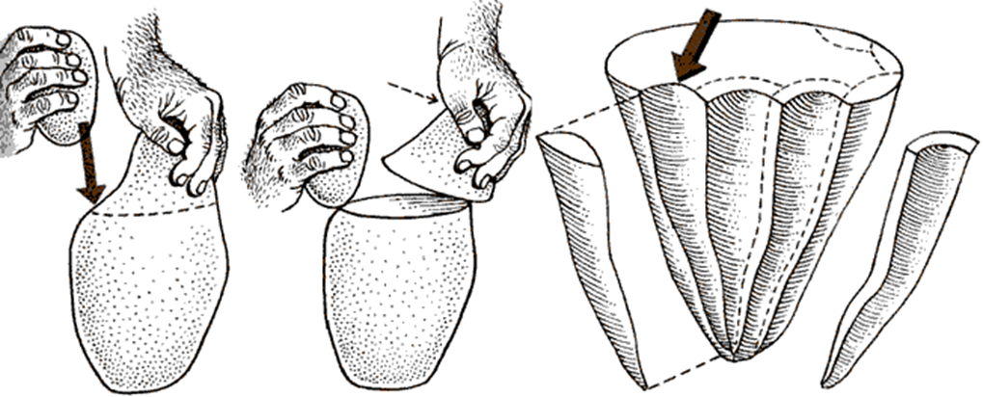
Homo neanderthalensis
Caves used as shelter
Hunted lots of meat – butchered at site of kill
Buried the dead
Shared food and resources
Mousterian tools
Ceremonial burial – religion
Cared for the weak
Environment no longer a factor in where they live
“Flake Tools” made from stone
Sophisticated – made to plan
Each tool had a very specific purpose
Made by: Hammer used to flake off several small flakes from a prepared core – delicate work
Hafting – attached to wooden shaft
Used for: Hunting; Butchering; Clothes making
Possible language

Slide 17
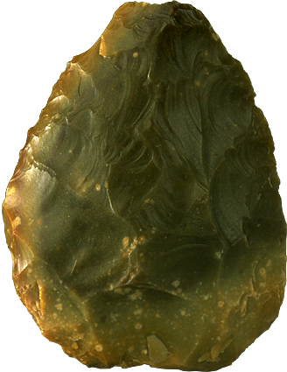
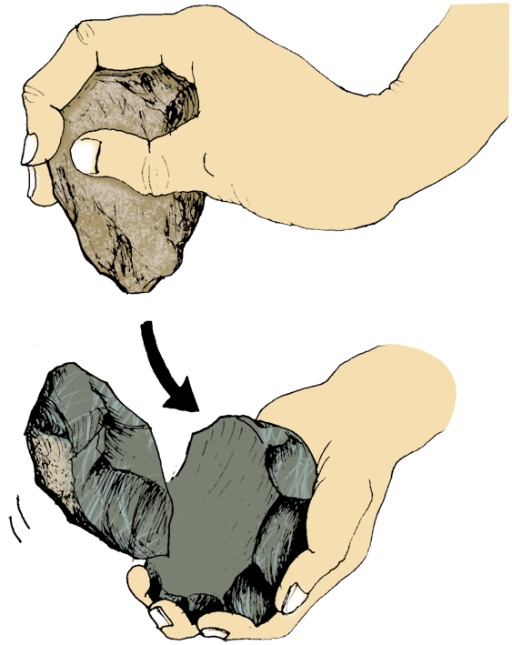
Mousterian Tool Culture
First Appeared:150,000 years ago
Associated hominin: Homo neanderthalensis
  More refined tool culture than the earlier Acheulian tool culture.
  Flint became a preferred material to produce stone tools because of the very predictable way in which it would
  chip when struck with another hard object (much finer workmanship was possible).
  The Levallois tool making method involved preparing a core and striking off a large oval flake which was then
  retouched on one surface only.
Making a scraper by the Levallois method

Slide 18
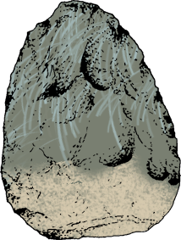
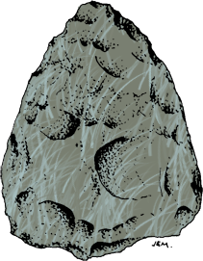
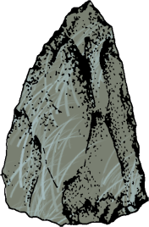
Mousterian Tool Culture
Tool use and manufacture: Use of cave shelters by some groups, others constructed shelters of wood or mammoth tusks, covered with skins.
Tools of the Mousterian culture include fine points, sharp knives and scrapers. Some stone points were hafted onto spears.
Used fire for warm and cooking. Probably made clothing and blankets from animal skins
Side scraper
from Le Moustier, France
Flint, length 9cm
The scraper made by the Levallois flake method is retouched on one surface.
Handaxe
from Le Moustier, France
Flint, length 8.5cm
Levallois point
from Le Moustier, France
Flint, length 6cm

Slide 19
Tool Making Methods
  Levallois method
  (Mousterian)
Hammer stone
Tool is removed as a single large flake
Core from which the large flake is struck

Slide 20
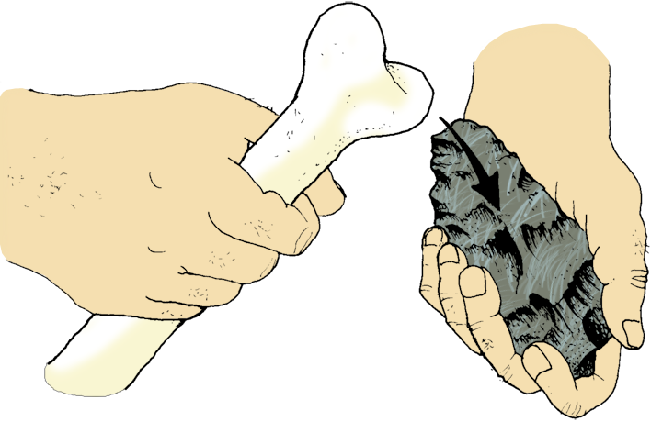

Tool Making Methods
Tool making methods included:
  Soft hammer percussion
  (Mousterian and
  Upper Paleolithic)
Soft hammer made of bone
Core is being struck to remove flakes

Slide 21
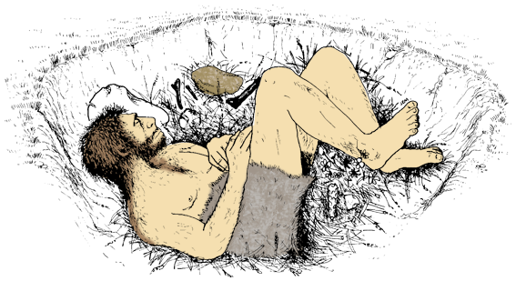
Neanderthal Culture
The Neanderthals of Europe and south-west Asia buried their dead in a way that suggests they practiced ritualized burial:
  The grave is usually characterized by certain items found buried with the body (burnt animal bones, stone tools, and flowers).
  The position and orientation of the body are also found consistently the same (aligned east-west with legs curled up).
A flute-like piece of cave bear bone has been found at a Neanderthal hunting camp in
Slovenia (dated at between 43,000 and 82,000 years ago) suggesting that Neanderthals may have made music.
Animal bones, red ochre and horns buried with the body
Position and orientation of the body with legs pulled up as if sleeping
Stone pillow
Flowers
Stone tools

Slide 22
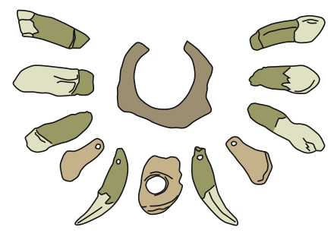
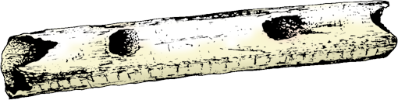
Neanderthal Culture
Creative ability was not just restricted to visual art objects. Music also appeared to feature in Paleolithic life (see flute below).
It has been postulated that the Neanderthals possessed artistic ability (see necklace at right).
Necklace found at a late Neanderthal site (was it made by Neanderthals, or traded or stolen from modern humans?)
This 25,000-year-old flute, made of bird bone, is one of the earliest instruments providing evidence of music.

Slide 23
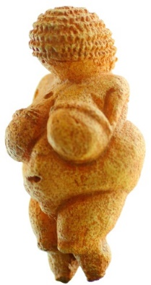
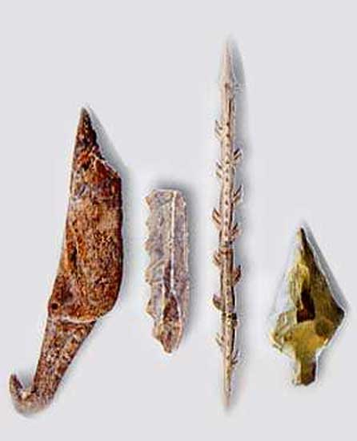
Homo sapiens
Clothing that was sewn together (increased skill level)
Better shelters – able to survive in colder climates in different geographical locations
Advancement in tool making e.g. bladed tools
Articulated speech
Increased cranial capacity and brain size
Art work
Animal fat burned for oil lamps
Source of meat
tools
Aurignacian, Solutrean and Magdalenian tool cultures
Dominance of bone and antler tools
Hafting – attached to wooden shaft
Burins – a tool made to help make other tools
Used for: Hunting; Butchering; Clothes making
Carvings
Murals
Re-working blades with intricate designs

Slide 24
Upper Paleolithic
Flint, bone and antler used more routinely
Tool culture and manufacture: new stone technology characterized by specialized and standardized stone blade tools which replaced the Mousterian technology.
Long narrow blades were the basis of most tools, adapted for special functions by careful retouching of the edges.
Use of bone and antler as a tool making material to produce needles, harpoons etc.

Slide 25
The Aurignacian Culture
The Aurignacian Culture (42,000 to 27,000 years ago) - the first widely recognized modern human culture - is named after the French site that tools associated with it were found.
They consisted of blades and advanced bone tools.
Because the oldest Aurignacian tools predate the earliest modern human fossils in Europe, some scientists think they have been made by Neanderthals. The people of this culture also produced some of the earliest known cave art

Slide 26
The Aurignacian Culture
These tools had long blades from prepared cores rather than flakes.
The Aurignacian tools are:
  Worked bone or antler points with grooves cut in the bottom
  Tools, double end scrapers, burins, pins and awls
  Their flint tools include fine blades and bladelets struck from prepared cores
The burin – a tool with a narrow sharp face at the tip used for engraving and other purposes is often found at Aurignacian sites
Unlike most of their ancestors who made stone tools from localised sources, modern humans quarried fine grained and colourful flints from as far away as 500km from where they lived.

Slide 27
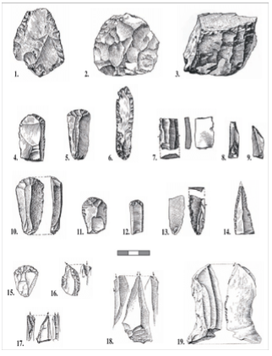
The Aurignacian Culture

Slide 28
Solutrean Period
Solutrean Period (22,000 to 17,000 years ago)
Named after the French site — the Crôt du Charnier site in Solutré-Pouilly, in Saône-et-Loire — that tools associated with it were found.
Some tools - pointes à face plane, laurel leaves, shouldered points - were made by a sophisticated retouch that was obtained by a new technique called pressure flaking, on flint which had been heat treated to make it much more workable.

Slide 29
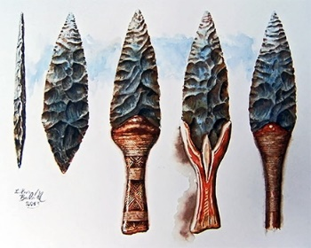
Solutrean Period
To make these lanceolate (leaf-shaped) points, the Solutrean people developed an exceptionally deft technique of pressure flaking – pressing with a soft tool such as an antler tine or bone point – instead of striking directly with a soft or hard hammer.
Solutrean people raised this technique to an artform where their arrowheads and spearpoints were as efficient as possible and like many optimum designs
The Solutrean technology is largely isolated in the prehistoric record. It was preceded by an industry based on Acheulian bifaces and scraper tools and it was succeeded by the widespread adoption of microlith technology in the Upper Palaeolithic and Mesolithic periods.

Slide 30

Magdalenian Period
The Magdalenian Period (17,000 to 12,000 years ago)
Named after the French site — La Madeleine, a rock shelter in the Véz're valley, in the Dordogne region of France — that tools associated with it were found.
The earliest phases are recognised by the varying proportion of blades and specific varieties of scrapers

Slide 31
[A microlith is a small stone tool usually made of flint or chert and typically a centimetre or so in length and half a centimetre wide]. Microliths were used to form the points of hunting weapons, such as spears and (in later periods) arrows,
the last phases by harpoons made of bone, antler and ivory.
Elaborate worked bone, antler and ivory which served both functional and aesthetic purposes

Slide 32




Upper Paleolithic Tool Culture
Punch blade method
Hammer stone
Antler or bone punch
Solutrean blade
Finely worked edge
Side scraper
Core
Anvil stone
Burin
used as a drill
Blades and waste flakes

Slide 33
Tool Making Methods
Hammer stone
Tool making methods included:
  Punch blade method
  (Upper Paleolithic)
Antler or bone punch
Core
Anvil stone
Blades and waste flakes

Slide 34

Tool Making Methods
Tool making methods included:
  Pressure flaking
  (Solutrean industry of the
  Upper Paleolithic)
Antler
Small, carefully controlled flakes are chipped off from the blade

Slide 35



Upper Paleolithic Tool Culture
Throwing sticks were a major development in the arsenal of the Paleolithic hunter.
They drastically increased the ballistic range of the spear and tipped the balance in favor of the hunter.
Bone needle
Throwing stick
Harpoon heads made from bone or antler

Slide 36


Aurignacian, Solutrean and Magdalenian
https://www2.palomar.edu/anthro/homo2/mod_homo_3.htm

Slide 37


Complete pages 45 – 51 to summarise tool culture in hominids

Slide 38


Slide 39

Tool making techniques

