Slide 1
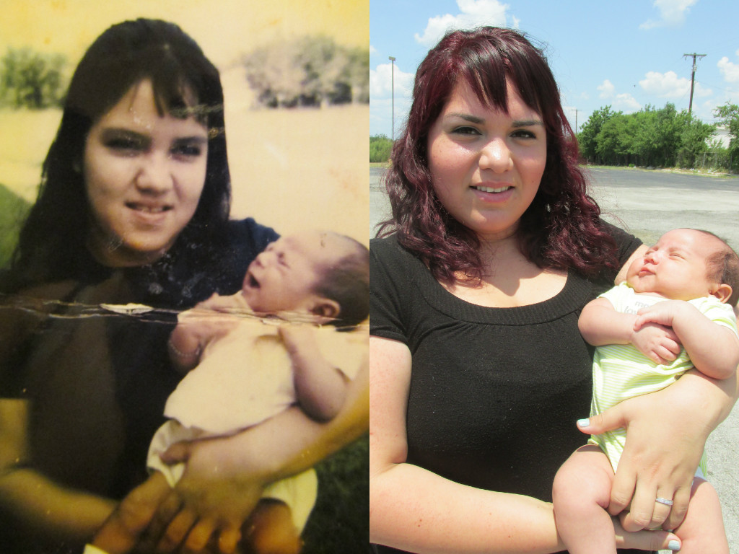
Title: DNA – the code for life Monday, 23 February 2026
Learning question: What is DNA and how it made?

Slide 2

Key words
Deoxyribonucleic acid
Histones
Chromatin
Chromosomes
Nitrogenous base
Double helix
Complementary
Hydrogen bonds
Sugar-phosphate bonds
Adenine
Thymine
Cytosine
Guanine

Slide 3
Learning Objectives
Describe the structure of DNA, including the following:
  shape
  names of the matching bases
  three main components that make up the molecule.
Describe how the unique structure of DNA enables it to perform its functions
List three roles of DNA in a cell.

Slide 4
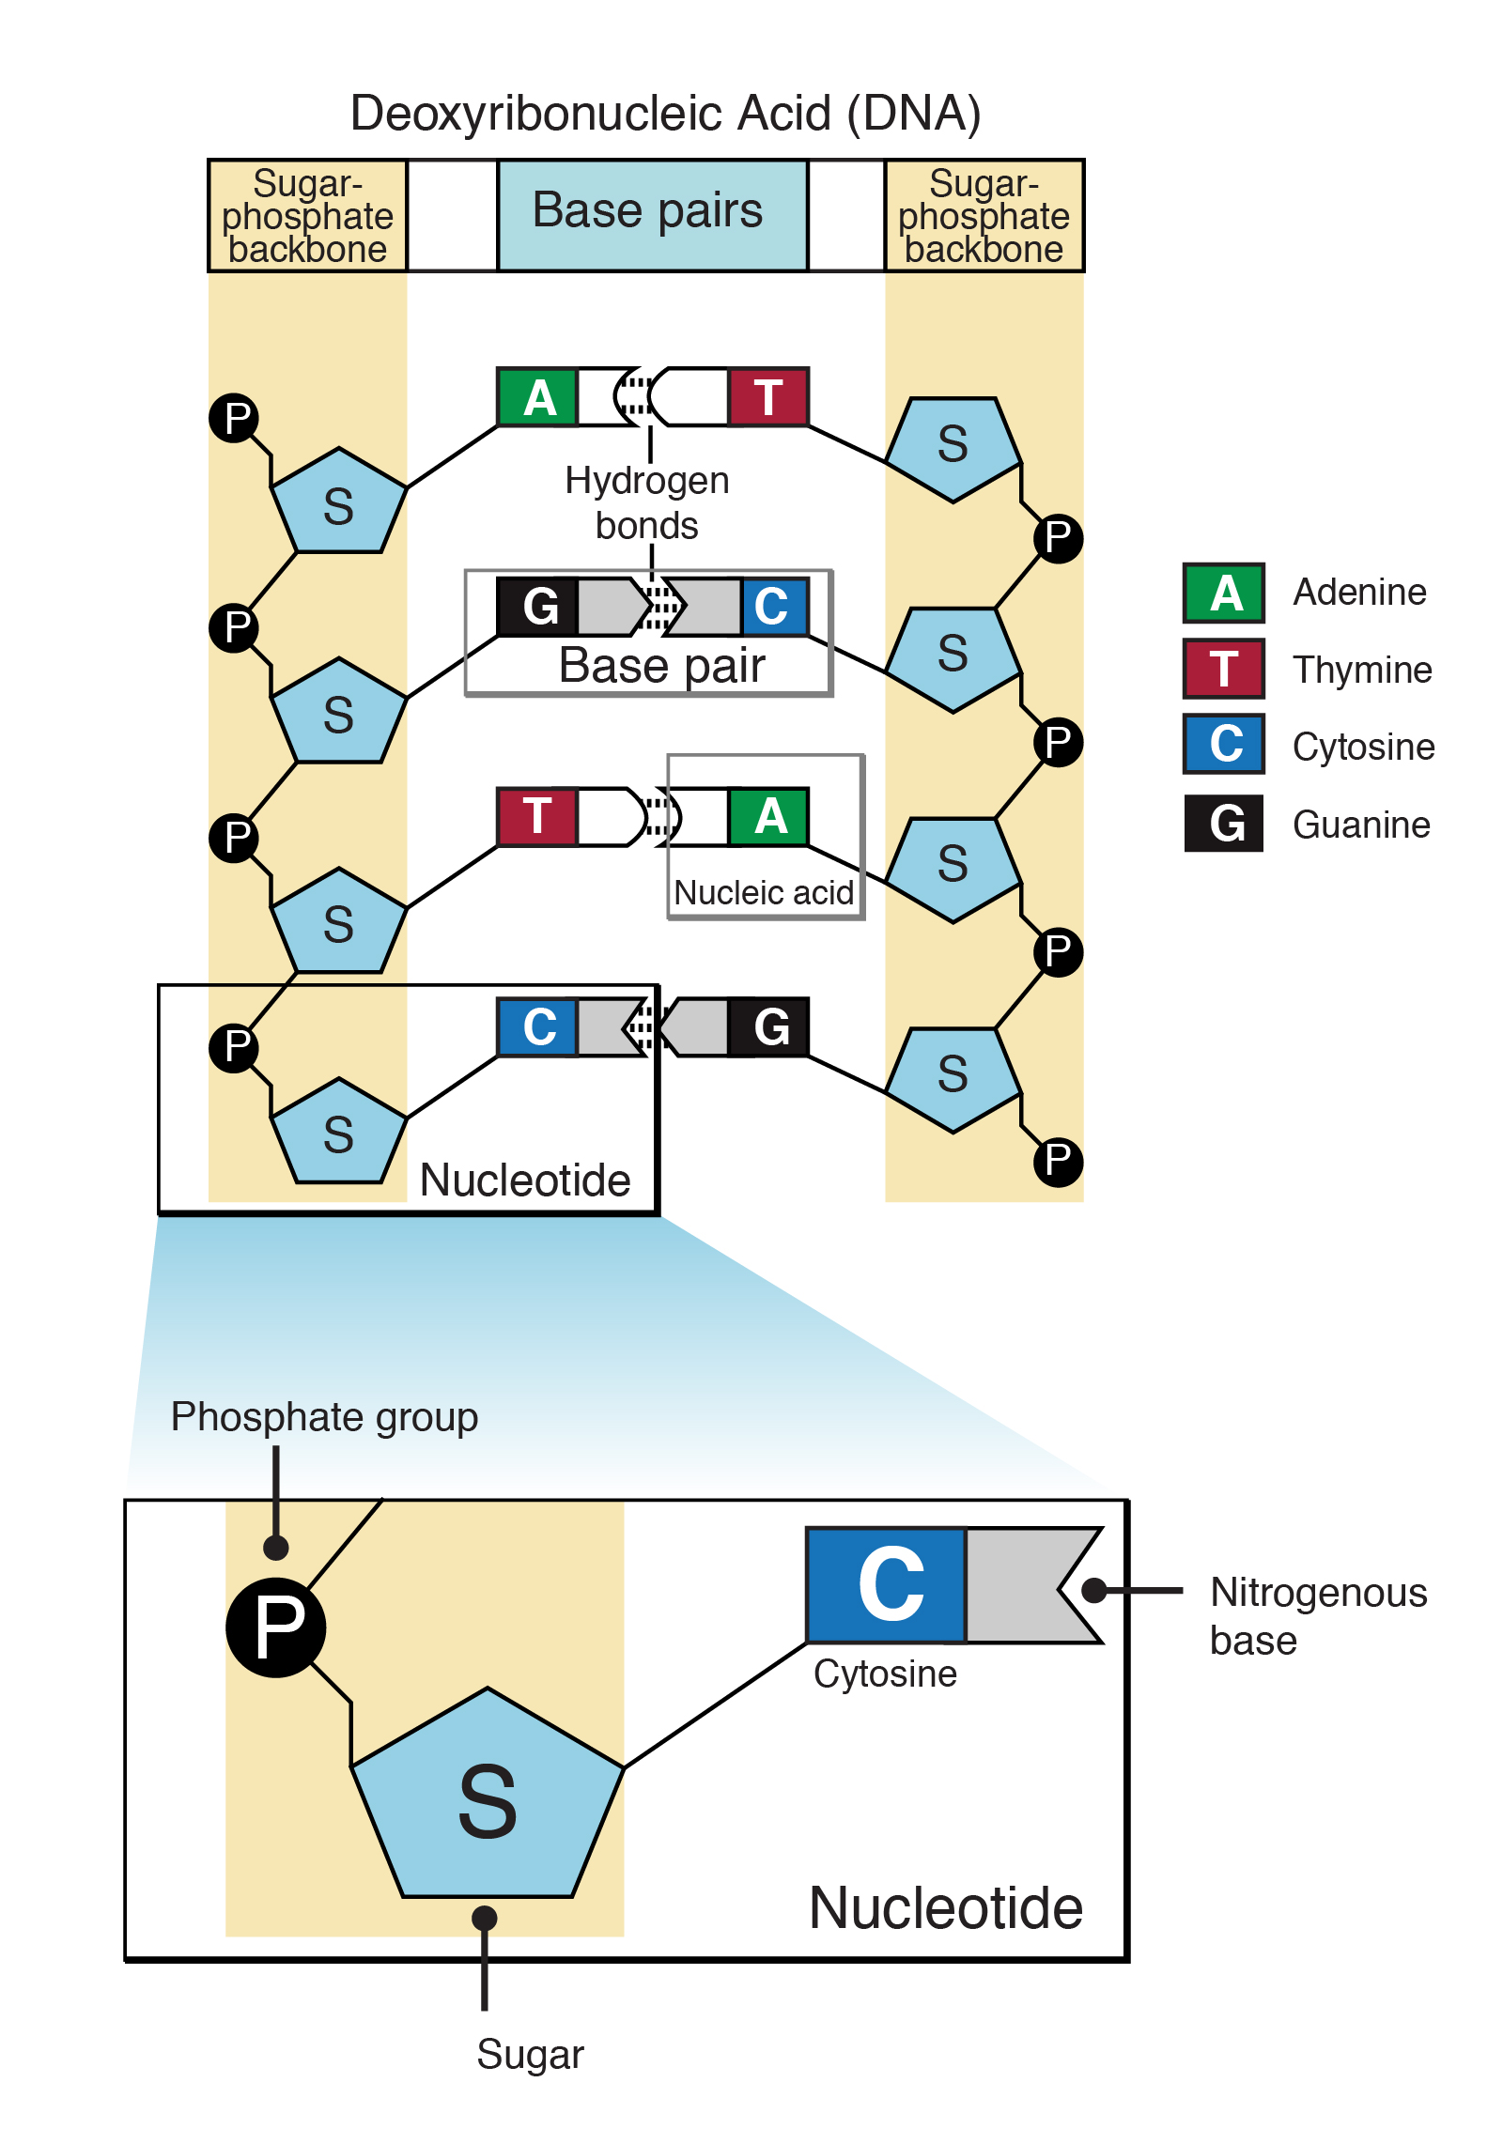
Deoxyribonucleic Acid
Found in the nucleus of eukaryotes
A polymer made of repeating units called nucleotides
Nucleotides composed of
  Nitrogenous base (4 types)
  Deoxyribose sugar
  Phosphate group

Slide 5
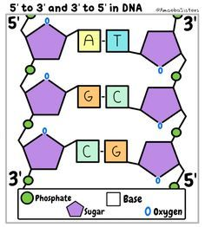
Nitrogenous Bases
The four different bases that make up DNA nucleotides pair up with each other in a special way
This is called complementary base pairing
Adenine always pairs with Thymine
Cytosine always pairs with Guanine
Make sure you can spell these words correctly!

Slide 6
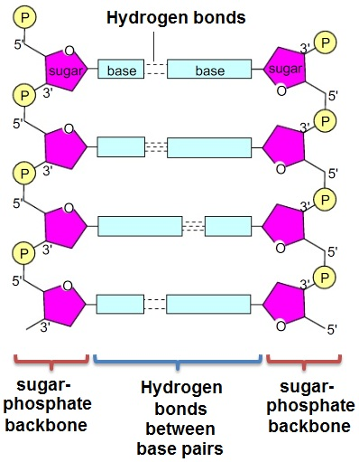
Bonding
Nucleotides are held together by strong chemical sugar-phosphate bond that forms the backbone or ‘uprights’ of the DNA ladder
Weak hydrogen bonds form between complimentary bases that form the ‘rungs’ of the DNA ladder
The two strands of DNA twist into a spiral shape called a double helix

Slide 7
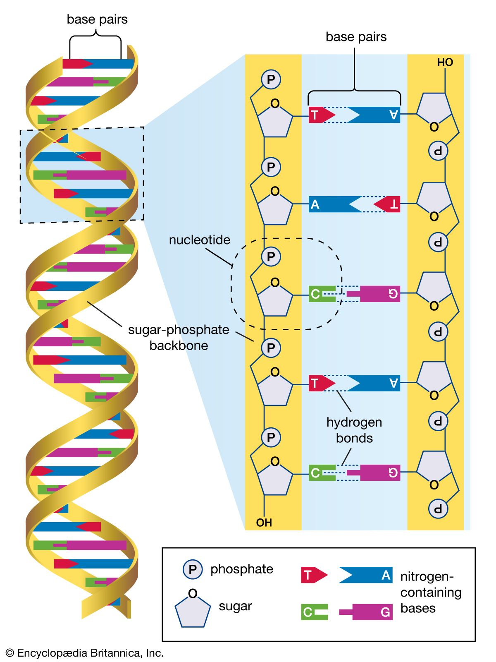
https://www.sciencehistory.org/historical-profile/james-watson-francis-crick-maurice-wilkins-and-rosalind-franklin

Slide 8
Questions
Draw two nucleotides, one on top of the other and label the 3 different structures that make up a nucleotide
Draw a sugar-phosphate bond between these two nucleotides
What are the names of the bases in DNA?
Which bases are complementary in DNA?
What element is present in all bases?
What is the name of the bond that holds complementary bases together?

Slide 9
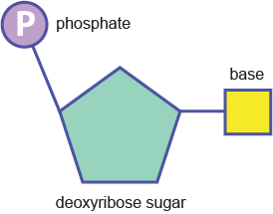
Answers
3. Adenine, thymine, cytosine and guanine
4. Adenine pairs with thymine, cytosine pairs with guanine
5. Nitrogen
6. Hydrogen bonds

Slide 10
Bonus Question!
For the DNA strand 5'-TACGATCATAT-3'
the correct complementary DNA strand is:
A | 3'-TACGATCATAT-5'
B | 3'-ATGCTAGTATA-5'
C | 3'-AUGCUAGUAUA-5'
D | 3'-GCATATACGCG-5'
E | 3'-TATACTAGCAT-5'

Slide 11
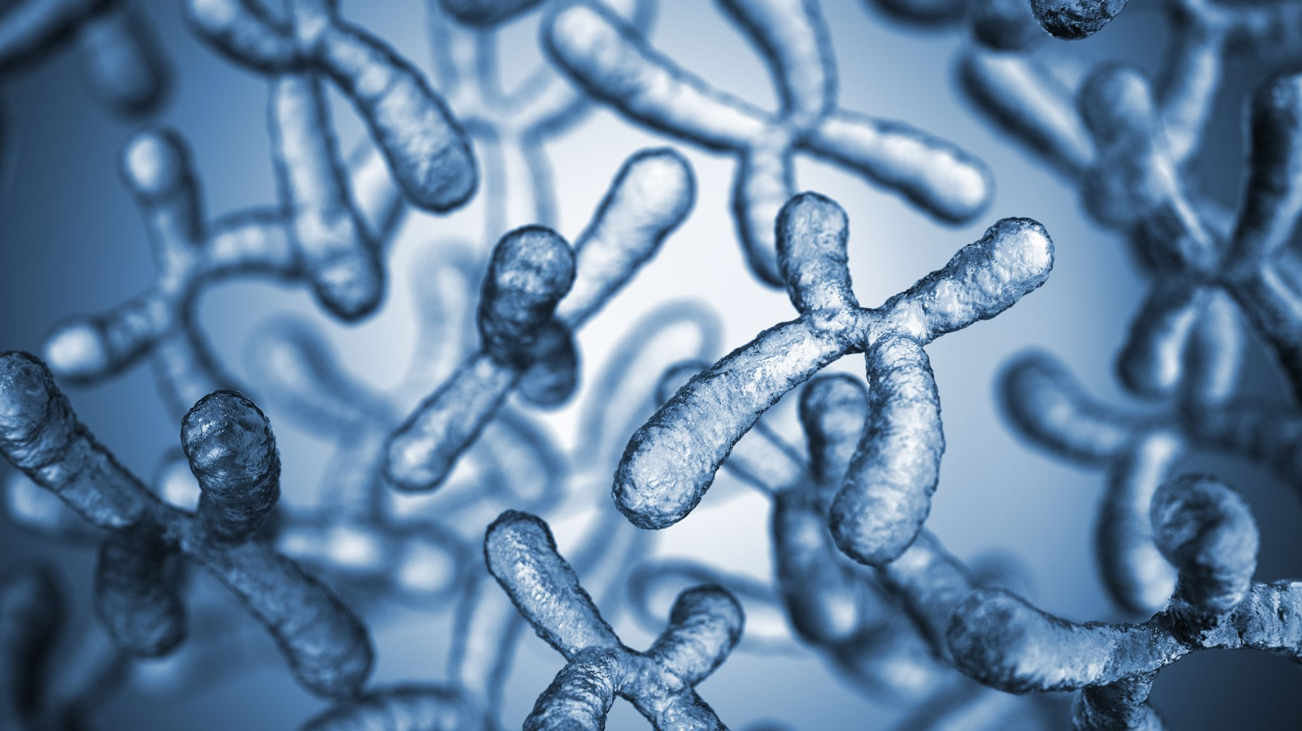
The Structure of Chromosomes

Slide 12
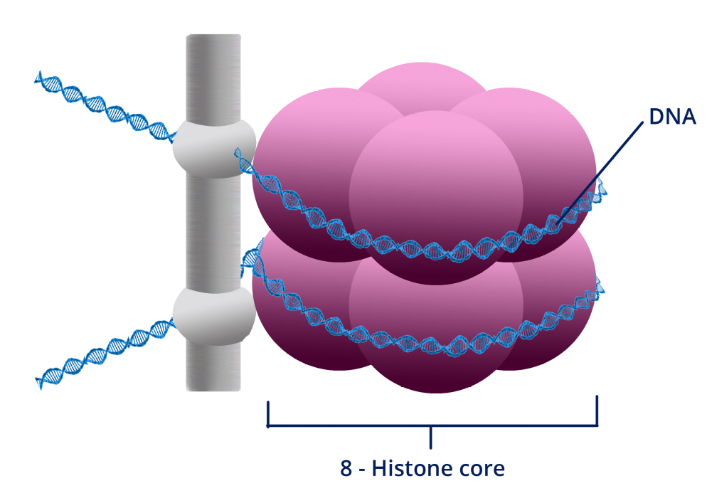
The Structure of Chromosomes
DNA is a very long molecule. To fit all the genetic material into a small space, it is tightly coiled
DNA is wound around a series of 8 proteins called histones
The histone proteins wrapped in DNA is called a nucleosome
There are many nucleosomes in a DNA molecule

Slide 13
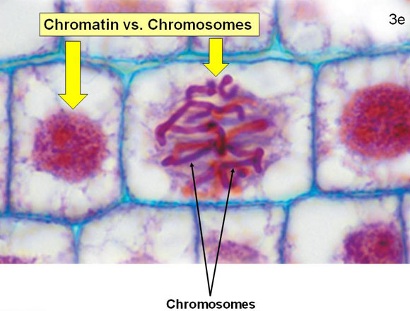
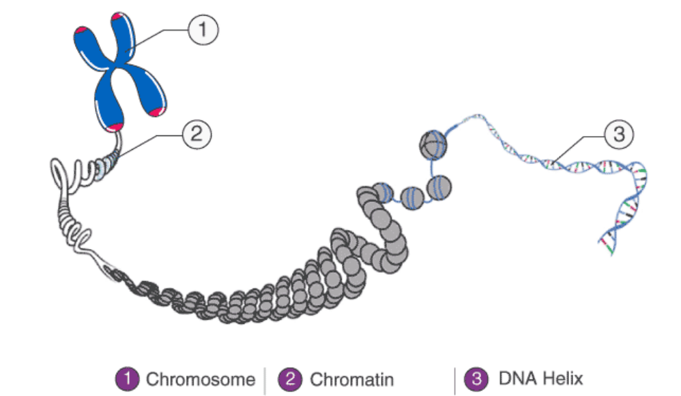
Chromatin and Chromosomes
When a cell is not dividing, its DNA exists as a mass of tangled chromatin
When a cell divides, the chromatin becomes very tightly coiled into structures known as chromosomes
Normal humans have 46 chromosomes and the DNA code for a particular protein on a chromosome is called a gene

Slide 14
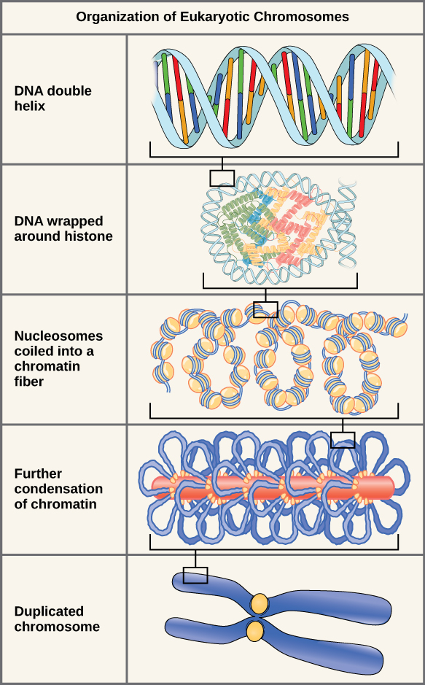
DNA double helix composed of repeating nucleotides
DNA wraps around groups of 8 histone proteins to form a nucleosome
Nucleosomes coil up to form chromatin
Chromatin super coils to form chromosomes, when the cell is about to divide
Booklet page 5

Slide 15
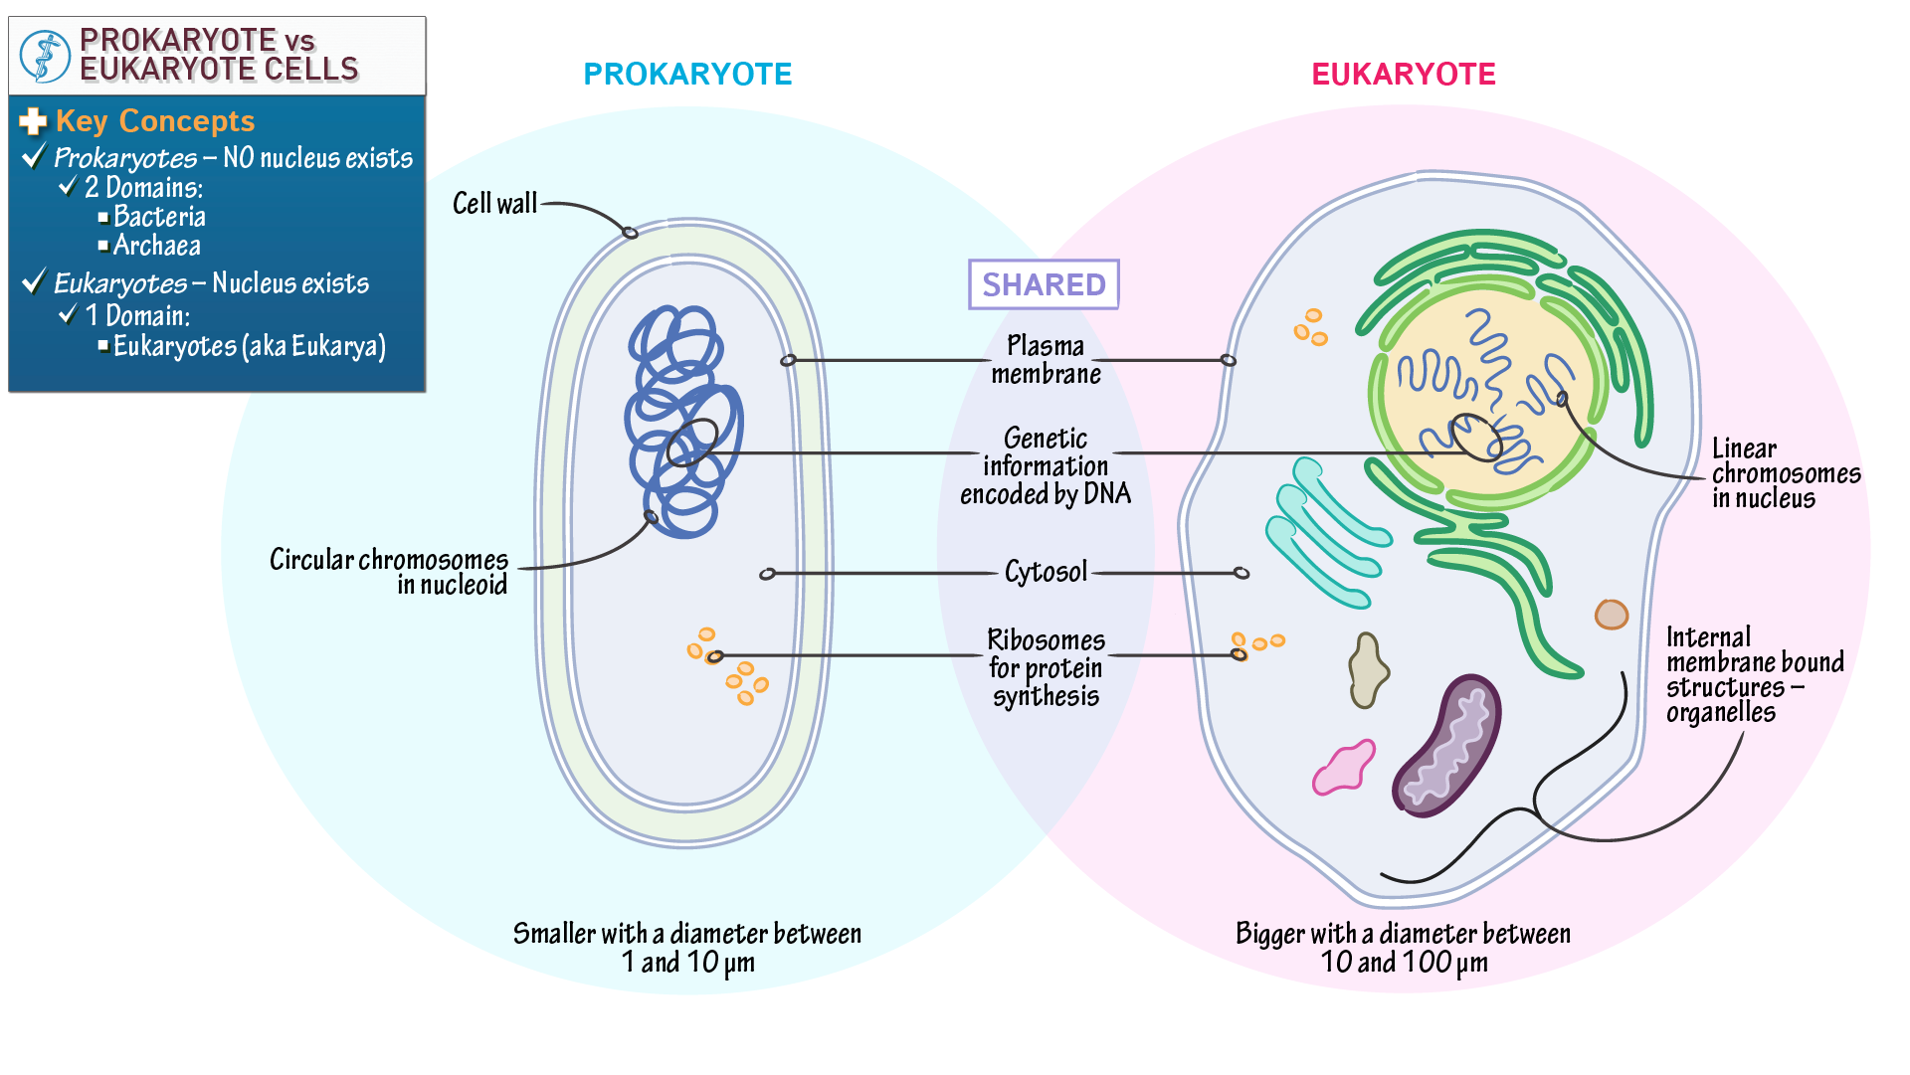
Where is DNA found in eukaryotes and prokaryotes?
Prokaryotic DNA:
Is found freely in the cytoplasm (within a region called the nucleoid)
Is naked (i.e. not bound with proteins and therefore doesn’t form chromatin)
Genomes are compact (contain little repetitive DNA and no introns)
Contains extra-chromosomal plasmids
Is circular in shape
Eukaryotic DNA:
Is contained within a nucleus
Is bound to histone proteins
Genomes contain large amounts of non-coding and repetitive DNA (including introns)
Do not contain plasmids (but organelles such as the mitochondria may contain their own chromosomes)
Are linear in shape

Slide 16
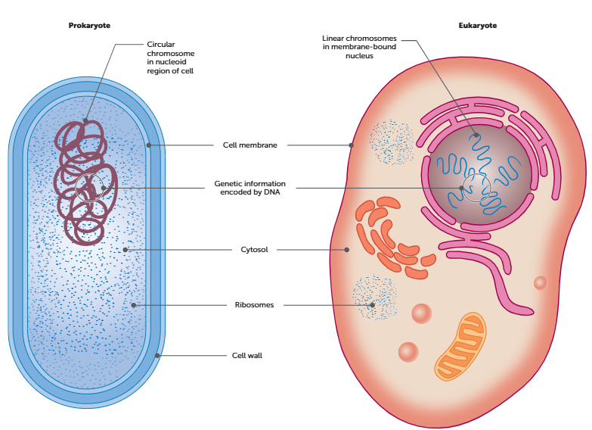
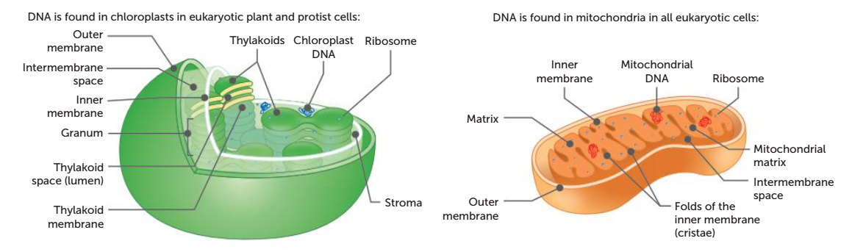
Mitochondrial and Nuclear DNA
DNA is a double-stranded helical molecule.
In eukaryotic cells, DNA is found in a linear form bound to proteins in the nucleus, and in an unbound circular form in chloroplasts and mitochondria.
In prokaryotic cells, DNA is found in an unbound circular form in the nucleoid region of the cytosol.

Slide 17
Summary of DNA structure and location
Feature | Eukaryotic Cells | Prokaryotic Cells
DNA structure | Double‑stranded, helical molecule | Double‑stranded, helical molecule
DNA shape | Linear (in nucleus); circular (in organelles such as mitochondria and chloroplasts) | Circular
DNA location | Nucleus (bound to proteins); chloroplasts and mitochondria (unbound) | Nucleoid region of the cytosol
Protein association | Bound to proteins in the nucleus; unbound in organelles | Unbound

