Slide 1
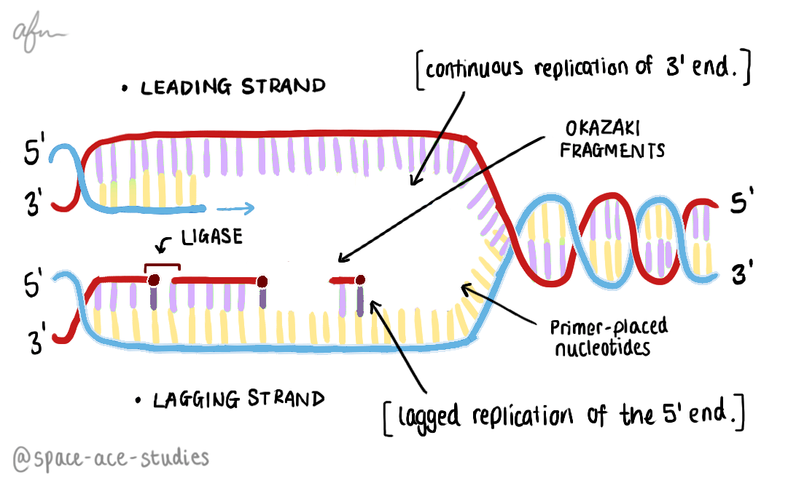
Title: DNA Replication Monday, 23 February 2026
Learning question: How does DNA copy itself?

Slide 2

Key words
DNA replication
DNA helicase
DNA ligase
DNA polymerase
Template strand
Hydrogen bonds
Covalent bonds
Complementary base pairing
Okazaki Fragments
Coding
Non-coding

Slide 3
Learning Objectives
Explain the process of DNA replication, including the role of the following:
  Helicase
  DNA polymerase
  DNA ligase
Describe how the unique structure of DNA enables it to perform its functions

Slide 4
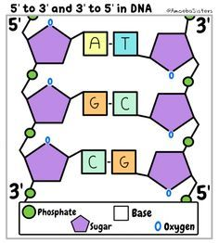
The Structure of DNA
DNA is described as having anti-parallel strands
This means that the strands flow in opposite directions
  One strand flows 5’ → 3’ (5 prime to 3 prime) while the other flows 3’ → 5’
  These are called the leading (5’ → 3’) and lagging (3’ → 5’) strands of DNA

Slide 5
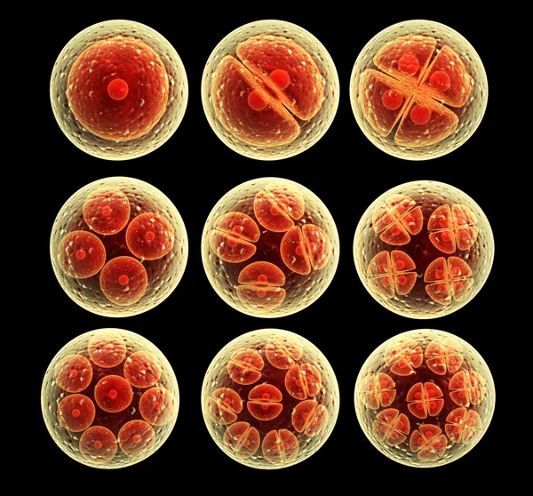
Replication of DNA
DNA is able to copy itself exactly.
  Mistakes in copying the DNA code can lead to mutations and cancers.
It needs to do this in mitosis, where cells copy and divide to produce more cells that are the same.
E.g. A zygote must do this many times to form a larger mass of cells which eventually become differentiated into specific cell types.

Slide 6
Replication of DNA
DNA replication occurs in the nucleus of eukaryotic cells. What do you think will be needed to make a brand-new strand of DNA?
A template to copy from
A primer to know here to start copying from
Enzymes – remember these speed up the rate of reaction in cells
  DNA helicase (unwinds DNA double helix into parallel strands)
  DNA polymerase (adds nucleotides)
  DNA ligase (glues sections of DNA together)
Free nucleotides to make new DNA strands
ATP – our energy source to make and break bonds

Slide 7
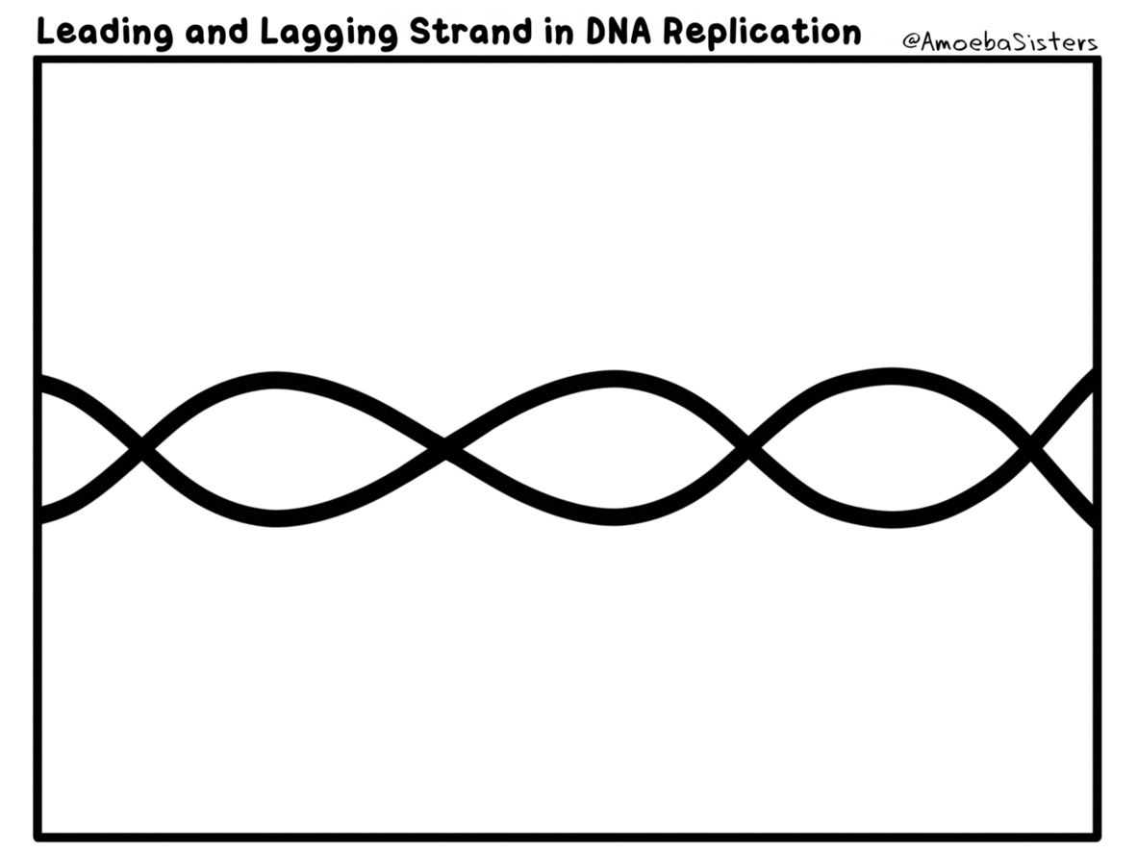
Watch the animation carefully and observe what is happening

Slide 8
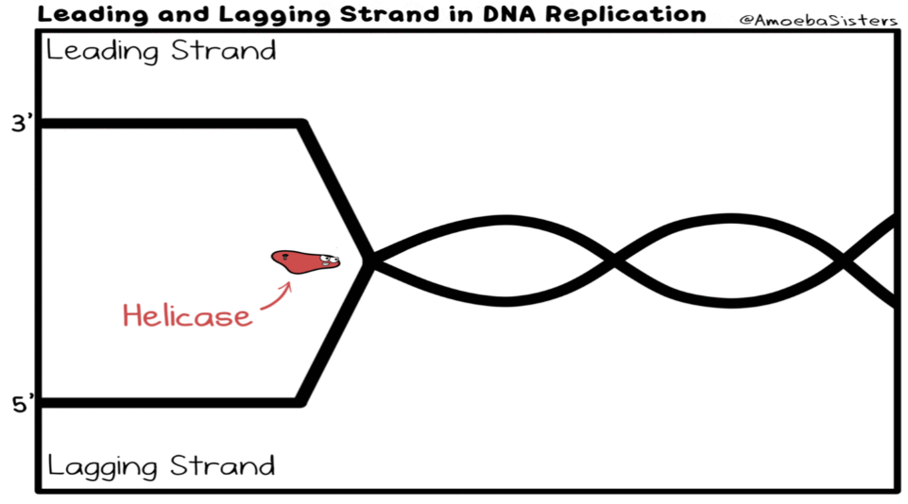
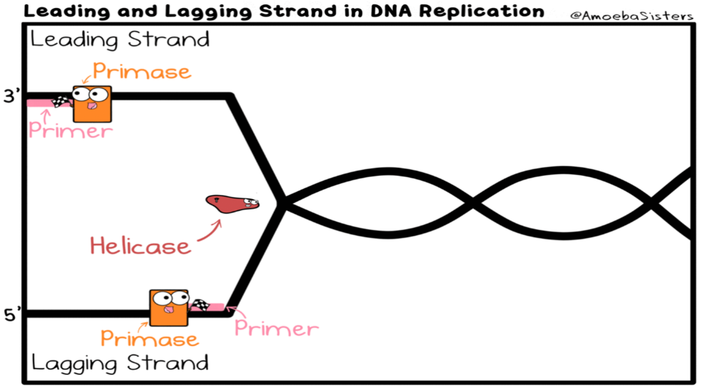
Stages of Replication
DNA helicase causes the DNA double helix to unwind and “unzip”. Unzipping is caused by weak hydrogen bonds between bases breaking.
A primer attaches to the DNA – this shows nucleotides where to start copying from.

Slide 9
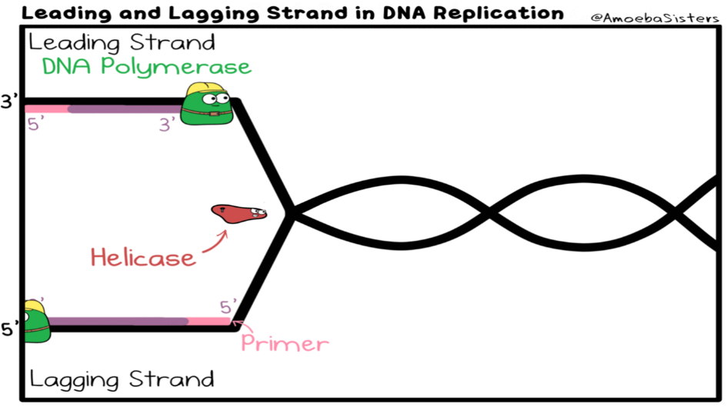
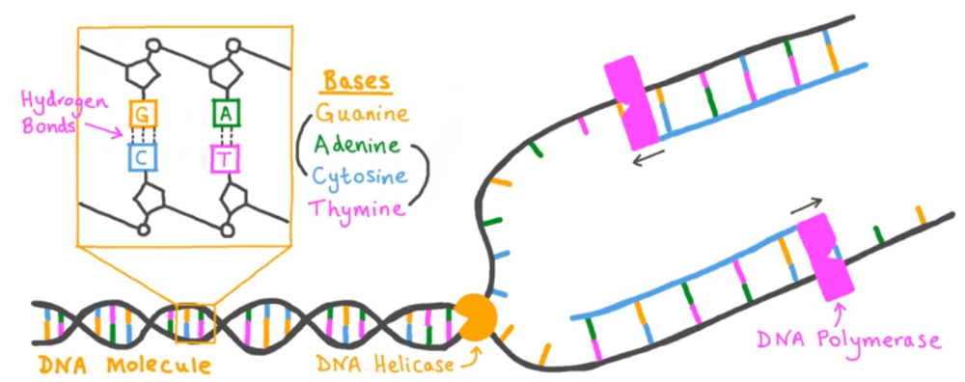
Stages of Replication
Free nucleotides pair up with exposed DNA bases. DNA polymerase helps this process to happen
Weak hydrogen bonds form between complementary base pairs.
Strong covalent bonds form between adjacent nucleotides forming a “backbone”.

Slide 10
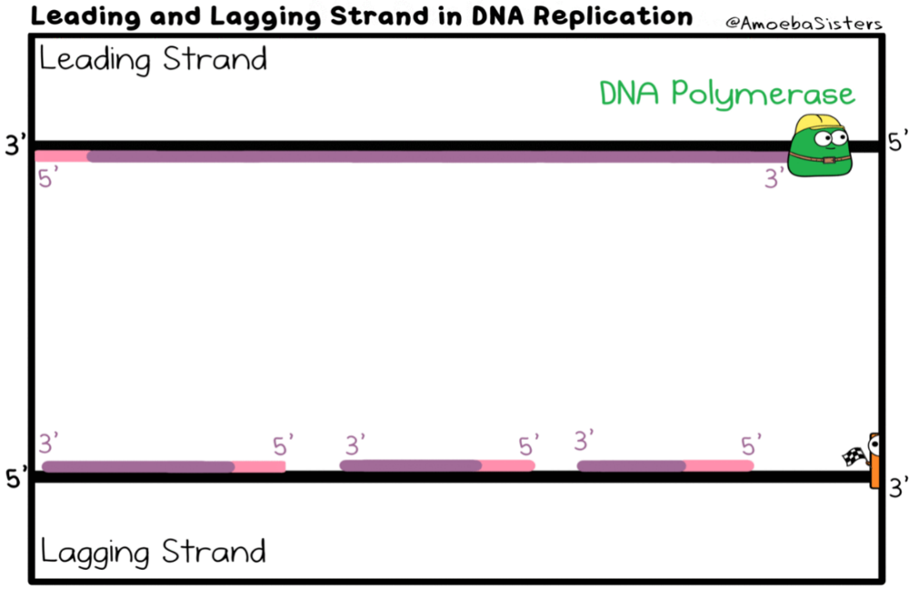
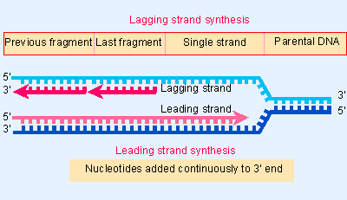
Stages of Replication
The leading strand in DNA can form a continuous copy of DNA as nucleotides are being added from 5’ → 3’
DNA replication on the lagging strand occurs in short sections, called Okazaki fragments, because nucleotides are being added from 3’ → 5’
The short sections of DNA are then ‘glued’ together by the enzyme DNA ligase.

Slide 11
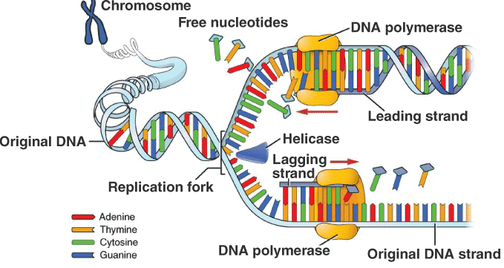
Stages of Replication
After the fragments of DNA have been bonded together, DNA helicase rewinds the DNA molecules
Two identical daughter strands are formed

Slide 12
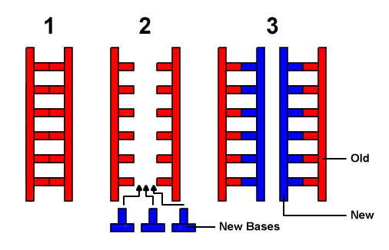
Semi-conservative Replication
DNA replication is described as being semi-conservative (half of the original DNA is kept in the new double helix)
Two new strands of DNA are formed, but one strand is from the original piece of DNA that it was copied from.

Slide 13
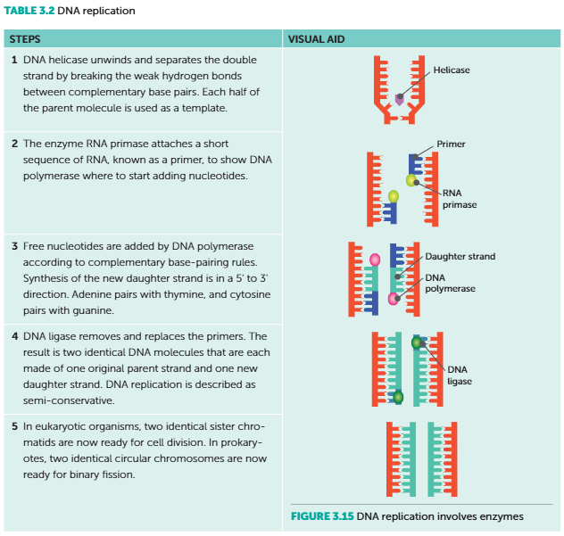
Summary of DNA replication

Slide 14
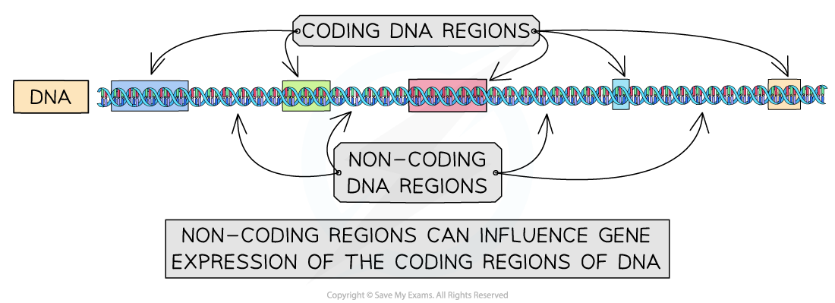
Coding and Non-Coding
Coding DNA is DNA that codes for proteins
Sections of coding DNA are called genes
Genes contain instructions for the sequence of amino acids that make proteins that make organisms function
Only 1-2% of the human genome codes for DNA
Non-coding DNA makes up the majority of the human genome
Some of this non-coding DNA can be transcribed into functional RNA, e.g., transfer RNA
Once thought to be ‘junk’ DNA, but now understood to play important regulatory roles in cells

Slide 15
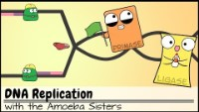
https://www.youtube.com/watch?v=Qqe4thU-os8

