Slide 1
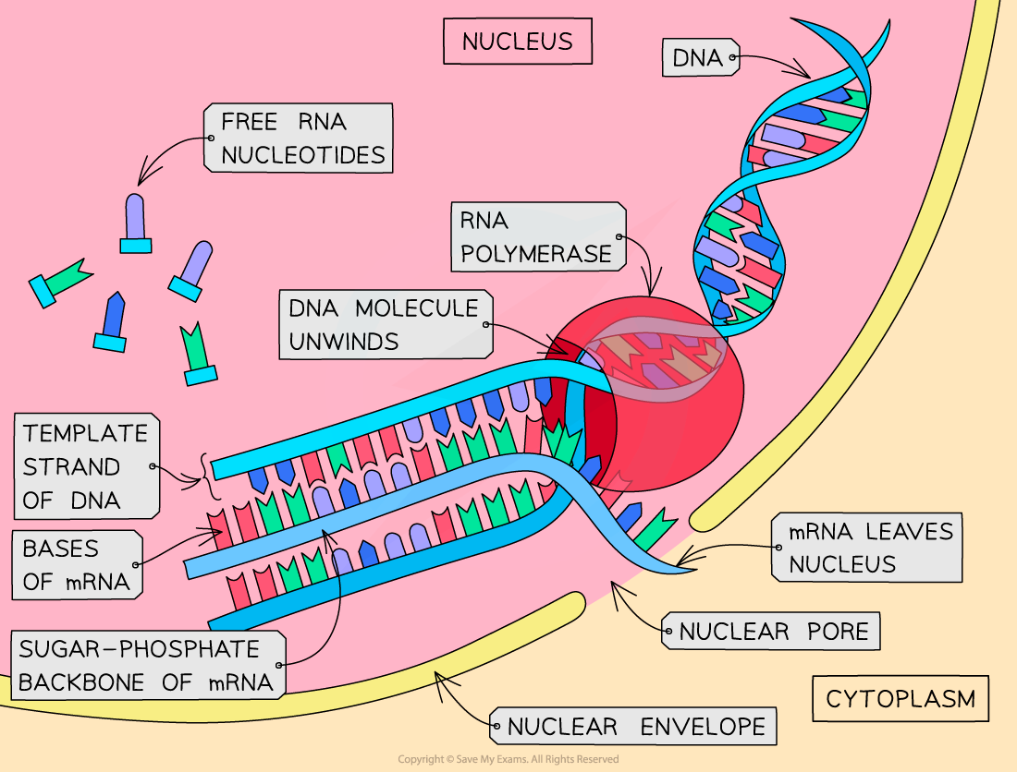
Title: Protein Synthesis - Transcription Monday, 23 February 2026
Learning question: How are proteins made in cells?

Slide 2

Key words
Triplet
Codon
mRNA
RNA
Uracil
Adenine
Cytosine
Guanine
Thymine
Intron
Exon
Splicing

Slide 3
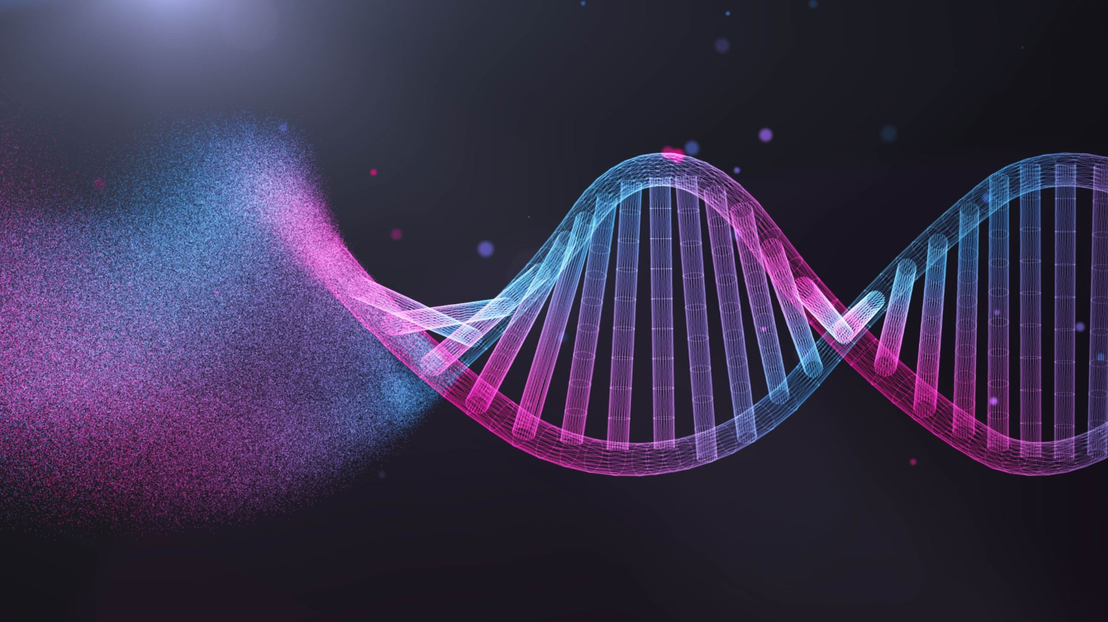
Learning Objectives
Describe the genetic code as a base triplet code, where each codon codes for a specific amino acid
Describe genes as sections of DNA that include both coding and non-coding DNA, and explain that many genes contain information for protein production
Describe the process of protein synthesis, including:
  Transcription of a gene into messenger RNA (mRNA) in the nucleus
  Translation of mRNA into an amino acid sequence at the ribosome
  Splicing of introns to produce a mature mRNA transcript of DNA
Explain the role of proteins, including enzymes and structural proteins, in maintaining cell structure and cellular functioning

Slide 4
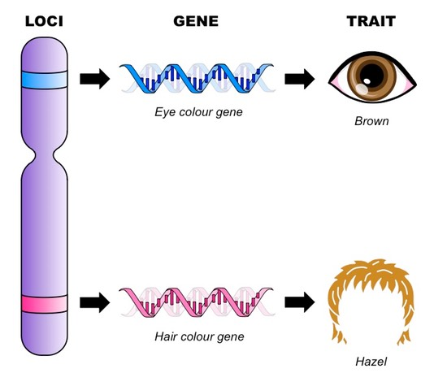
What is a gene?
Genes are lengths of DNA, made from a sequence of nucleotide bases.
These code for one or more proteins.
Genes are units of hereditary – they can be passed on.
Most genes are found inside the nucleus of a cell, although some are found in the mitochondria/chloroplasts in eukaryotes.
The specific space where a gene is found is known as the locus.

Slide 5
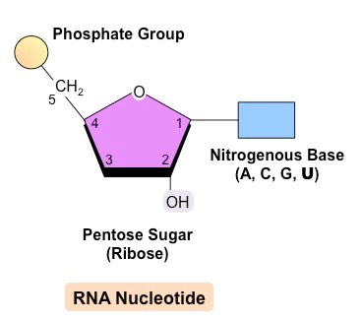
RNA Structure
This is a second type of nucleic acid called ribonucleic acid
RNA is also made up of smaller subunits called nucleotides
Phosphate group
Ribose Sugar
Base

Slide 6
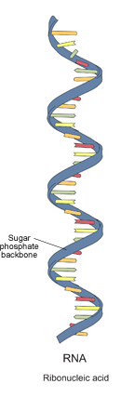
RNA Structure
Unlike DNA, RNA only has one nucleotide strand.
RNA has one base that is different from DNA – the base Uracil replaces Thymine and so Uracil now becomes the complementary base partner of Adenine.

Slide 7
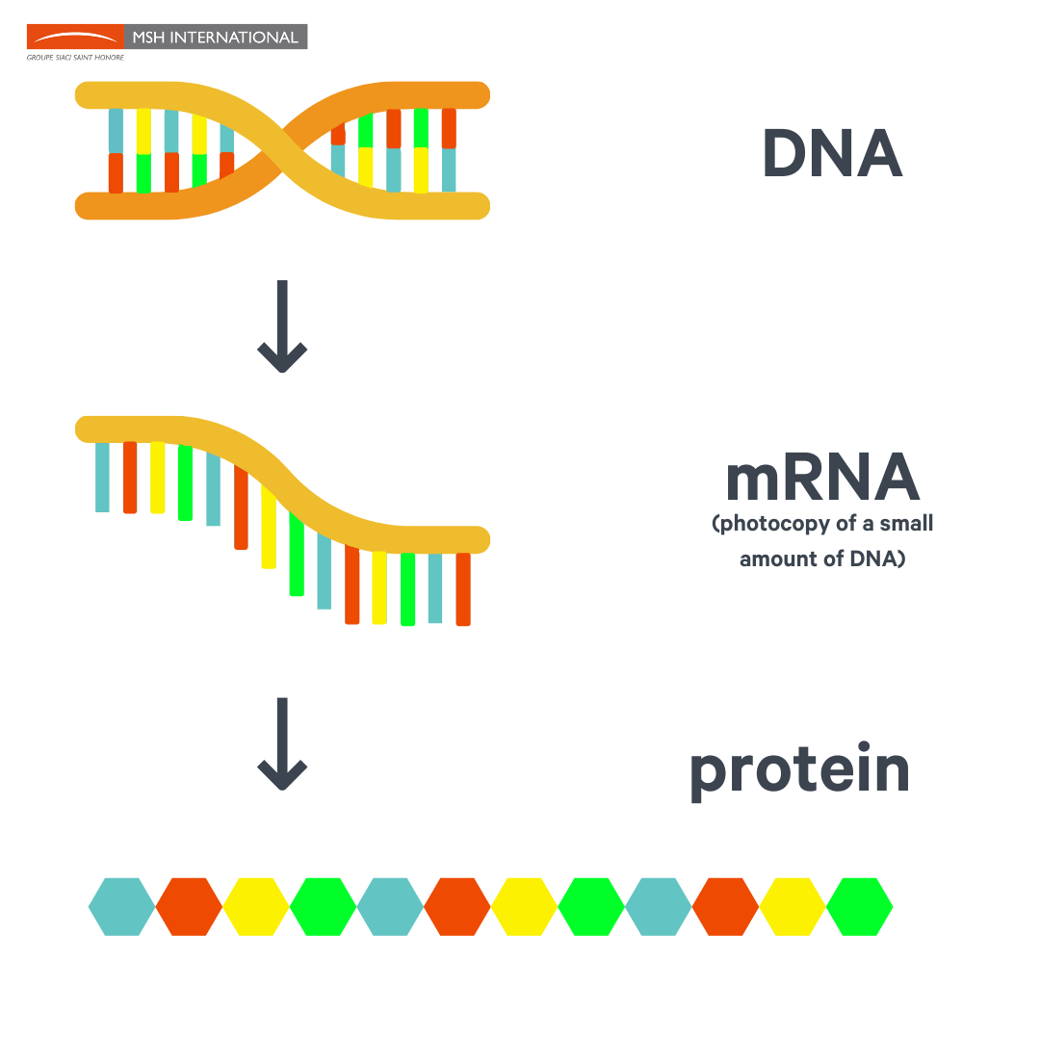
Messenger RNA
DNA is the “instruction manual” for making proteins, but protein synthesis itself occurs in the cytoplasm.
Messenger RNA (mRNA) is a type of RNA that copies information from a particular strand of DNA and carries it out into the cytoplasm.
This process is called transcription.

Slide 8
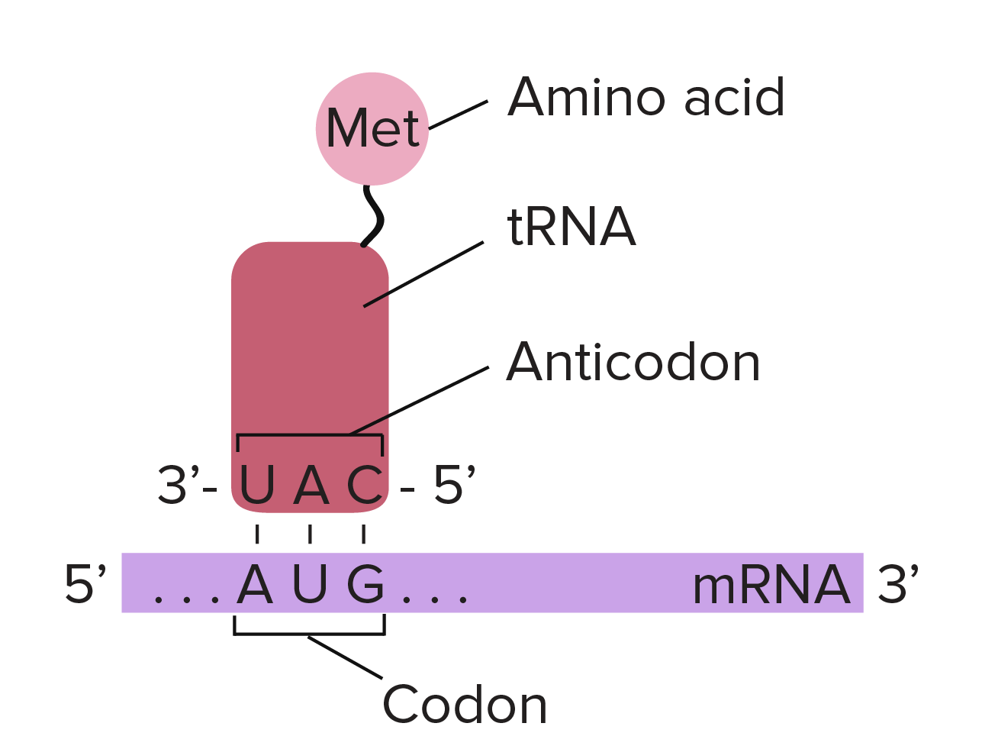
Transfer RNA (tRNA)
A small molecule of RNA, containing only 70 – 90 nucleotides.
Each tRNA molecule can carry a specific amino acid and therefore plays a vital role in protein synthesis (translation)

Slide 9
Summary of similarities and differences between DNA and RNA
 | DNA | RNA
Similarities | Bases – adenine, cytosine and guanine Both found in the nucleus Involved in protein synthesis Formed by polymerase
Differences | Thymine | Uracil
 | Unable to leave nucleus | Can leave the nucleus
 | Double strand | Single strand
 | Removal of oxygen – “deoxyribose” | Extra oxygen present
 | Is not broken down after use | Broken down after for it to be reused

Slide 10
Protein Synthesis
Protein synthesis is a two-part process
The code to make a new protein is copied from a section of DNA and taken out of the nucleus to be read (Transcription)
The ‘instructions’ that have been copied are used to build new proteins (Translation)

Slide 11
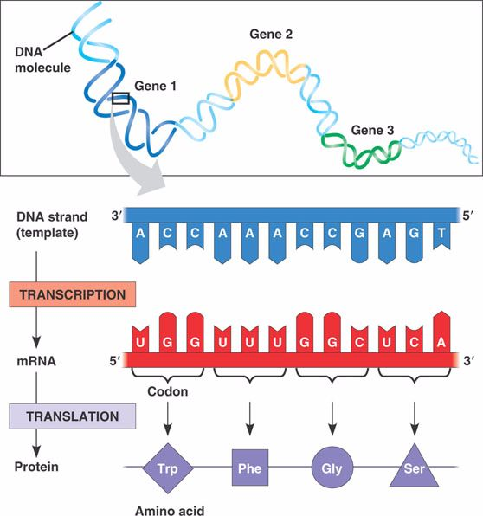
Triplets and Codons
A group of three adjacent bases in DNA is known as a triplet and in mRNA it is known as a codon.
Eventually, these groups of three bases code for a single amino acid and therefore proteins.
This is why DNA codes for proteins

Slide 12
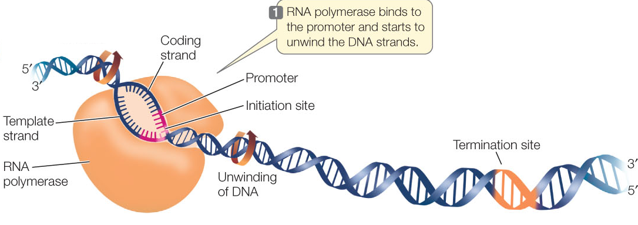
Transcription
In order to copy the set of instructions needed to make a particular protein, the section of the DNA helix where the gene is located needs to unwind (DNA Helicase) and unzip to expose the code (series of bases).
The unwound and unzipped part of DNA that is to be copied is known as the DNA template.
A nucleotide sequence at the start of the gene sequence on DNA is called a promoter.
Proteins position RNA polymerase on to DNA at the start of the promoter

Slide 13
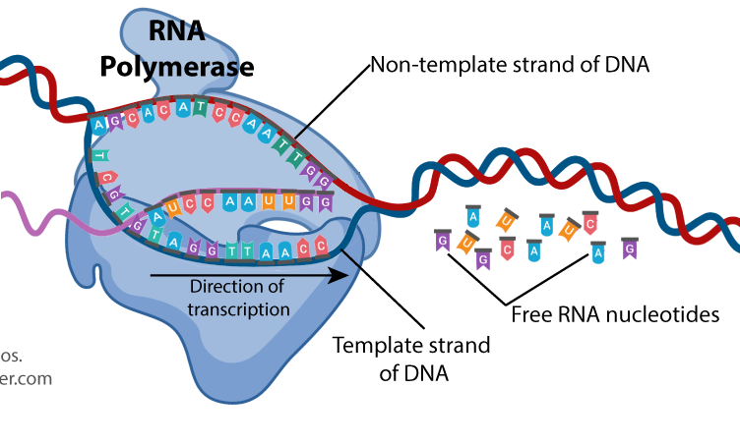
Transcription
Free RNA nucleotides start to pair up with their complementary base of DNA on the strand opposite them and form weak hydrogen bonds.
The RNA nucleotides start to link together by forming covalent bonds between the phosphate of one nucleotide linking onto the sugar of another to make a single RNA strand.
This is called messenger RNA or mRNA.

Slide 14
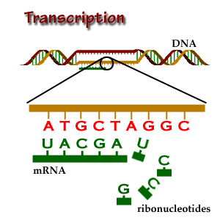
Weak hydrogen bonds forming between bases
covalent bonds forming between sugar and phosphate groups.

Slide 15
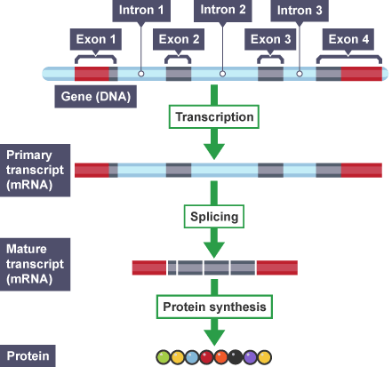
RNA Splicing
Genes are DNA sequences that code for a protein. It is an unusual feature of most genes that the sequence of nucleotides that code for a protein is regularly interrupted by non-coding stretches of DNA:
  The coding regions of a gene are called exons
  The intervening non-coding regions are called introns
When genes are to be expressed by a cell, they need to be copied, and the non-coding parts edited out before they can be turned into protein. This process is called RNA splicing.
First, the gene is copied in full to produce a primary transcript. This includes both introns and exons.
The primary transcript of mRNA is then processed to remove the introns and join the remaining exons together. A mature transcript of mRNA is formed.

Slide 16
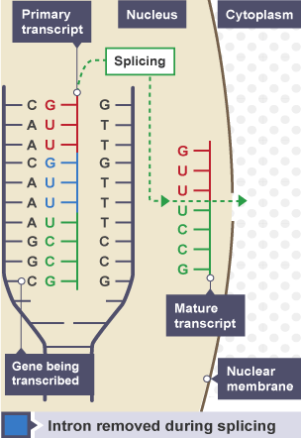
Transcription
The newly transcribed section of mature mRNA now leaves the nucleus via the nuclear pores and enters the cytoplasm.
Hydrogen bonds between DNA bases re-form, and DNA winds back up into a double helix.

Slide 17
Recap of Transcription
When a gene is to be expressed, the base sequence of DNA is copied or transcribed into mRNA (messenger RNA). This process takes place in the nucleus and occurs in a series of stages.
RNA polymerase moves along the DNA, unwinding the strand.
Hydrogen bonds between base pairs break, which allows the unzipping of the double helix.
As RNA polymerase breaks the bonds, it synthesises a primary transcript of mRNA using RNA nucleotides. These form hydrogen bonds with the exposed DNA strand by complementary base pairing.
The primary transcript of mRNA is processed to produce a mature transcript of mRNA by removing the introns, so only the exons remain
The mature mRNA transcript is now ready to leave the nucleus via a nuclear pore and travel to the ribosome.

Slide 18

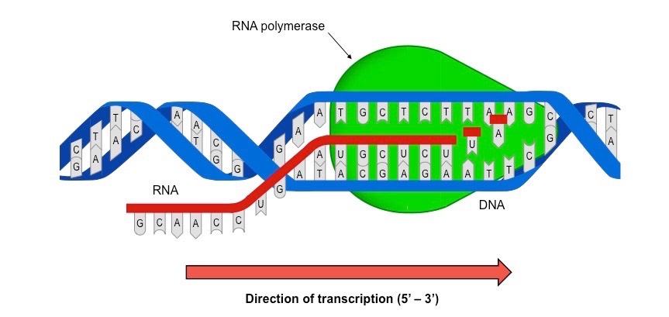
Write a summary of the stages of transcription using the key words below
Key words:
RNA polymerase
DNA template
Messenger RNA
Transcription
Nucleotides
Uracil
Thymine
Adenine
Cytosine
Guanine
Intron
Exon
Mature mRNA transcript
Nuclear pore

Slide 19
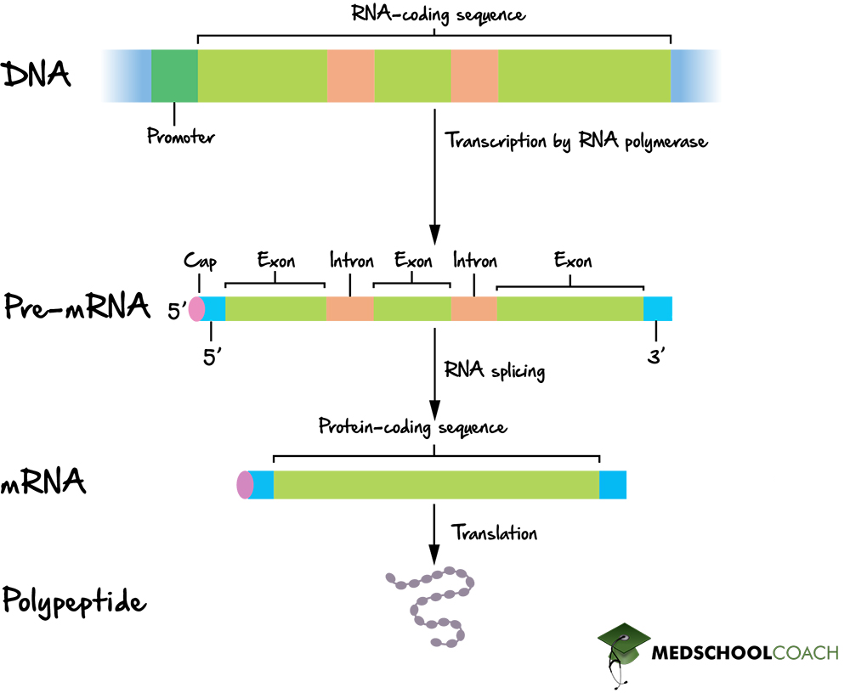
Summary
A section of DNA that codes for a specific protein is known as a gene.
A group of three bases in DNA is known as a triplet
A group of three bases in mRNA is known as a codon
The first stage of protein synthesis is called transcription. This is where the section of DNA that codes for a specific gene is copied by mRNA nucleotides. This is done through base-pairing; adenine pairs with uracil in mRNA and thymine in DNA, while cytosine always pairs with guanine.
The initial mRNA contains introns and exons in the code.
  The introns are non-coding sequences, while the exons are coding sequences.
The mRNA is processed to remove the non-coding introns.
The single-stranded mature mRNA in the nucleus and leaves via a nuclear pore and enters the cytoplasm.
RNA and DNA are similar molecules but differ in key ways:
  RNA has uracil instead of thymine
  RNA is single-stranded
  mRNA can leave the nucleus
  RNA has an extra oxygen molecule

Slide 20
A
T
C
G
G
C
C
G
A
T
C
G
A
T
T
A
Notes:
Shows the structure of a length of DNA

Slide 21
T G C G A T T A G C A T C G T A C G T A
A C G C T A A T C G T A G C A T G C A T
Notes:
The sense and antisense strands are introduced

Slide 22
the double stranded DNA starts to unwind...
T G C G A T T A G C A T C G T A C G T A
A C G C T A A T C G T A G C A T G C A T

Slide 23

T G C G A T T A G C A T C G T A C G T A
A C G C T A A T C G T A G C A T G C A T

Slide 24
T G C G A T T A G C A T C G T A C G T A
A C G C T A A T C G T A G C A T G C A T

Slide 25
T G C G A T T A G C A T C G T A C G T A
A C G C T A A T C G T A G C A T G C A T

Slide 26
T G C G A T T A G C A T C G T A C G T A
exposing the sense and antisense (DNA) strands
A C G C T A A T C G T A G C A T G C A T

Slide 27
T G C G A T T A G C A T C G T A C G T A
A C G C T A A T C G T A G C A T G C A T

Slide 28
antisense strand (DNA)
T G C G A T T A G C A T C G T A C G T A
A C G C T A A T C G T A G C A T G C A T
sense strand (mRNA)
Notes:
RNA polymerase binds to the sense strand

Slide 29
T G C G A T T A G C A T C G T A C G T A
A C G C T A A T C G T A G C A T G C A T

Slide 30
T G C G A T T A G C A T C G T A C G T A
A C G C T A A T C G T A G C A T G C A T

Slide 31
T G C G A T T A G C A T C G T A C G T A
A C G C T A A T C G T A G C A T G C A T

Slide 32
T G C G A T T A G C A T C G T A C G T A
RNA polymerase enzyme
A C G C T A A T C G T A G C A T G C A T

Slide 33
T G C G A T T A G C A T C G T A C G T A
A C G C T A A T C G T A G C A T G C A T

Slide 34
T G C G A T T A G C A T C G T A C G T A
A C G C T A A T C G T A G C A T G C A T

Slide 35
T G C G A T T A G C A T C G T A C G T A
A C G C T A A T C G T A G C A T G C A T
Notes:
And the free RNA nucleotides are joined together using the sense strand as a template

Slide 36
T G C G A T T A G C A T C G T A C G T A
U
G
C
A
A C G C T A A T C G T A G C A T G C A T

Slide 37
T G C G A T T A G C A T C G T A C G T A
free mRNA nucleotides
G
U
A
C
A C G C T A A T C G T A G C A T G C A T

Slide 38
T G C G A T T A G C A T C G T A C G T A
U
G
A
C
A C G C T A A T C G T A G C A T G C A T

Slide 39
T G C G A T T A G C A T C G T A C G T A
U
G
A
C
A C G C T A A T C G T A G C A T G C A T

Slide 40
T G C G A T T A G C A T C G T A C G T A
U
G
A
C
A C G C T A A T C G T A G C A T G C A T

Slide 41
T G C G A T T A G C A T C G T A C G T A
U
A
G
C
A C G C T A A T C G T A G C A T G C A T

Slide 42
T G C G A T T A G C A T C G T A C G T A
A
U
G
C
A C G C T A A T C G T A G C A T G C A T

Slide 43
T G C G A T T A G C A T C G T A C G T A
the free nucleotides bind with their complementary base pairs
A
U
G
C
A C G C T A A T C G T A G C A T G C A T

Slide 44
T G C G A T T A G C A T C G T A C G T A
A
U
G
C
A C G C T A A T C G T A G C A T G C A T

Slide 45
T G C G A T T A G C A T C G T A C G T A
A
U
G
C
G
A C G C T A A T C G T A G C A T G C A T

Slide 46
T G C G A T T A G C A T C G T A C G T A
the RNA polymerase moves along the sense strand of DNA
U
G
C
G
A
A C G C T A A T C G T A G C A T G C A T

Slide 47
T G C G A T T A G C A T C G T A C G T A
U
U U A
G
C
G
A
A C G C T A A T C G T A G C A T G C A T

Slide 48
T G C G A T T A G C A T C G T A C G T A
U
U U A G C A
G
C
G
A
A C G C T A A T C G T A G C A T G C A T

Slide 49
T G C G A T T A G C A T C G T A C G T A
U
U U A G C A U C G
G
C
G
A
A C G C T A A T C G T A G C A T G C A T

Slide 50
T G C G A T T A G C A T C G T A C G T A
U
U U A G C A U C G U A C
G
C
G
A
A C G C T A A T C G T A G C A T G C A T

Slide 51
T G C G A T T A G C A T C G T A C G T A
U
U U A G C A U C G U A C G U A
G
C
G
A
A C G C T A A T C G T A G C A T G C A T

Slide 52
T G C G A T T A G C A T C G T A C G T A
when a “stop” sequence is reached the enzyme becomes detached
U
U U A G C A U C G U A C G U A
G
C
G
A
A C G C T A A T C G T A G C A T G C A T
Notes:
Shows the exit of the mRNA from the nucleus via a pore

Slide 53
T G C G A T T A G C A T C G T A C G T A
U
U U A G C A U C G U A C G U A
G
C
G
A
A C G C T A A T C G T A G C A T G C A T

Slide 54
T G C G A T T A G C A T C G T A C G T A
U
U U A G C A U C G U A C G U A
G
C
G
A
A C G C T A A T C G T A G C A T G C A T

Slide 55
T G C G A T T A G C A T C G T A C G T A
U
U U A G C A U C G U A C G U A
G
C
G
A
A C G C T A A T C G T A G C A T G C A T

Slide 56
T G C G A T T A G C A T C G T A C G T A
U
U U A G C A U C G U A C G U A
G
C
G
A
A C G C T A A T C G T A G C A T G C A T

Slide 57
T G C G A T T A G C A T C G T A C G T A
U
U U A G C A U C G U A C G U A
G
C
G
A
A C G C T A A T C G T A G C A T G C A T

Slide 58
T G C G A T T A G C A T C G T A C G T A
U
U U A G C A U C G U A C G U A
G
C
G
A
A C G C T A A T C G T A G C A T G C A T

Slide 59
T G C G A T T A G C A T C G T A C G T A
U
U U A G C A U C G U A C G U A
G
C
G
A
A C G C T A A T C G T A G C A T G C A T

Slide 60
T G C G A T T A G C A T C G T A C G T A
U
U U A G C A U C G U A C G U A
G
C
G
A
A C G C T A A T C G T A G C A T G C A T

Slide 61
T G C G A T T A G C A T C G T A C G T A
U
U U A G C A U C G U A C G U A
G
C
the double stranded DNA rewinds and the mRNA is released
G
A
A C G C T A A T C G T A G C A T G C A T

Slide 62
T G C G A T T A G C A T C G T A C G T A
U
U U A G C A U C G U A C G U A
G
C
G
A
A C G C T A A T C G T A G C A T G C A T

Slide 63
T G C G A T T A G C A T C G T A C G T A
U
U U A G C A U C G U A C G U A
G
C
G
A
A C G C T A A T C G T A G C A T G C A T

Slide 64
T G C G A T T A G C A T C G T A C G T A
A C G C T A A T C G T A G C A T G C A T

Slide 65
T G C G A T T A G C A T C G T A C G T A
A C G C T A A T C G T A G C A T G C A T

Slide 66
T G C G A T T A G C A T C G T A C G T A
A C G C T A A T C G T A G C A T G C A T

Slide 67
T G C G A T T A G C A T C G T A C G T A
A C G C T A A T C G T A G C A T G C A T

Slide 68
T G C G A T T A G C A T C G T A C G T A
A C G C T A A T C G T A G C A T G C A T

Slide 69
U
U U A G C A U C G U A C G U A
G
C
G
A

Slide 70
U
U U A G C A U C G U A C G U A
G
C
G
A

Slide 71
U
U U A G C A U C G U A C G U A
G
C
G
A

Slide 72
U
U U A G C A U C G U A C G U A
G
C
G
A

Slide 73
the mRNA leaves the nucleus via a pore in the nuclear membrane
U
U U A G C A U C G U A C G U A
G
C
G
A

Slide 74
U
U U A G C A U C G U A C G U A
G
C
G
A

Slide 75
U
U U A G C A U C G U A C G U A
G
C
G
A

Slide 76
U
U U A G C A U C G U A C G U A
G
C
G
A

Slide 77
U
U U A G C A U C G U A C G U A
G
C
G
A

Slide 78
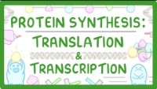
Watch up to 6:50 mins for a summary of transcription https://www.youtube.com/watch?v=ubdoUqmNF98

Slide 79
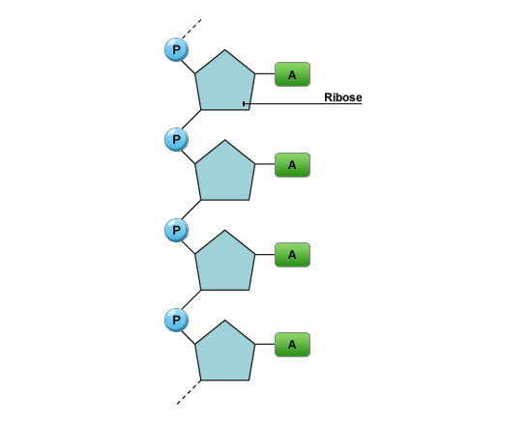
Quiz!
1. What type of nucleic acid is shown in this diagram?

Slide 80
2. What type of bond does the arrow point to?

Slide 81
3. What base is missing from RNA that is present in DNA?
4. What base is it substituted with?

Slide 82
5. Where does the first stage of protein synthesis take place?
6. What is the function of RNA polymerase?

Slide 83
Answers
Ribonucleic acid
Covalent bond
Thymine
Uracil
Nucleus
RNA polymerase adds new RNA nucleotides to the growing mRNA strand.

