Slide 1
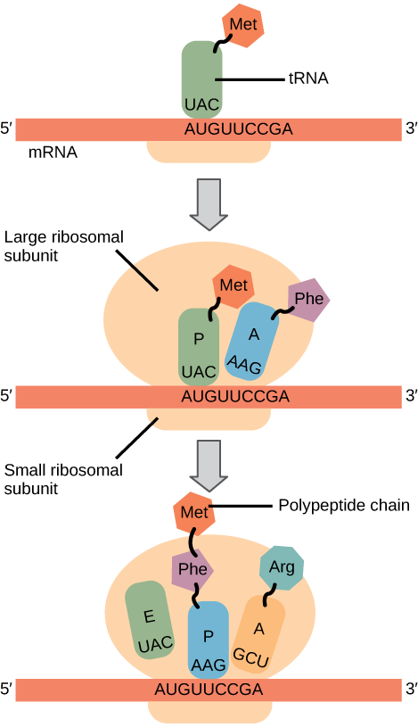
Title: Translation Monday, 23 February 2026
Learning question: How can we produce new proteins?

Slide 2
Learning objectives:
Explain the process of protein synthesis, including the role of the following
  Ribosomes
  Codon
  Anticodon
  Amino acids
  Peptide bonds
Interpret an amino acid chart.
Describe genes as sections of DNA that include both coding and non-coding DNA, and explain that many genes contain information for protein production
Describe the process of protein synthesis, including:
    Transcription of a gene into messenger RNA (mRNA) in the nucleus
    Translation of mRNA into an amino acid sequence at the ribosome
    Splicing of introns to produce a mature mRNA transcript of DNA
Explain the role of proteins, including enzymes and structural proteins, in maintaining cell structure and cellular functioning

Slide 3

Key words:
mRNA
tRNA
Codon
Anti-codon
Amino acid
Degenerate code
Ribosome
Peptide bond
Complementary
Initiation
Elongation
Termination

Slide 4
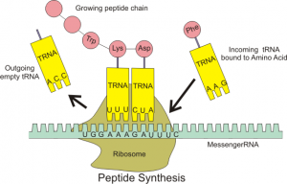
Translation Overview
Translation is the process of forming a protein using tRNA polymerase by matching complimentary codons and anticodons then forming peptide bonds between adjacent amino acids.
This process occurs in the cytoplasm of the cell at ribosomes.
Ribosomes read the mRNA code and helps tRNA molecules to bind to mRNA.
This process requires ATP as peptide bodes are formed

Slide 5
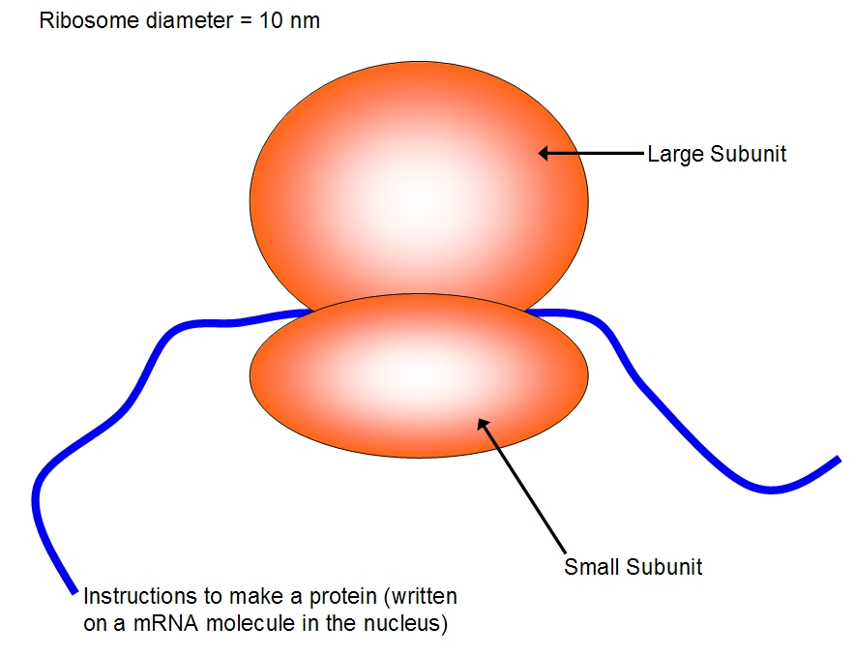
Ribosomes
Made of two subunits.
Groove in the middle is where mRNA code is fed through and read
Assembly of amino acids in the correct sequence occurs here to make a functioning protein.
large subunit
small subunit

Slide 6
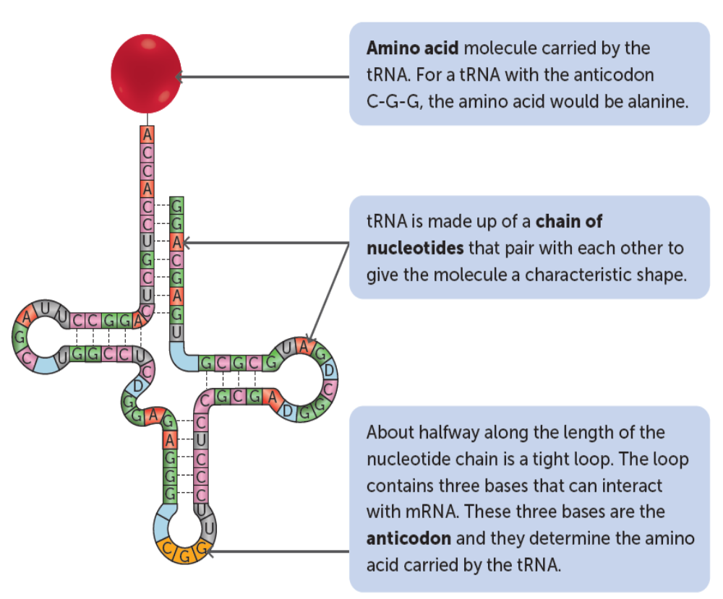
Translation
A second type of RNA is called transfer RNA (tRNA) which is also made in the nucleus but transferred into the cytoplasm
Molecules of tRNA have a set of triplet bases – these are known as anticodons
Anticodons have base sequences that are complementary to mRNA codons
At the top of tRNA molecule, there are 3 unpaired bases where a particular amino acid will join on to.

Slide 7
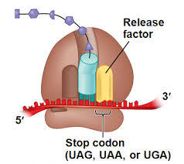
Translation Overview
There are three steps involved in translation:
Initiation – starting the process
Elongation – growing a polypeptide chain
Termination – stopping the process

Slide 8
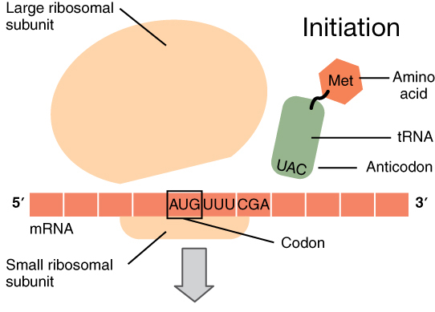
Initiation
A ribosome attaches to the first codon of mRNA, which is the start codon AUG. This codes for the amino acid methionine
The start codon signals the beginning of translation and the formation of a polypeptide chain.
A tRNA molecule with the complementary anticodon sequence, UAC, binds to the start codon.
This tRNA molecule carries the amino acid methionine to the ribosome.
During initiation, two codons are positioned in the ribosome, but after initiation, translation proceeds with one codon being read at a time.

Slide 9
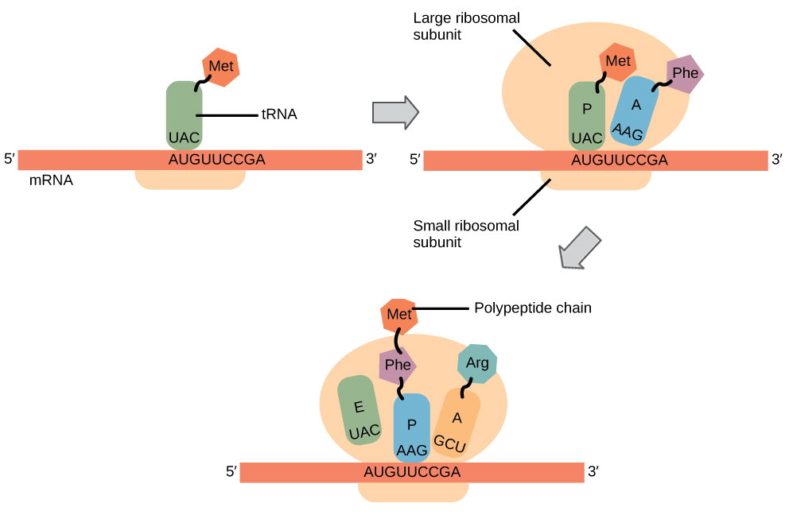
Elongation
Complementary codons on mRNA and anticodons on tRNA combine via base pairing.
Each tRNA carries a specific amino acid that is determined by the codon it pairs with
Once a codon is read, the mRNA moves along the ribosome, allowing the next codon to be read, and another tRNA molecule delivers an amino acid
Peptide bonds form between adjacent amino acids and the tRNA releases it and goes to the cytoplasm to collect another specific amino acid
This process continues as the polypeptide chain grows

Slide 10
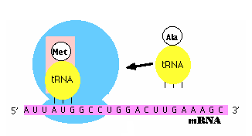
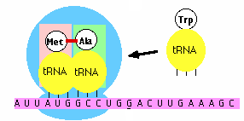
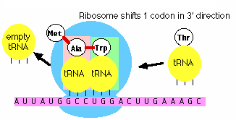

Slide 11
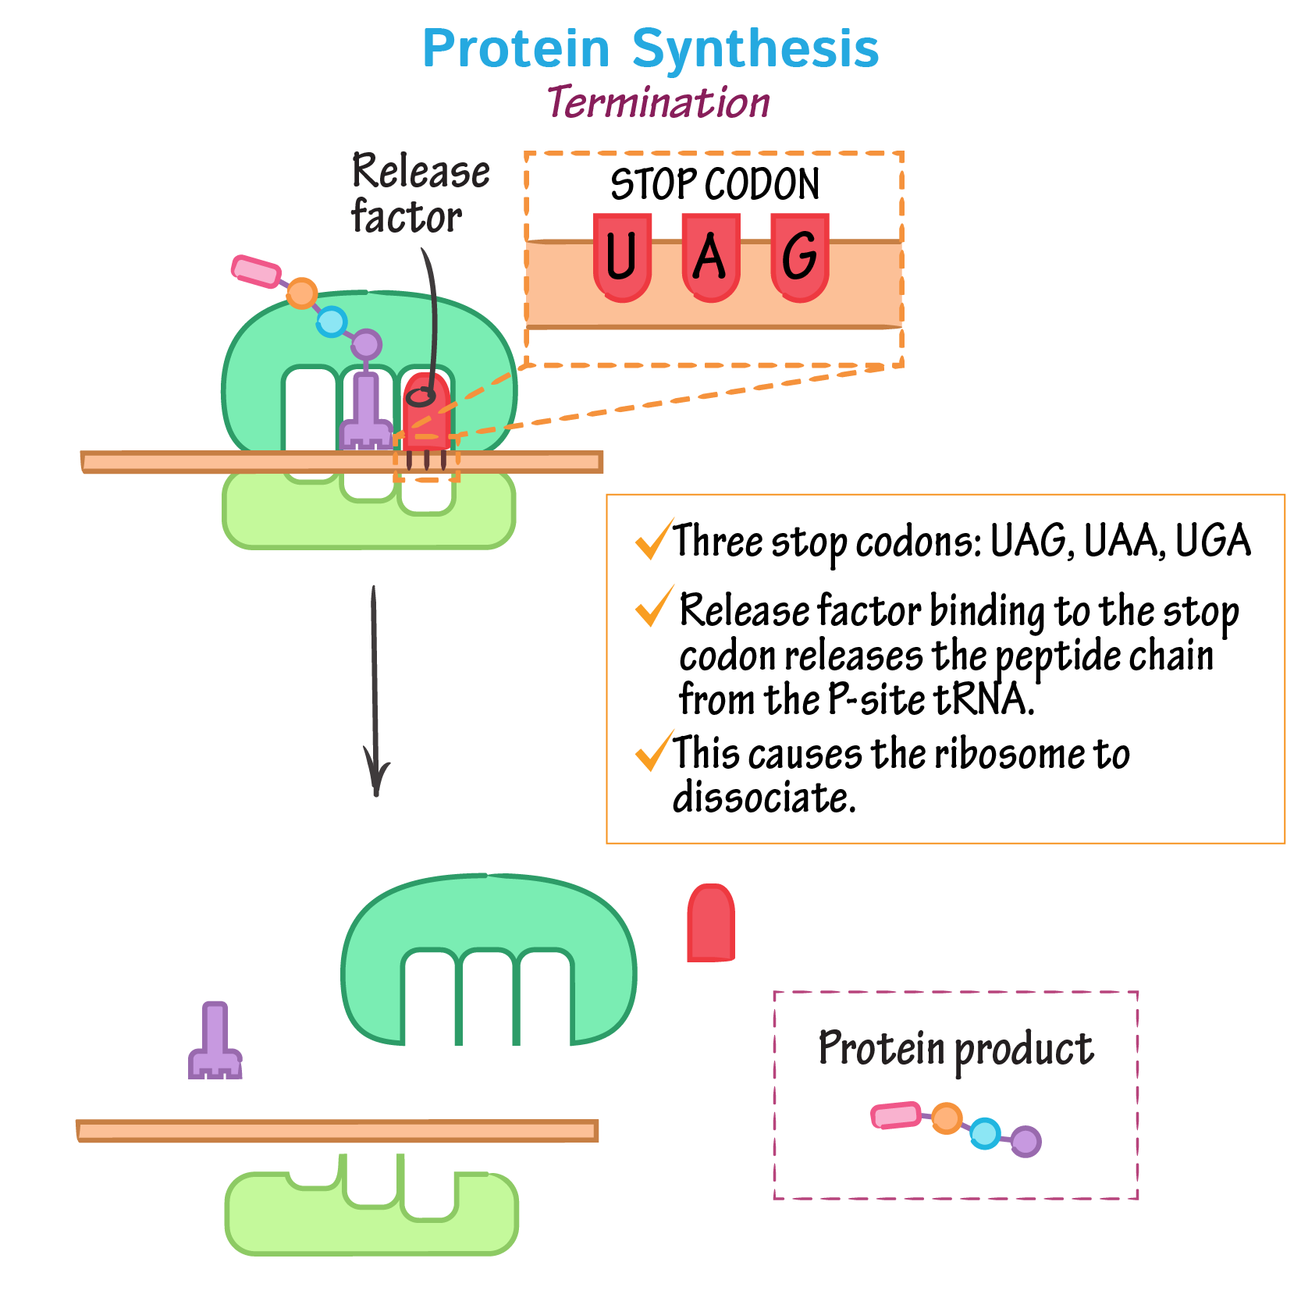
Termination
Elongation continues until a stop codon enters the ribosome (UAG, UAA and UGA)
Stop codons do not code for an amino acid, they are simply a signal to end translation
The completed polypeptide chain is released from the ribosome, and the mRNA detaches.
The polypeptide will enter the Golgi body to be folded into a specific shape to become a functional protein

Slide 12
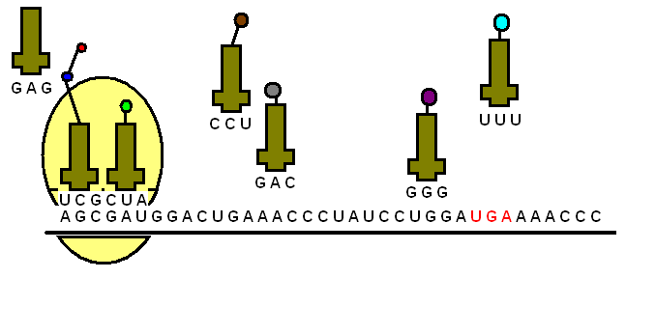

Slide 13
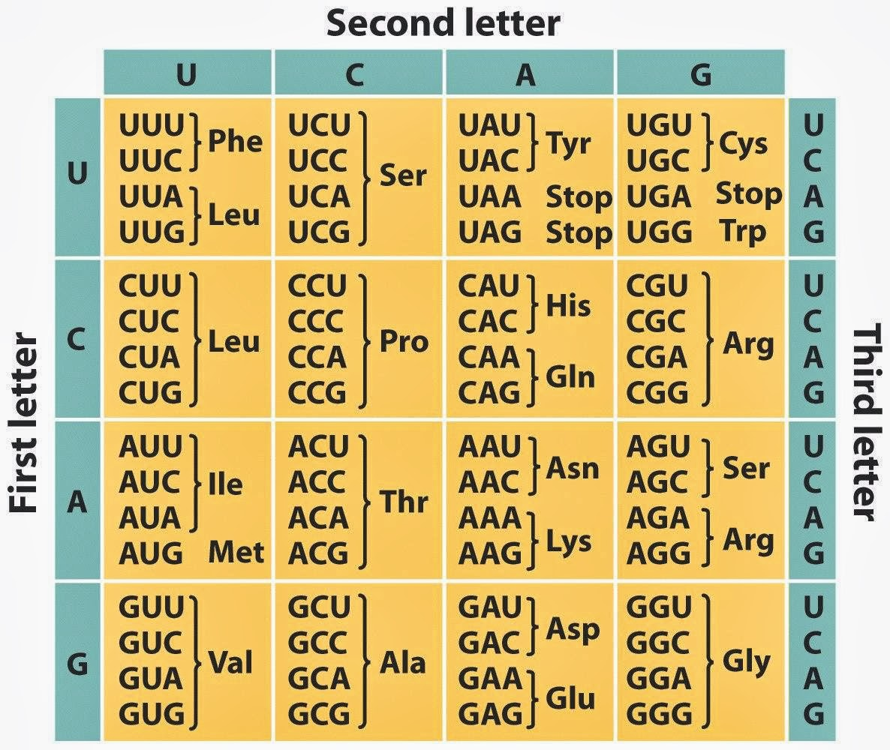
The genetic code
Degenerate code
4 different bases (A, T, C and G)
Triplet codes make 64 different combinations (4³) of amino acid (there are only 20 so this is plenty)
A degenerate code (several codes with the same meaning) except methionine
Some codes do not code for an amino acid, but for a “stop” or end of the polypeptide chain sequence.
Some code is universal e.g. serine is the same in all organisms (TCT) – this is useful in genetic engineering as gene transfer will still result in production of the same protein

Slide 14
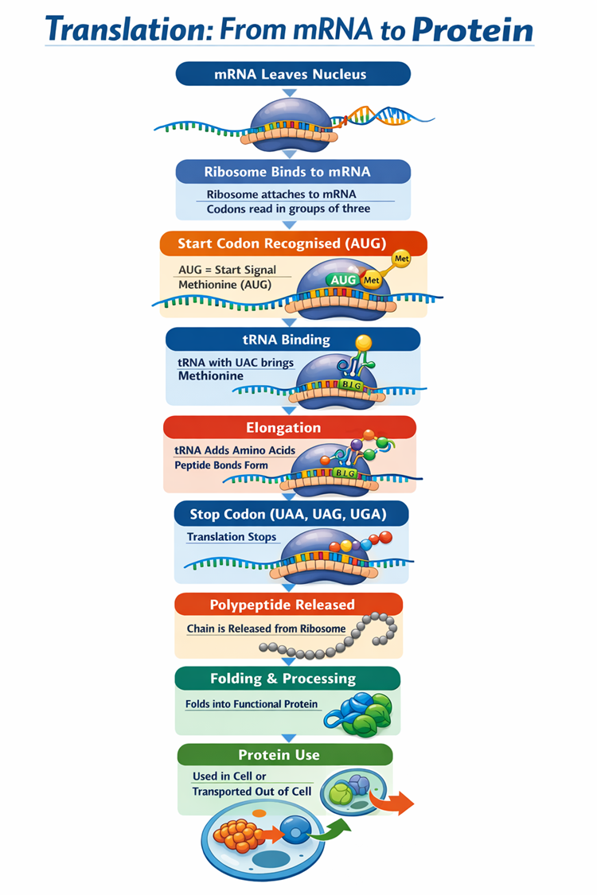
Translation
mRNA strand leaves the nucleus via a nuclear pore and move into the cytoplasm, where it attaches to a ribosome
Ribosomes starts to read the mRNA code
Transfer RNA (tRNA) molecules carry amino acids to the ribosome.
The first amino acid in any polypeptide is usually methionine. The codon for this is AUG, which has come to be known as the start codon as a result.
The tRNA anticodon is therefore UAC. Codons and anti-codons attach by complementary base pairing
The second tRNA molecule attaches itself to the next codon on the mRNA in the same way.
The two amino acids attached to the tRNA molecules are joined by a peptide bond. This process uses ATP. The first tRNA moves away, leaving the amino acid behind.
A third tRNA molecule binds to the next codon on the mRNA. Its amino acid binds to the first two and the second tRNA molecule moves away.
This process continues, producing a chain of linked amino acids (a polypeptide chain) until there is a stop codon on the mRNA molecule.
The polypeptide chain moves away from the ribosome and translation is complete.

Slide 16
U
U U A G C A U C G U A C G U A
G
C
G
A
Notes:
Shows the exit of the mRNA from the nucleus

Slide 17
U
U U A G C A U C G U A C G U A
G
C
G
A

Slide 18
U
U U A G C A U C G U A C G U A
G
C
G
A

Slide 19
the mRNA leaves the nucleus via a pore in the nuclear membrane
U
U U A G C A U C G U A C G U A
G
C
G
A

Slide 20
U
U U A G C A U C G U A C G U A
G
C
G
A

Slide 21
U
U U A G C A U C G U A C G U A
G
C
G
A

Slide 22
U
U U A G C A U C G U A C G U A
G
C
G
A

Slide 23
U
U U A G C A U C G U A C G U A
G
C
G
A

Slide 24
U U U C G A U G C A U C G C A A C U C G C
Notes:
Shows how a ribosome binds to the mRNA

Slide 25
U U U C G A U G C A U C G C A A C U C G C

Slide 26
U U U C G A U G C A U C G C A A C U C G C

Slide 27
U U U C G A U G C A U C G C A A C U C G C

Slide 28
U U U C G A U G C A U C G C A A C U C G C
a ribosome binds to the mRNA
Notes:
Introduces the concept of the triplet code

Slide 29
codon
U U U C G A U G C A U C G C A A C U C G C
the genetic code is read in groups of 3 letters called codons

Slide 30
codon
codon
codon
codon
codon
codon
codon
U U U C G A U G C A U C G C A A C U C G C
Notes:
Shows the structure of tRNA including the anticodon

Slide 31
codon
codon
codon
codon
codon
codon
codon
U U U C G A U G C A U C G C A A C U C G C
A A A
aa₁

Slide 32
codon
codon
codon
codon
codon
codon
codon
U U U C G A U G C A U C G C A A C U C G C
A A A
tRNA molecules have specific anticodons for each of the 20 amino acids
anticodon
aa₁

Slide 33
codon
codon
codon
codon
codon
codon
codon
U U U C G A U G C A U C G C A A C U C G C
A A A
anticodon
aa₁
Notes:
Shows how the tRNA molecules read the triplet code of the mRNA

Slide 34
codon
codon
codon
codon
codon
codon
codon
U U U C G A U G C A U C G C A A C U C G C
A A A
aa₁

Slide 35
codon
codon
codon
codon
codon
codon
codon
U U U C G A U G C A U C G C A A C U C G C
A A A
aa₁

Slide 36
codon
codon
codon
codon
codon
codon
codon
U U U C G A U G C A U C G C A A C U C G C
A A A
the complementary anticodon is attracted to the first codon on the mRNA
aa₁

Slide 37
codon
codon
codon
codon
codon
codon
codon
U U U C G A U G C A U C G C A A C U C G C
A A A
G C U
aa₁
aa₂
Notes:
And how the polypeptide chain builds up

Slide 38
codon
codon
codon
codon
codon
codon
codon
U U U C G A U G C A U C G C A A C U C G C
A A A
G C U
aa₁
aa₂

Slide 39
codon
codon
codon
codon
codon
codon
codon
U U U C G A U G C A U C G C A A C U C G C
A A A
G C U
aa₁
aa₂

Slide 40
codon
codon
codon
codon
codon
codon
codon
U U U C G A U G C A U C G C A A C U C G C
A A A
G C U
aa₁
aa₂

Slide 41
U U U C G A U G C A U C G C A A C U C G C
A A A
G C U
the second codon also attracts its complementary anticodon
aa₁
aa₂

Slide 42
U U U C G A U G C A U C G C A A C U C G C
A A A
G C U
aa₁
aa₂

Slide 43
U U U C G A U G C A U C G C A A C U C G C
A A A
G C U
A C G
aa₁
aa₂
a peptide bond is formed
aa₂

Slide 44
U U U C G A U G C A U C G C A A C U C G C
G C U
A A A
A C G
aa₁
aa₂
aa₃

Slide 45
U U U C G A U G C A U C G C A A C U C G C
G C U
A C G
A A A
aa₁
aa₂
aa₃

Slide 46
U U U C G A U G C A U C G C A A C U C G C
G C U
A C G
aa₁
aa₂
aa₃

Slide 47
U U U C G A U G C A U C G C A A C U C G C
A C G
G C U
U A G
aa₁
aa₂
aa₃
aa₄

Slide 48
U U U C G A U G C A U C G C A A C U C G C
A C G
U A G
the ribosome moves along the mRNA forming a polypeptide
aa₁
aa₂
aa₃
aa₄

Slide 49
U U U C G A U G C A U C G C A A C U C G C
U A G
C G U
aa₁
aa₂
aa₃
aa₄
aa₅

Slide 50
U U U C G A U G C A U C G C A A C U C G C
C G U
U G A
aa₁
aa₂
aa₃
aa₄
aa₅
aa₆

Slide 51
U U U C G A U G C A U C G C A A C U C G C
U G A
aa₁
aa₂
aa₃
aa₄
aa₅
aa₆

Slide 52
U U U C G A U G C A U C G C A A C U C G C
U G A
once a stop sequence is reached the polypeptide is cast off
aa₁
aa₂
aa₃
aa₄
aa₅
aa₆

Slide 53
U U U C G A U G C A U C G C A A C U C G C
U G A
aa₁
aa₂
aa₃
aa₄
aa₅
aa₆

Slide 54
U U U C G A U G C A U C G C A A C U C G C
A A A
G C U
aa₆
aa₁
aa₂
aa₅
aa₄
aa₃
aa₂
aa₁
Notes:
Shows how several ribosomes may read a piece of mRNA at once

Slide 55
U U U C G A U G C A U C G C A A C U C G C
A A A
G C U
several ribosomes may pass along the mRNA behind the first - each producing an identical polypeptide
aa₆
aa₁
aa₂
aa₅
aa₄
aa₃
aa₂
aa₁

Slide 56
A A A
+
aa₁
Notes:
Shows how tRNA is reactivated

Slide 57
A A A
+
aa₁

Slide 58
A A A
ATP ADP
+
aa₁

Slide 59
A A A
A A A
ATP ADP
+
aa₁
aa₁

Slide 60
A A A
A A A
ATP ADP
+
aa₁
the tRNA molecules are activated after use by recombining with their specific amino acid
aa₁

Slide 61
Plenary
Translation is the second stage of protein synthesis whereby amino acids assemble to make a protein
This happens in a sequence dictated by the sequence of codons (triplet of bases of mRNA)
The genetic code for this is copied from the template strand of DNA in the nucleus.
mRNA makes a copy of the DNA code, which is translated into a sequence of amino acids, attached to molecules of tRNA
Ribosomes are the site of protein synthesis. They can be found free in the cytoplasm or attached to endoplasmic reticulum (rough ER)

Slide 62
Task
Complete textbook pages 9 – 11
Complete Chapter 9 Review Questions (page 246-247) Questions 4,6,9,14-15

Slide 63
Quiz Questions
State the name of the two stages of protein synthesis.
State where the first stage of protein synthesis take place.
When does RNA polymerase stop making mRNA?
Where does the second stage of protein synthesis take place?

Slide 64
Exam questions
A drug that inhibits cell growth is found to be able to bind to DNA, preventing RNA polymerase from binding. Explain how this drug will affect protein synthesis (2)
A polypeptide chain (protein) from a eukaryotic cell is 10 amino acids long.
  Predict how ling the mRNA for this protein would be in nucleotides (without the start and stop codons). Explain your answer.(2)
  Describe how mRNA is translated into the polypeptide chain (6)

Slide 65
Exam answers
The drug binds to DNA, preventing RNA polymerase from binding, so transcription cannot take place and no mRNA can be made (1 mark)
This means that there is no mRNA for translation and so protein synthesis is inhibited (1 mark)
2. (a) 10 x 3 = 30 nucleotides long (1 mark)
each amino acid is coded for by three nucleotides (a codon), so the mRNA length is nucleotides is the number of amino acids multiplied by three (1 mark)

Slide 66
Exam answers
2(b)
The mRNA molecule attaches itself to a ribosome and transfer RNA (tRNA) molecule carry amino acids to the ribosome
A tRNA molecule, with an anticodon that is complementary to the first codon on the mRNA (the start codon), attaches itself to the mRNA by complementary base paring.
A second tRNA molecule attaches itself to the codon on the mRNA in the same way
The two amino acids attached to the tRNA molecules are joined by a peptide bond and the first tRNA molecule moves away, leaving its amino acid behind
A third tRNA molecule binds to the next codon on the mRNA and its amino acid binds to the first two and the second tRNA molecule moves away
This process continues, producing a chain of linked amino acids (a polypeptide chain), until there is a stop codon on the mRNA molecule

Slide 67
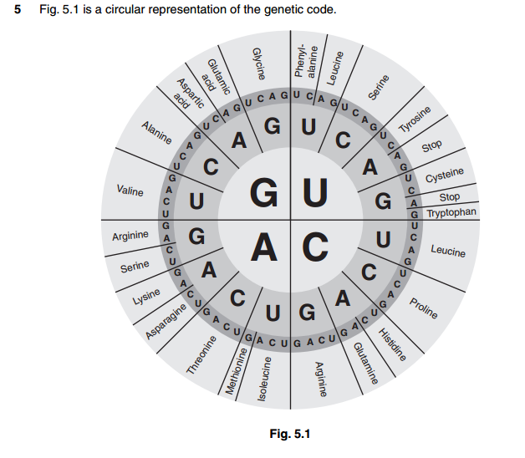
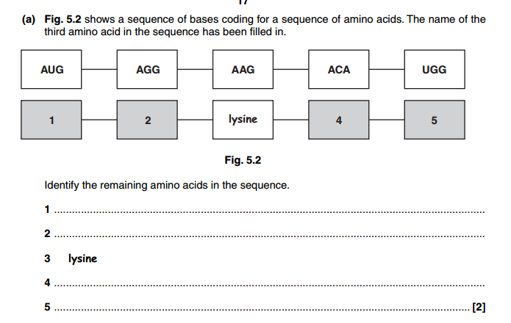

Slide 68
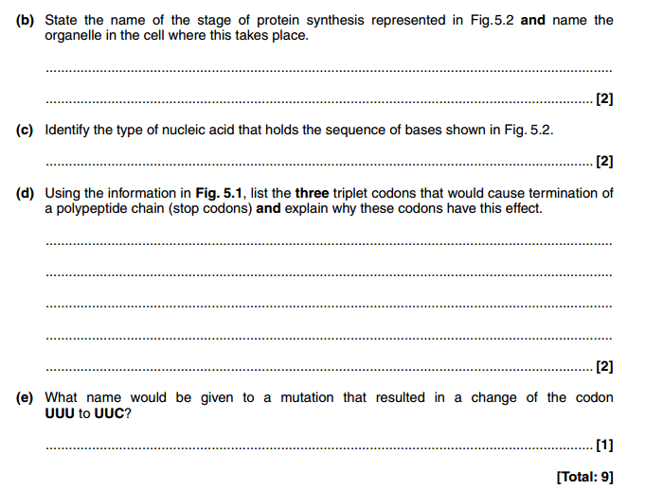

Slide 69
